Slide 1

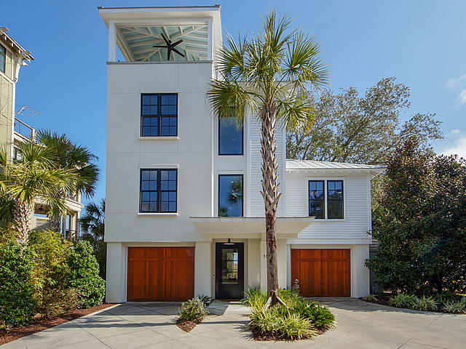
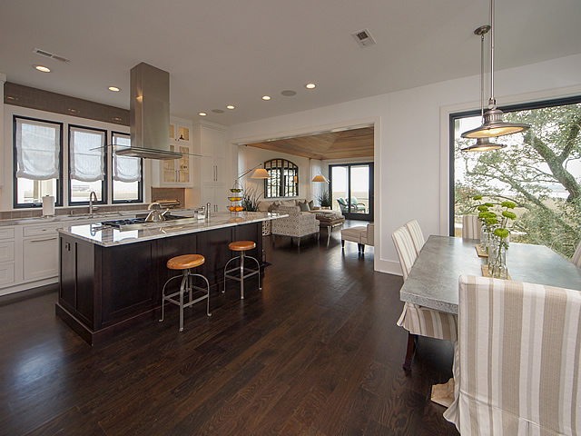
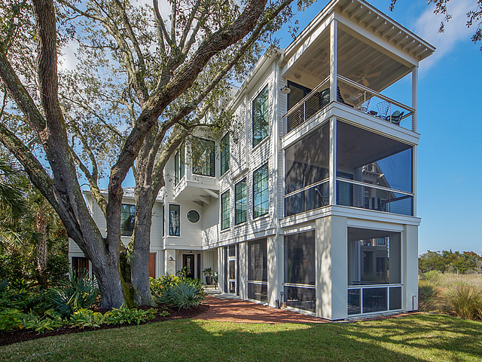
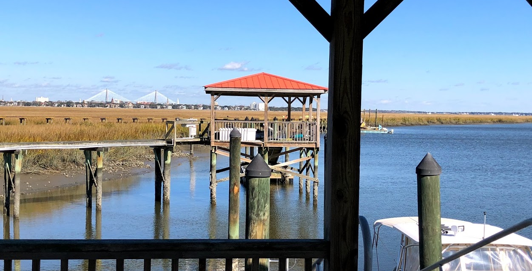
PUBLIC OPEN HOUSE
Saturday, March 30th 2-4pm
10 Old Summerhouse Road
Point Verona ~ Charleston
MLS# 19005438 ~ $1,950,000
Deep-water Boat Slip
3 Minutes To Downtown
Gated Community
Stunning Architecture...
You MUST See For Yourself
Kara Delpino
(843) 860-4166
kara@hbrtwn.com
www.karadelpino.com
Harbourtowne Real Estate
672 Marina Drive, Ste 110
Daniel Island, SC 29492

