Slide 1

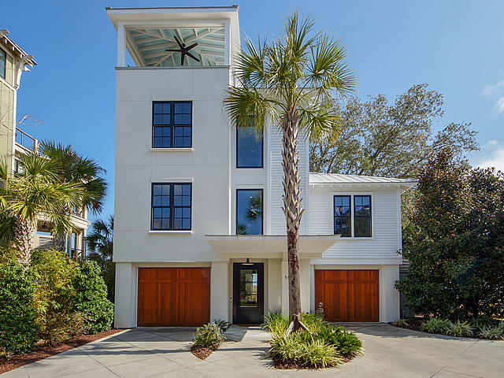
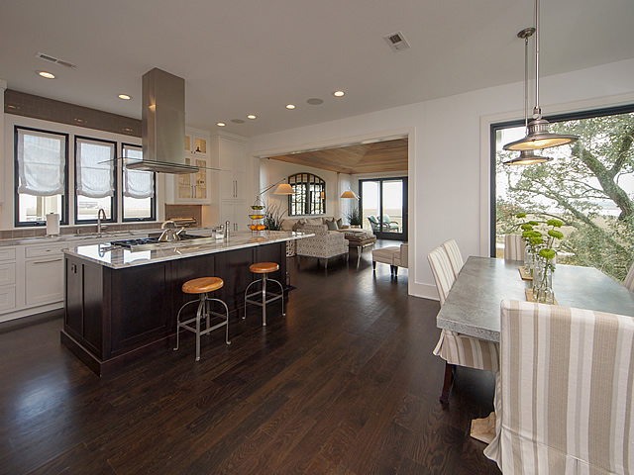
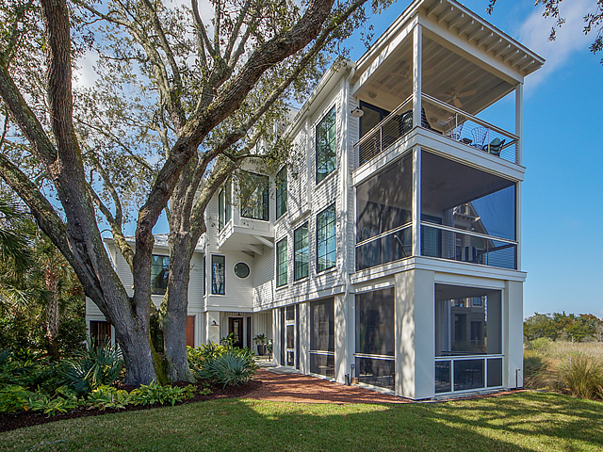
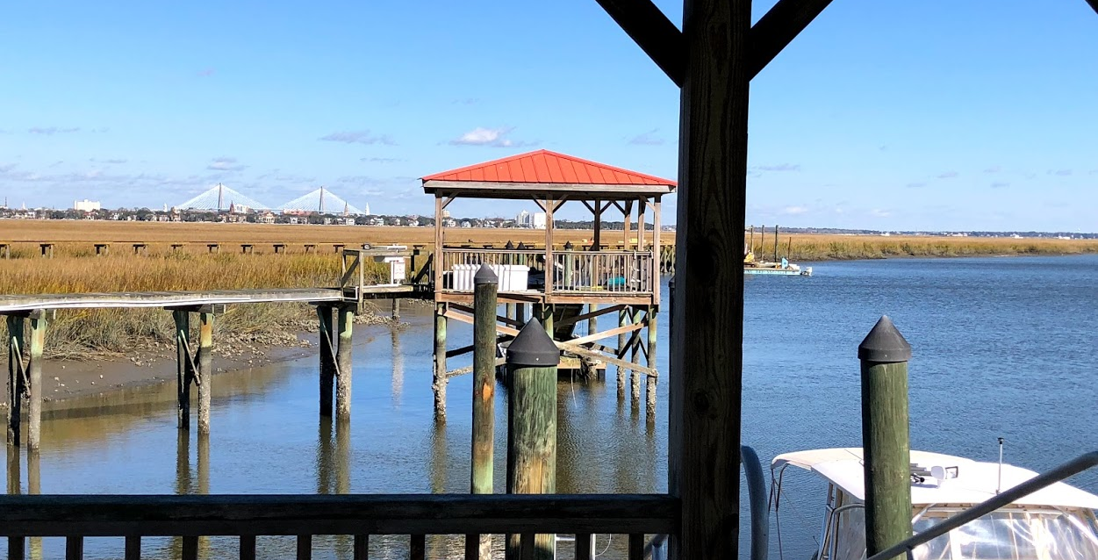
10 Old Summerhouse Road
Point Verona ~ Charleston ~ MLS# 19005438 ~ $1,950,000
EXCLUSIVE BROKER OPEN
Wednesday, March 13th 4:30-7:30
Deep-water Boat Slip
3 Minutes To Downtown
Gated Community
Stunning Architecture...
You MUST See For Yourself
Kara Delpino
(843) 860-4166
kara@hbrtwn.com
www.karadelpino.com
Harbourtowne Real Estate
672 Marina Drive, Ste 110
Daniel Island, SC 29492

