Slide 1
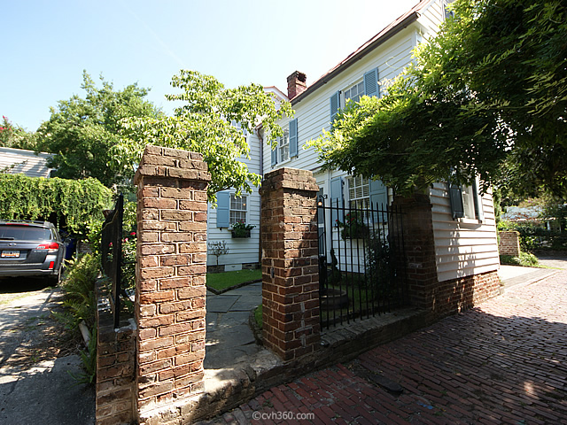
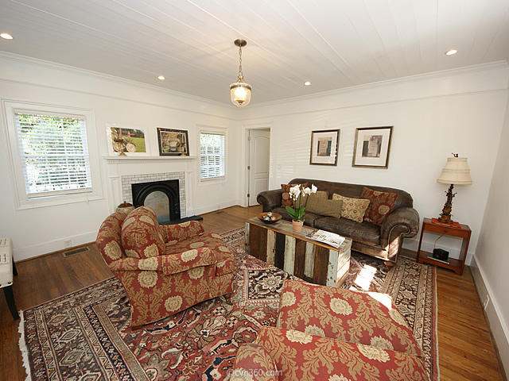
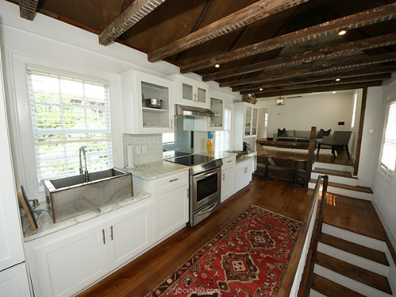
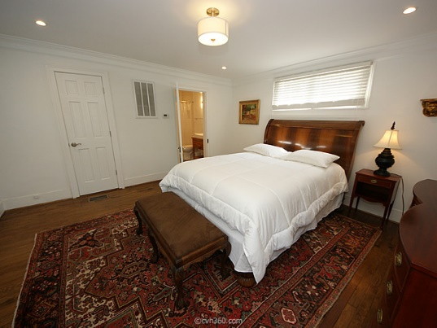
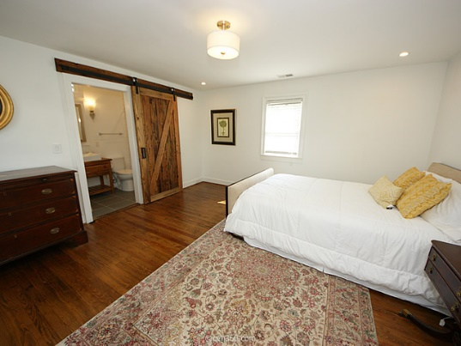

South of Broad Open House
Wednesday, December 2nd from 11am to 1pm
10 Stolls Alley – Charleston, SC
MLS# 15021089 - $1,195,000
Charming restored South of Broad home in a superb location.
Dual master bedrooms and baths, new kitchen, Rennai system and completely upgraded and ready to move in!
Within walking distance to shopping, restaurants, art galleries and much more.
Angela Black Drake Broker Associate
angela@limehouseproperties.com
O: (843) 577-6242 | C: (843) 991-0337 | F: (843) 577-0504
Limehouse Properties • 8 Cumberland Street • Charleston, SC 29401

