Slide 1
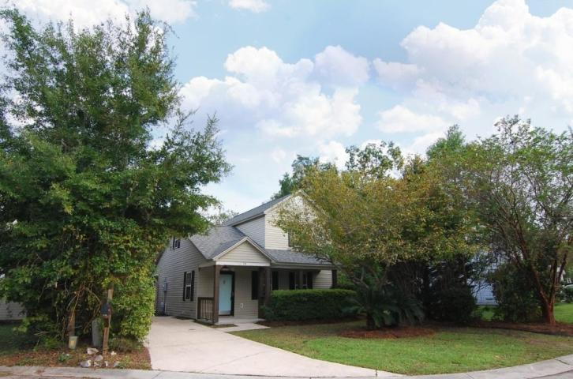
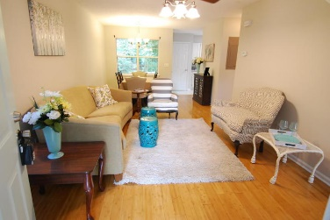
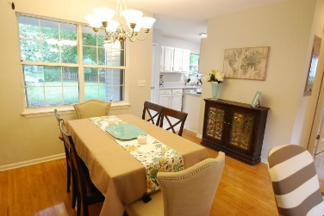
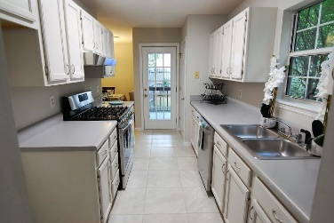
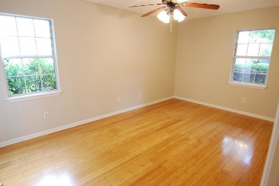
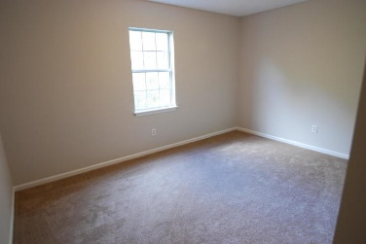
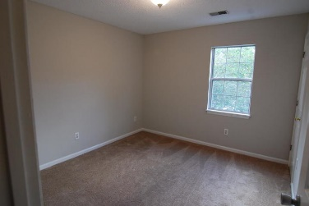
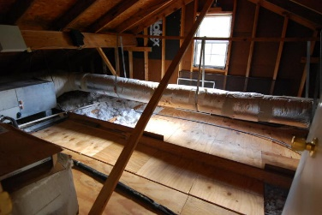
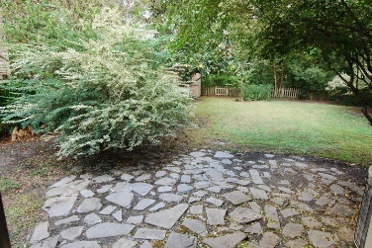


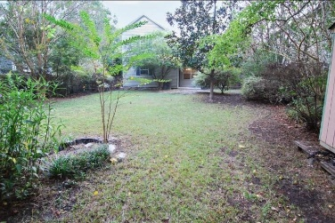

10 Timberleaf Court Woodlands ~ Charleston, SC 29407 MLS# 18027548 ~ $235,000
Open House
Sat 11am-1pm
Just Listed!
Ask your agent about 100% loan! Located on a quiet cul-de-sac on the fourth largest home site in the entire community, this 3 bedroom home in the heart of West Ashley has just been updated with a brand new roof, fresh paint throughout, new tile flooring in the kitchen and master bathroom, updated cabinets and hardware, new stainless steel dishwasher, upgraded stainless steel Samsung gas range, newer water heater and more! The home has extensive hardwood flooring in the family room, dining room and master bedroom. Upstairs, you'll find two large secondary bedrooms and walk-in access to the attic. This community is comprised of only 60 homes, and there is no HOA! It's also just 4 miles to Downtown Charleston, 2 miles to I-526, 4.5 miles to I-26 and close to major shopping as well as all of the best restaurants West Ashley has to offer!
Beth Moore
M (843) 532-4892
bmoore@carolinaone.com
Meg Kandik
M (843) 814-5137 | O (843) 603-4659
Meg@HolyCityRE.com | www.holycityre.com
Bennett Construction & Realty | 804 Tennent Dr | Charleston, SC 29412

