Slide 1
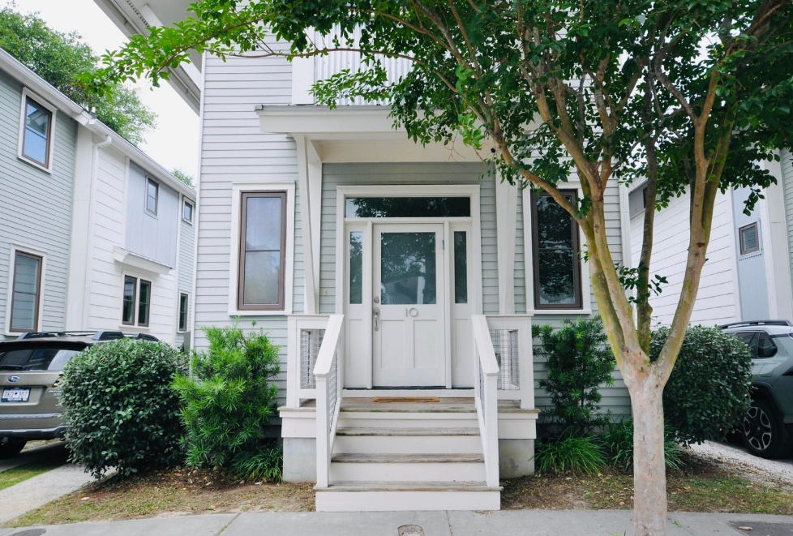
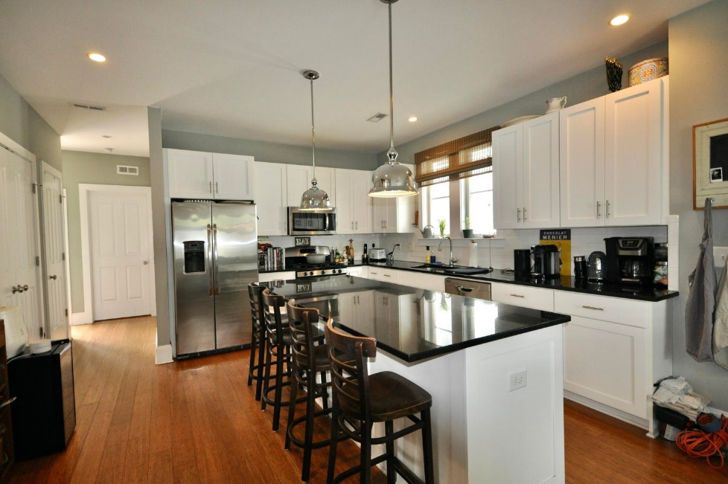








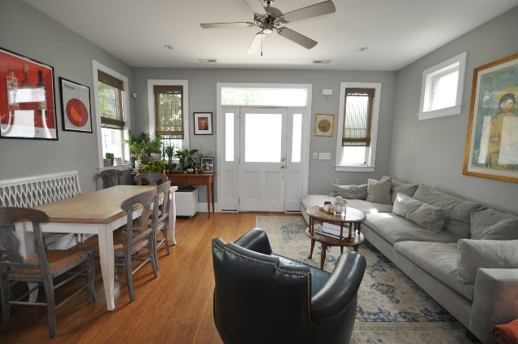
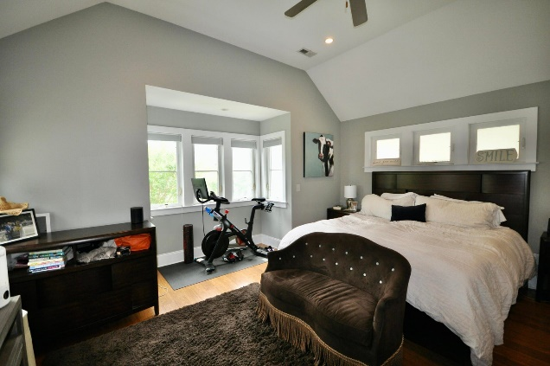
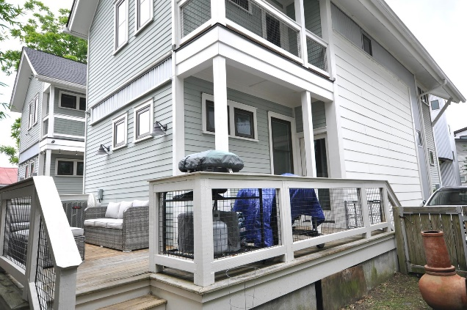
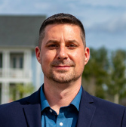
#23011943
10 Fields Place North Central
Charleston, SC 29403
Great Location!
Open House
Sat 10-12 & Sun 10-12
3 BED
3 BATH
1,628 SF
$869,000
This contemporary 3 bedroom and 3 full bathroom Charleston single style home is located in the very desirable North Central neighborhood just off Upper King St. The property is close to the area's vibrant restaurant and bar scene and near major thoroughfares and highways for easy commutes to downtown, Mt Pleasant and West Ashley. The open floor plan on the main level features a large and comfortable living/dining area and an upgraded kitchen with a large center island and an ample pantry. This level also has a bedroom/den/office with dual closets and a shared full bathroom. A large partially covered deck off the back of the house is perfect for relaxing and entertaining.
On the 2nd floor you'll find 2 additional bedrooms and a laundry closet. The larger, front ''Master'' has a large walk-in closet, en suite bath with dual vanity, shower, and separate water closet. The second bedroom also features an en suite bathroom with tub and a private piazza. 9 foot ceilings and easy to care for wood floors throughout the house. Extra utility closets on both levels add to your storage options. 2 off-street parking spaces provided by the side driveway.
Steve Auerbach
917-750-6965 | steve.auerbach@carolinaone.com
Carolina One Real Estate | 1503 Palm Blvd | Isle of Palms, SC 29451-2280
Matt Kimes
843-860-1669 | mattkimeshomes@gmail.com
www.mattkimeshomes.com

