Slide 1
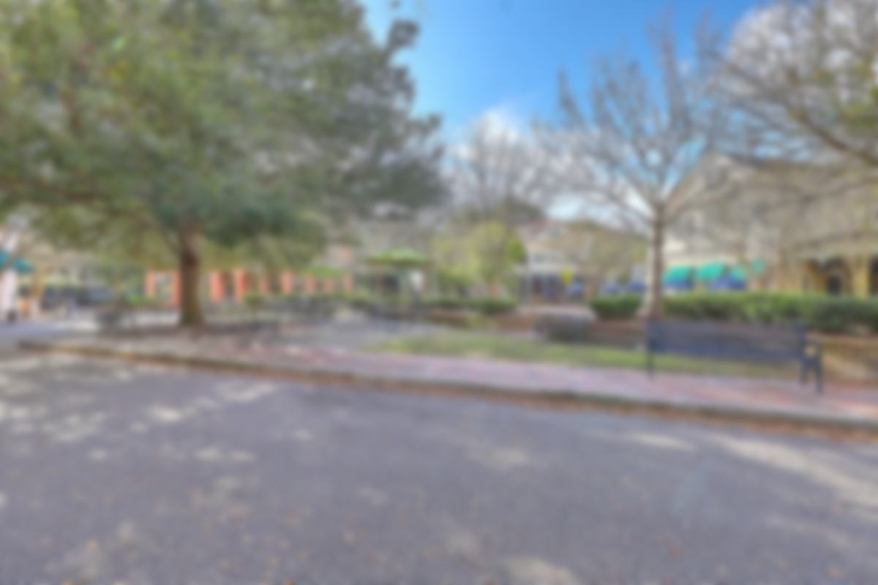
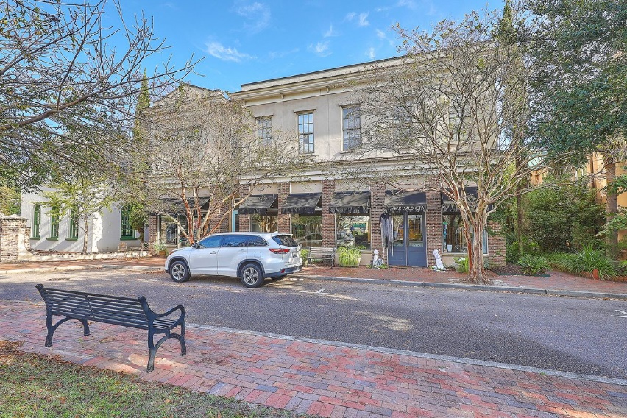
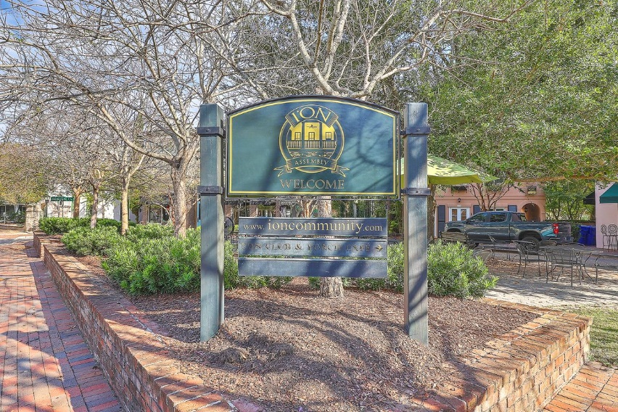
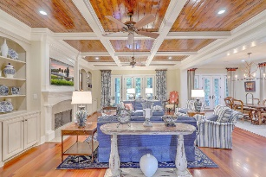
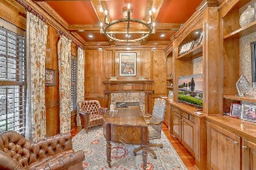
Two Individual Offices Now Available In I’On 10 Resolute Ln Mount Pleasant, SC 29464 | MLS# 30805488 | $38/sf
10 Resolute Lane offers second floor office suites that are located in the heart of the I'on commercial square.
Suites are offered as individual offices, as well as combinations of multi-room office configurations.
The monthly rent includes shared use of a kitchenette, conference room, and restrooms. electricity, and water.
Kenneth Nix
kenneth@landsouthofcharleston.com
M (843) 222-2582 | O (843) 577-5263
Land South of Charleston, LLC | 180 E Bay St Ste 300 | Charleston, SC 29401

