Slide 1
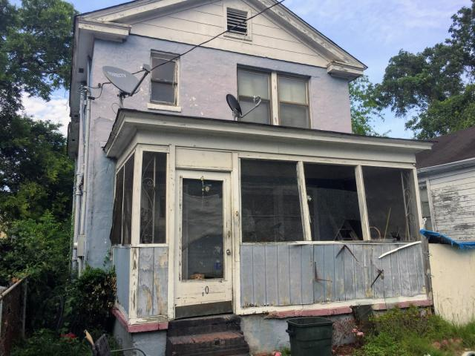
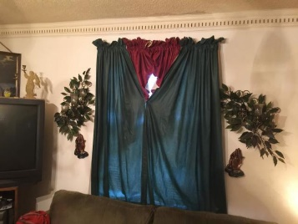
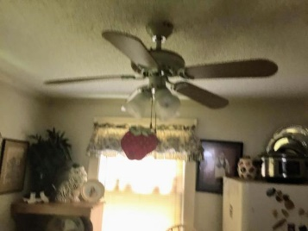
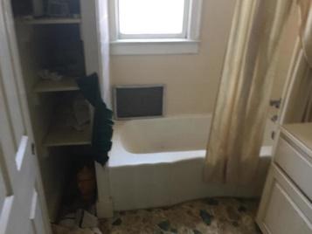

Downtown Investment Property
Buyer to receive 5 Day/4 Night cruise for 2.
~ ALSO ~
$1,000 Bonus to the Agent
Ratify by July 31, 2015, and close by August 30,2015
$500 Bonus
$1,000 Bonus
4% Commission
10 Rosemont Street
Charleston, SC 29403 ~ MLS# 19020279 ~ $400,000
Attention! Investors and Buyers a Great Investment Opportunity to own or rent this property located in historic downtown Charleston. This property features 1,520 sq.ft., 3 bedrooms, 2 full bathrooms. Excellent location! walking distance to the Hospital districts, Citadel Military College, College of Charleston,Brittlebank Park, Ashley River Harbor, and Joe Riley Stadium. Property being sold ''AS IS CONDITION'' Owners will not make any repairs. A rare opportunity to experience the pleasures of southern hospitality living in the lowcountry.
Short Sale
Edward Washington
843-737-3347
ewashington@exitlowcountry.com
Exit Realty Lowcountry Group
3618 Ashley Phosphate Rd
North Charleston, SC 29418
exitlowcountry.com

