Slide 1
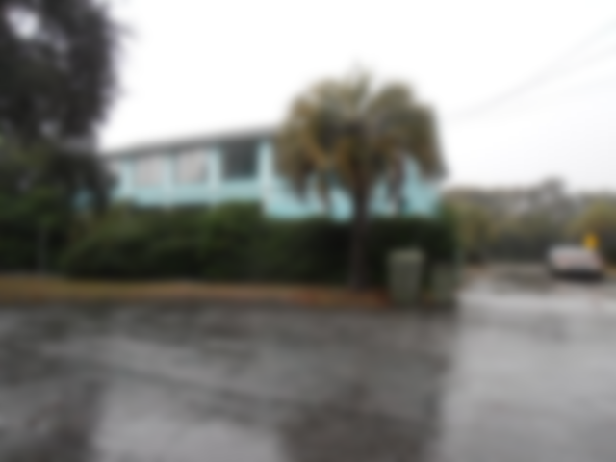
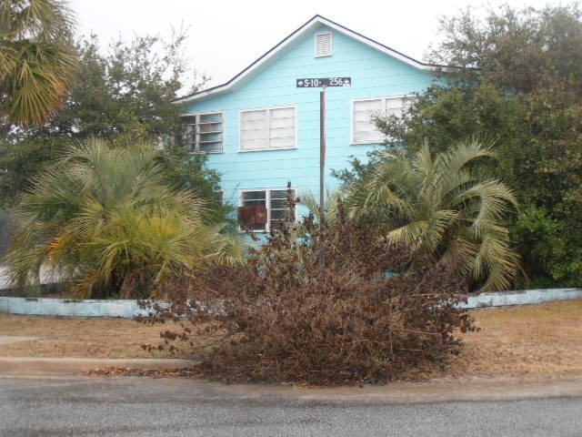
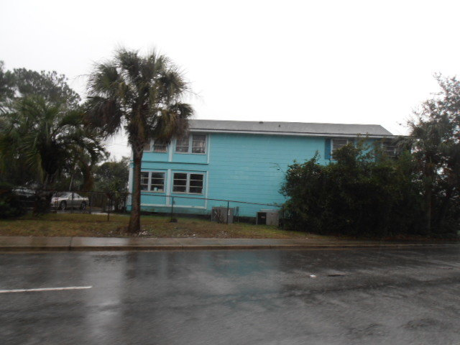
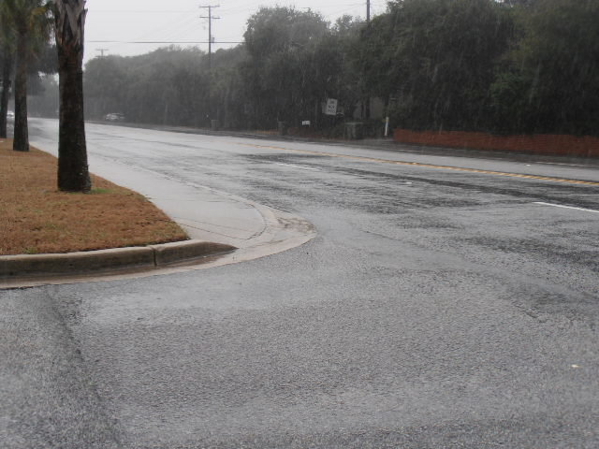
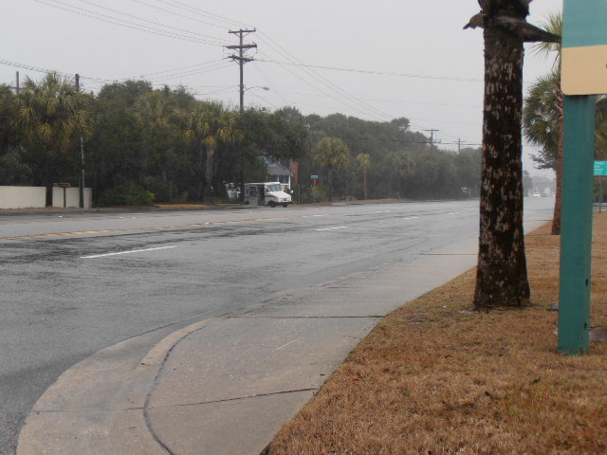
Restaurant/Office Space for Sale
1100 Palm Blvd
Isle of Palms, SC 29451
CMLS #30282949 ~ $1,650,000
130 Acres of Vacant Land
This property is zoned General Commercial (GC1) & is currently vacant. This property would be a great restaurant or office building.
Charles Salmonsen
M (843) 224-0300 | O (843) 388-6613 | charles@salmonsen.com
Salmonsen Realty | 864 Lowcountry Blvd Ste B | Mt Pleasant, SC 29464

