Slide 1
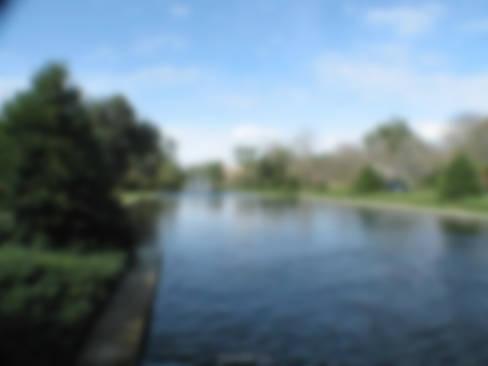
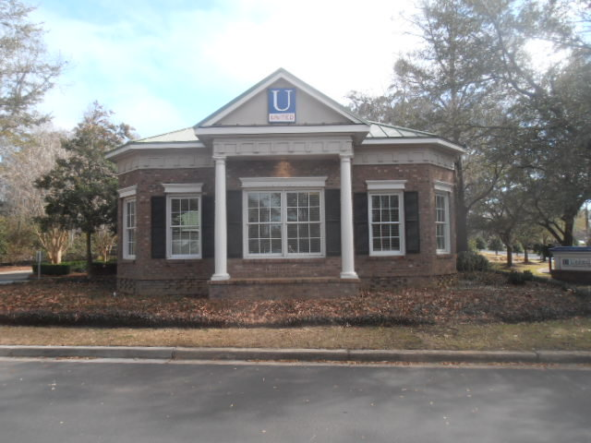
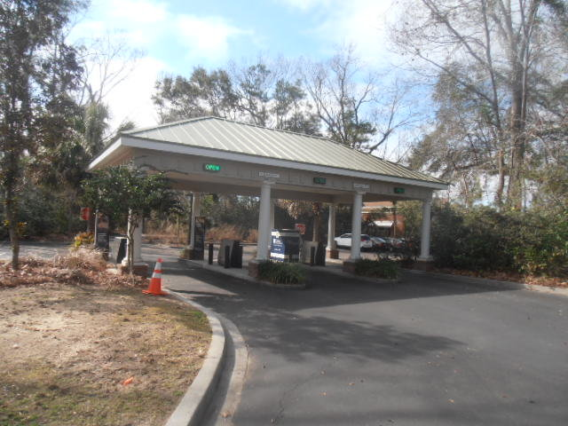
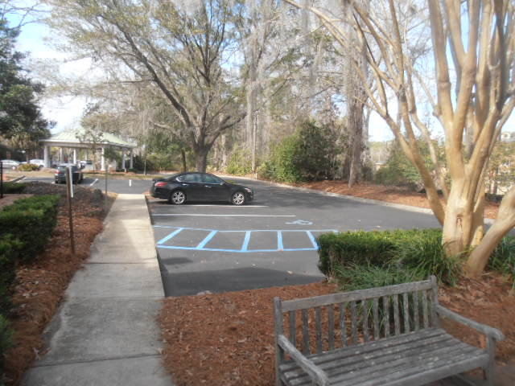
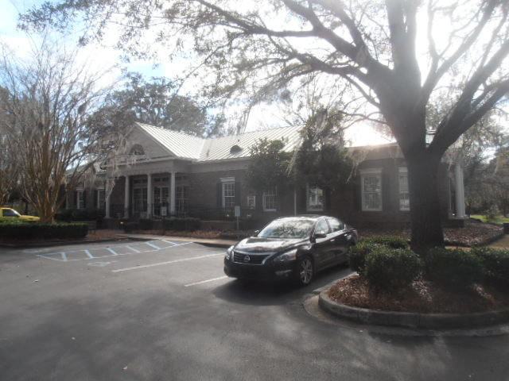
Existing Bank Building For Sale
1100 Park W Blvd
Mount Pleasant, SC 29466
CMLS# 30241810 ~ $1,550,000
130 Acres of Vacant Land
Beautiful existing 4350 sqft bank, suitable for professional offices, plentiful parking, good location,
easy access to Hwy 17 & Park West Blvd.
Charles Salmonsen
M (843) 224-0300 | O (843) 388-6613 | charles@salmonsen.com
Salmonsen Realty | 864 Lowcountry Blvd Ste B | Mt Pleasant, SC 29464

