Slide 1
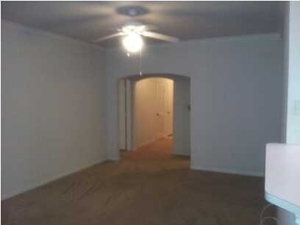
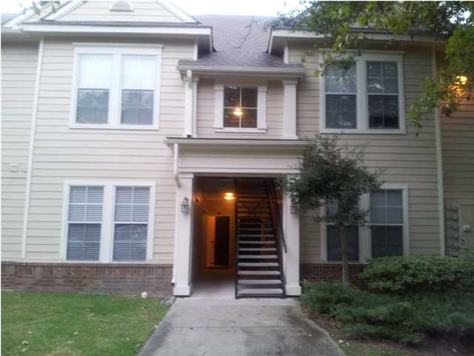
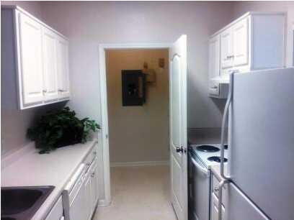
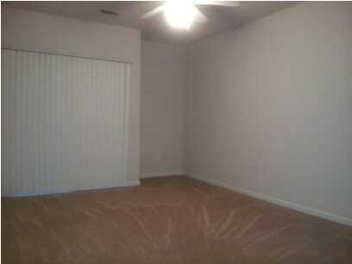
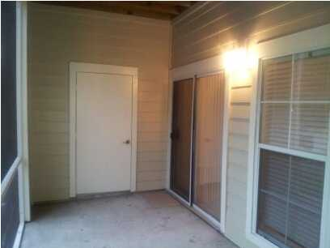

$140,000
1100 Legends Club Drive Unit 1117
The Legends at Mt Pleasant
MLS# 1222808
Great price and a motivated seller. Wonderful first floor unit with 2 generous bedrooms, 2 large baths and great closet and storage space. All appliances are included. The family room has access to the screened porch with storage closet. Secure gated community adjacent to Charleston National golf course, minutes to shopping and the beach, and just across the street from the New Roper St Francis Hospital. HOA covers exterior, grounds, termite and security. Amenities include club house, pool, car station, tennis courts, work out facilities, and play park.
geri lipps
Phone: 843.810.8398
FAX: 843.746.4942
glipps@carolinaone.com
www.gerilipps.com
Carolina One Real Estate | 195 W. Coleman Blvd | Mt. Pleasant, SC 29464

