Slide 1
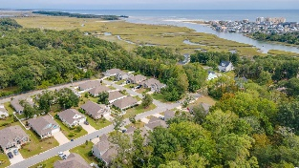
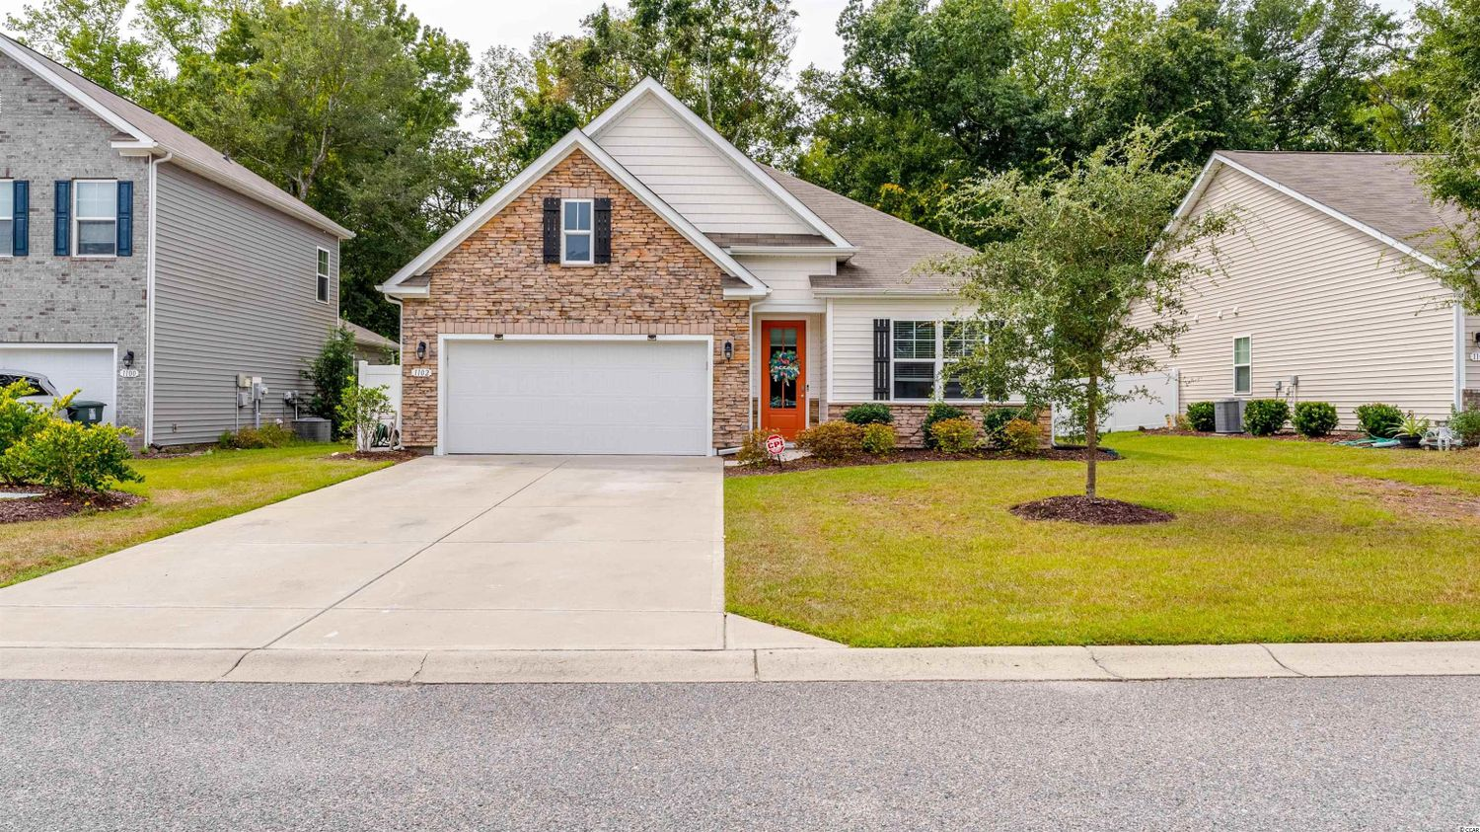
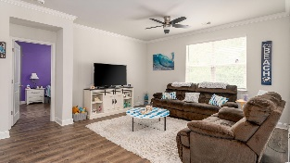
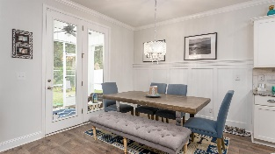
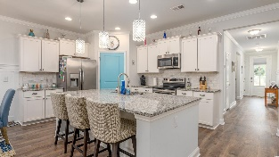
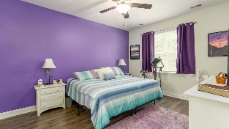
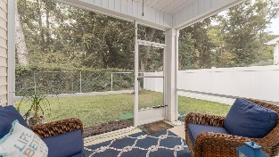
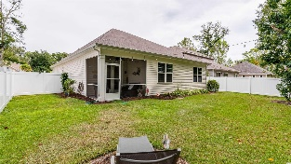
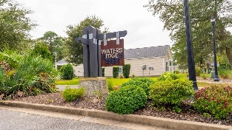
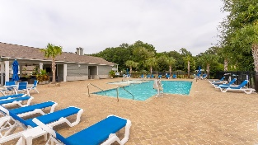
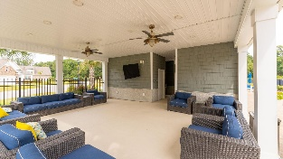



GATED, Affordable Single-family Home Community Located In The Popular Cherry Grove Section Of North Myrtle Beach
1102 Inlet View Dr
Water's Edge | North Myrtle Beach SC 29582 | MLS# 2221967 | $445,000
Water's Edge backs up to House Creek where the Atlantic Ocean feeds into Hoggs Inlet and the Cherry Grove channels. This is a wonderful, safe, comfortable development of about 80 homes with a central community center, small gym and beautiful gathering-place swimming pool. (Of the original development, only about 3 homes have resold as of this date.) It is also an area where history, natural beauty and limited development have been compatible. These happy homeowners value double-car garages, a walk-able neighborhood, handsome homes with subtle style, lots of storage and easily fenced backyards for even more contiguous indoor-outdoor livability. Water's Edge buyers wanted privacy, great value, easy living and a quiet, self-contained, gated neighborhood! Water's Edge just worked then and even better now...so do not miss this rare opportunity to own a beautiful Claiborne D plan with 4 bedrooms, one currently used as an office; two full baths; and wonderful open-concept floor plan. Kitchen features granite countertops, recessed and pendant lighting, and stainless steel appliances. Wood-look laminate flooring in foyer, dining, living, kitchen and throughout...no carpet anywhere! There are wainscoting designer features in the dining and entry hall. Rooms are spacious and afford privacy and comfort. The cheery master has lots of natural light, is over-sized with linen and giant walk-in closets, separate shower and water closet. The other bedrooms are equally spacious and have separation of design for unique privacy. The big second bath well serves the guest areas and bedrooms. And there are closets, closets, closets, a laundry room and a garage with, yes, even more storage. There are tile floors in baths and laundry, 9 ft. ceilings, 5 1/4" base boards and crown molding in the main living areas. Mature, fully sodded lawn with irrigation. Lawn maintenance is included in the HOA. This beautiful yard is nicely fenced, and the home opens out from the kitchen/dining area onto a screed-in back porch, pretty landscaping and an evening wonderland of soft lights and great trees, including a beautiful Magnolia. Little River Neck Rd. is, a tree-lined road to oceanfront Anne Tilghman Boyce Coastal Reserve, a nature conservancy, including Waties Island, with access for managed recreational use. Little River Neck itself is on an elevated peninsula of live oaks and southern pines between the Intracoastal Waterway and the Cherry Grove Inlet to the Atlantic Ocean. The area also preserves the singular look of its own historic origins. It is minutes from the beach, shopping & dining, schools, medical services, entertainment and access to major highways. Nearby public amenities include the ability to golf cart to the beach; close proximity to world-class Tidewater Plantation Golf Course, NAMED THE BEST IN SOUTH CAROLINA, pro shop and restaurants and bar, driving range, putting greens, event facilities overlooking the 18th hole; and access to Waties Island, one of the last accessible barrier islands in the world! This section of Horry County has a full range of things to do and to enjoy which really reflects a "way of life" nearby in North Myrtle Beach, a Top 5 Beach Town in the nation; but with low, low county taxes. See this desirable beauty today and be a short, golf-cart ride to the beach when you proudly call Water's Edge home.
Video Tour: https://youtu.be/3BinOVVouOc
3D Virtual Tour: https://my.matterport.com/show/?m=7EFT1KvK8hV
Connie Ross-Karl
702-306-2643
conniesross@aol.com
Ronnie Nichols
Realtor / BIC
ronnienichols8@aol.com
NEW WAY PROPERTIES MYRTLE BEACH

