Slide 1
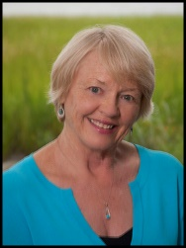
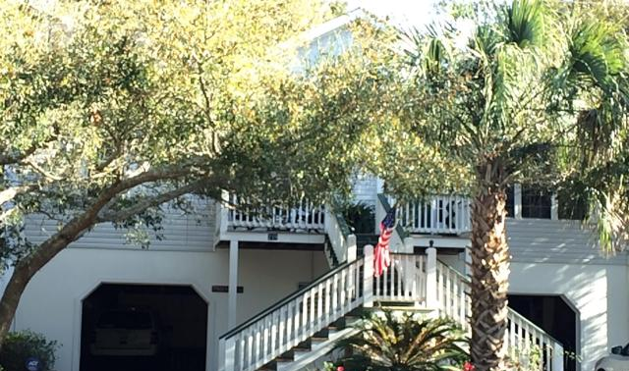
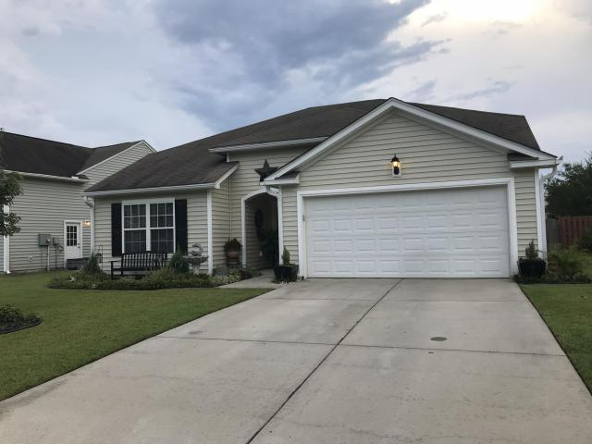
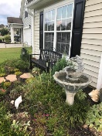
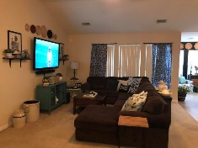
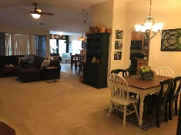
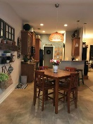
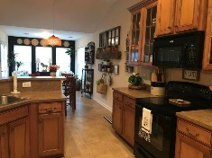
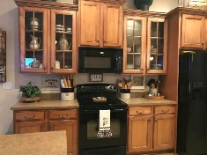
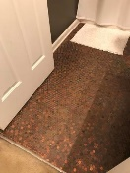
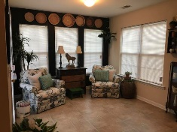
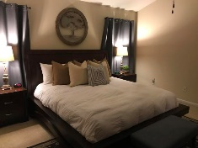
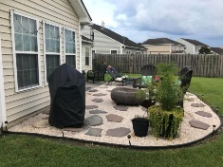
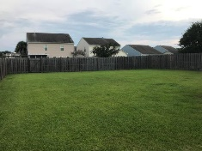
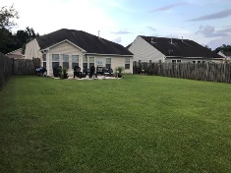

Open House Sunday 1-4
Part Of A Community-wide Open House Event
Jane Locke, Realtor
M (843) 819-3508
lockejaneb@aol.com
www.century21properties.com
1103 Cates Court | Myers Mill | Summerville | MLS# 18022758 | $228,500
DRAFT
Well kept spacious home. Open floor plan with easy access flow. Quiet neighborhood - home on cul-de-sac. Home has one of the largest back yards in neighborhood with wooden privacy fence with area designed for relaxing after a hard day's work. Kitchen has 42" cabinets with glass fronts. Master bedroom has vaulted ceiling, large shower in bath. Second bath has a copper penny floor - very lovely. Home has a home warranty that has been just renewed by the owner. Home is a show case as current owner is an interior designer. This is a must see.
Century 21 Properties Plus | 3301 Salterbeck St Suite 100 | Mt. Pleasant, SC 29466

