Slide 1
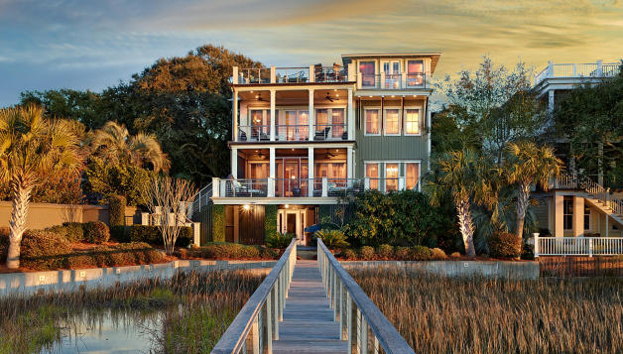
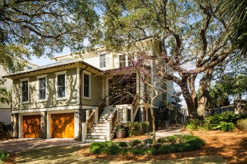
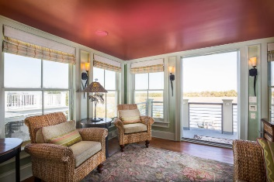
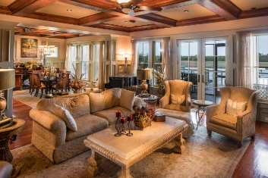
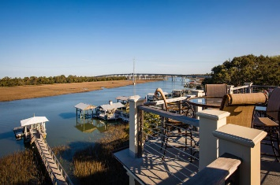
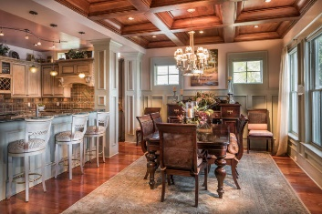
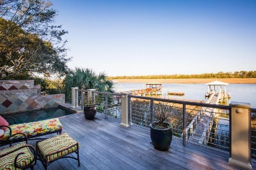
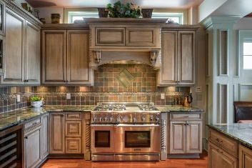
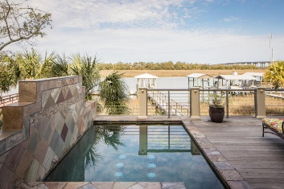
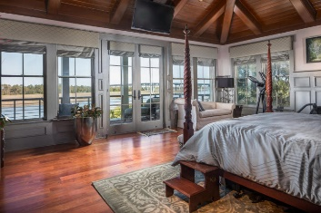
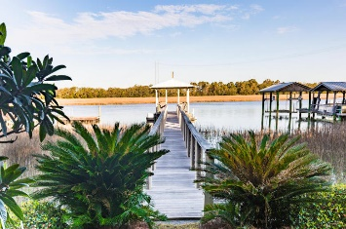
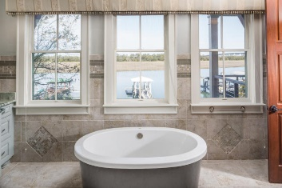
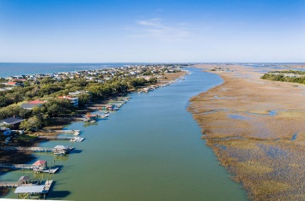

Open House Saturday, August 12th from 1-5
Price Reduced!
1103 Oak Harbor Boulevard
Isle of Palms, SC 29451 ~ MLS# 17006243 ~ $3,195,000
Deep Water on Isle of Palms! This luxurious custom home has 7 feet of water at low tide and is located just two blocks from the beaches of IOP. Enjoy perfect waterfront views from the main living areas and from the master suite. With a short dock, the waterfront views feel like they are right in your back yard. The spacious and immaculate home will take your breath away with amazing features like gleaming hardwood floors, coffered ceilings, built-in bookshelves, and custom woodwork. The chef’s kitchen features granite countertops, natural stone backsplash, custom cabinets, and top-of-the-line appliances. You'll find the perfect spot to relax is outside in the soothing hot tub, or on a hot day, you'll love cooling off in the refreshing swimming pool right on your deck.
Additional features include:
French doors from the great room lead to the screened patio and incredible views of Hamlin Creek
The gourmet kitchen includes granite countertops, natural stone backsplash, custom cabinetry, Thermador gas 6 burner, double oven range, wine cooler, breakfast bar, and a Thermador refrigerator that blends seamlessly with the cabinetry
Beautiful and spacious dining room that overlooks the pool, hot tub, and Hamlin Creek
First floor downstairs master bedroom with gorgeous wainscoting, his and her closets, and a huge bathroom with a walk-in shower and large soaking tub
Second floor master suite has a vaulted ceiling and its own private porch with phenomenal views of the water. The master bathroom features dual vanities, granite countertops, a large soaking tub, and a massive walk-in shower
Second floor also features two additional bedrooms with private bathrooms.
Third level sunroom with a wet bar, 180 degree views of Hamlin Creek, and outside access to the roomy top level sun deck
Detailed railing on the grand staircase
Surround sound inside and out
16KW generator
800 gallon underground propane tank
Well for lawn irrigation
Invisible fence for pets
All natural mosquito misting system
Beautiful oak trees and lovely landscaping
Book your showing today!
Matt O’Neill matt@mattoneillteam.com 843-532-4220

