Slide 1
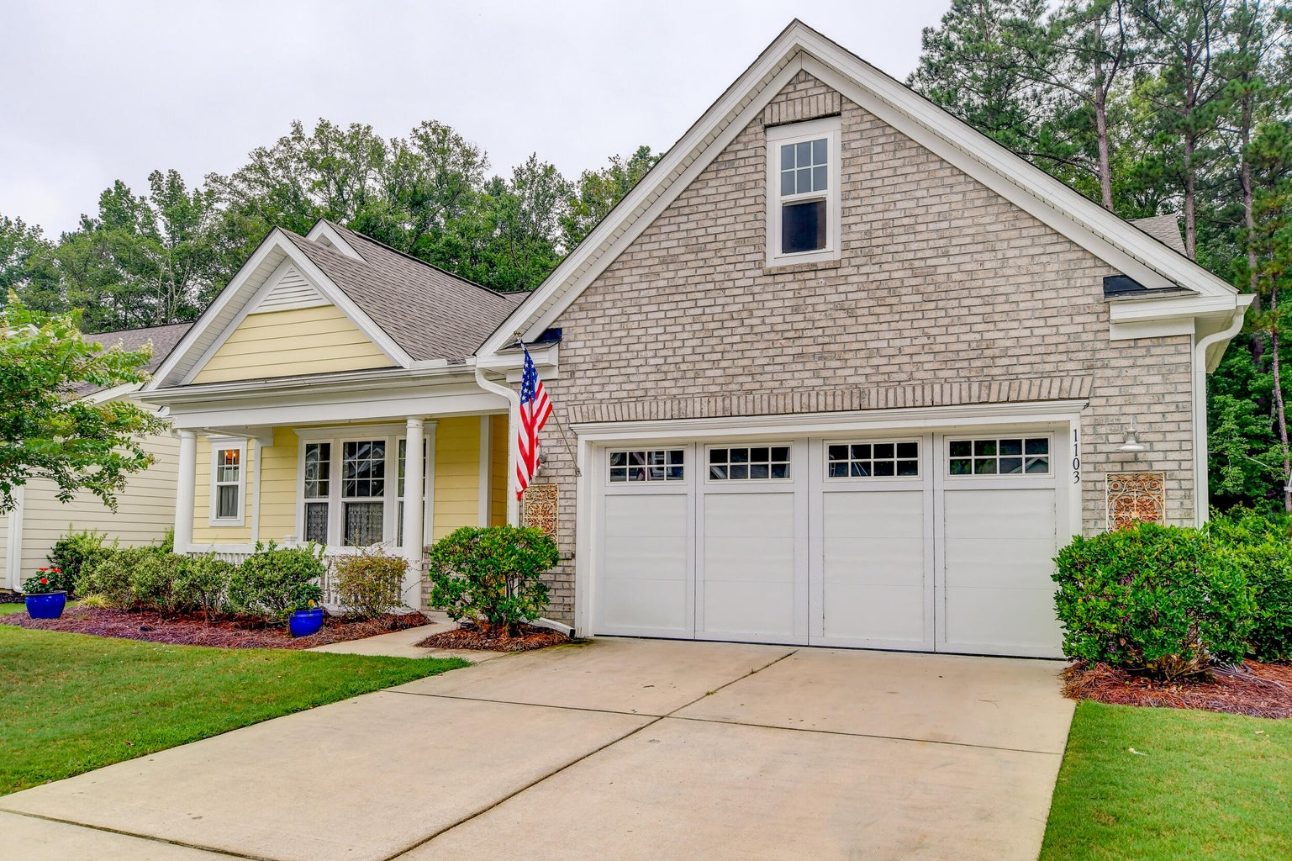

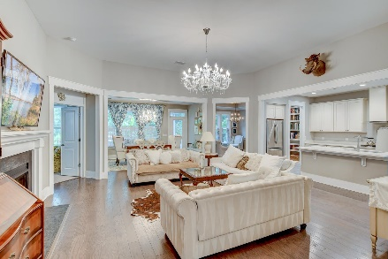
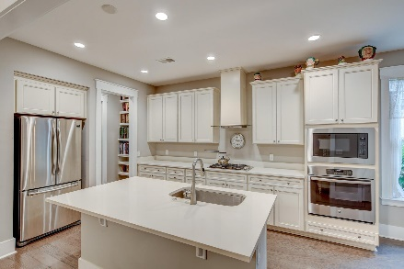
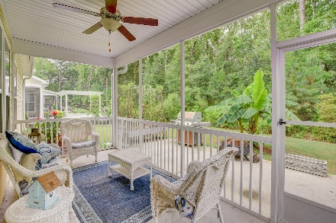
Open House Saturday 11-3
OPEN HOUSE
SATURDAY 12-3
Open House Saturday 12-3
1103 Old Field Drive
The Ponds | Summerville, SC 29483 | MLS# 23017651 | $550,000
Charming Home with Great Curb Appeal in the 55+ community of Cresswind at The Ponds! Welcome to this beautifully designed and well-maintained home that exudes charm and elegance from the moment you arrive. With its attractive front porch and immaculate landscaping, the curb appeal of this property is truly impressive. Inside the heart of the home you'll find an inviting central living area featuring a cozy fireplace, perfect for gatherings and relaxation. The adjacent formal dining room provides an elegant space for hosting dinner parties and special occasions.The kitchen is a chef's dream, complete with a convenient island, gas range, and double wall oven, and the breakfast nook is bathed in natural light.
The primary suite is a true retreat, boasting a tray ceiling and windows that fill the room with sunlight. The ensuite bathroom offers a double vanity, a spacious tiled shower, a separate makeup vanity, and a walk-in closet, providing both style and functionality. Two well-appointed bedrooms share a convenient Jack 'n' Jill bathroom, providing privacy and comfort for family members or guests. Additionally, there's a versatile flex space with a tray ceiling that can be used as a home office, study, or media room, adapting to your unique needs. Other amenities of this home include a half bath, a laundry room, and attic storage above the two-car garage.
The outdoor living spaces are equally inviting. Enjoy your morning coffee or relax in the evenings on the screened-in porch, offering bug-free comfort throughout the year. Step out onto the patio and soak in the serene atmosphere of your private yard, providing a sense of tranquility that's hard to find.
This property is located 6.9 miles from Harris Teeter, 7.4 miles to historic downtown Summerville, 12.7 miles to Givhans Ferry State Park, and 17.6 miles to Charleston International Airport.
Book your showing today!
Jeremiah Brown jbrown@mattoneillteam.com 803-730-1715

