Slide 1
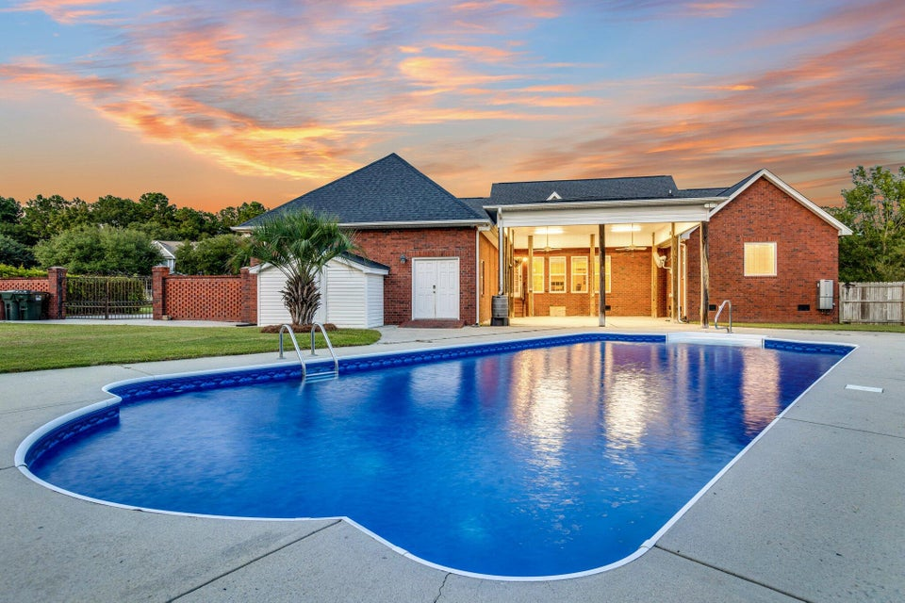



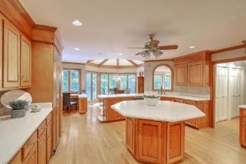
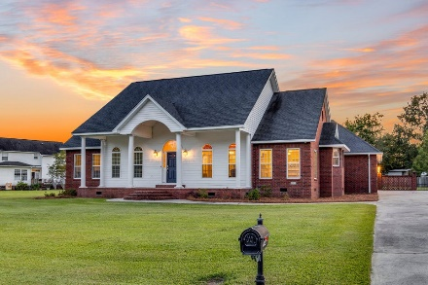



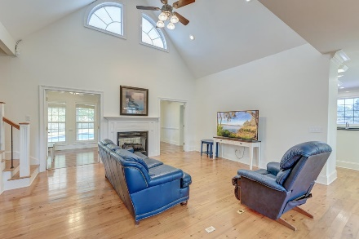

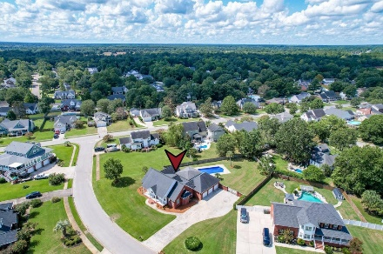
Parkshore Marshfront
Gorgeous Home with Back Yard Oasis
1103 Ole South Court
Stony Landing | Moncks Corner, SC 29461 | MLS# 24022010 | $565,000
Nestled on a spacious lot in the heart of Moncks Corner, this gorgeous home offers an exceptional blend of comfort, elegance, and outdoor leisure including a swimming pool. From the moment you arrive, the charming exterior captures your attention with its inviting front porch, large driveway, and three-car garage. The groomed yard and meticulously maintained landscaping set the tone for what awaits inside.
Step through the front door and be greeted by a world of luxury, where gleaming wood floors, soaring ceilings, and intricate moldings create a sense of grandeur. The open floor plan is awash with natural light, enhancing the home's warm and welcoming ambiance. To the right of the foyer, the formal dining room offers the perfect setting for memorable meals and gatherings.
Conveniently located just 5.3 miles from Lions Beach and 5.9 miles from the Thornley Forest II Boat Ramp on Lake Moultrie, this home offers easy access to outdoor adventures. Plus, you're just 16.3 miles from I-26, 19.2 miles from Historic Downtown Summerville, and 26.5 miles from Charleston International Airport.
Caroline Treece ctreece@mattoneillteam.com 843-754-0050

