Slide 1
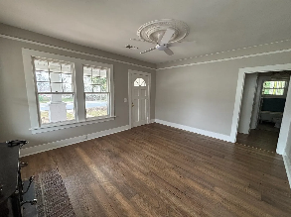
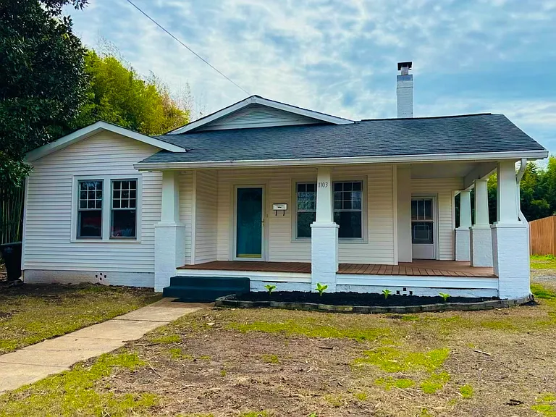
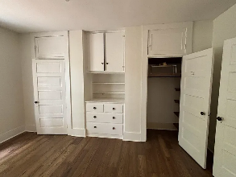
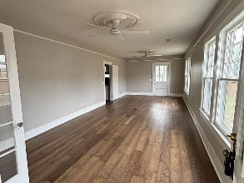
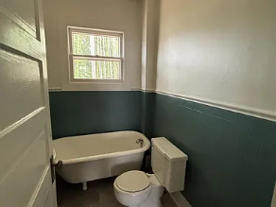
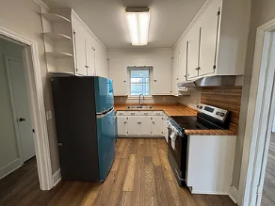
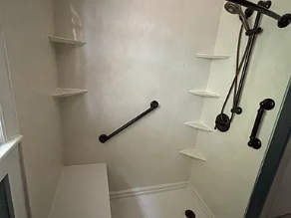
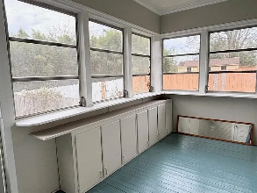
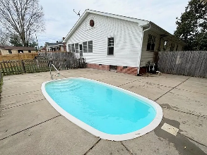
A Rare Opportunity To Make This Unique Treasure Yours
1103 W Main St
Union, SC 29379 | MLS# 334356 | $279,999
1,996 sq ft
3 Bed
2 Bath
0.36 acres
Tracey Suber, Realtor
tsuber69@gmail.com | 864-441-3834 | www.bnre.info
Brand Name Real Estate | 4 Carriage Lane, Suite 106 | Charleston, SC 29407

