Slide 1
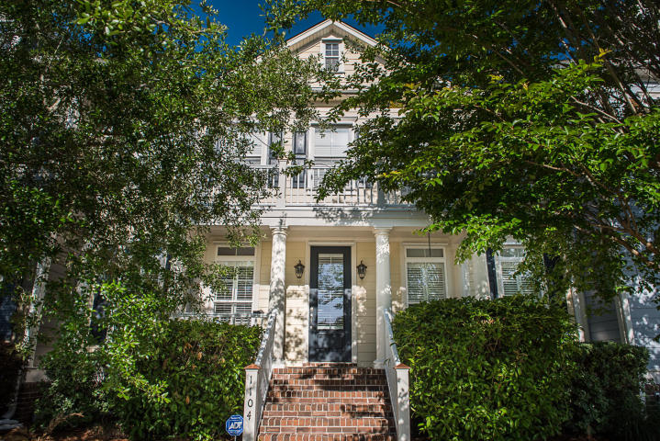
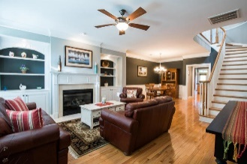
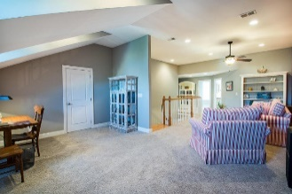
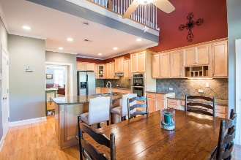
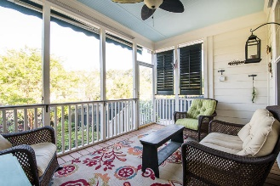
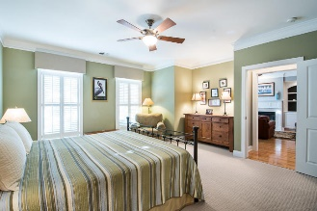
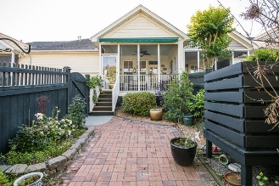
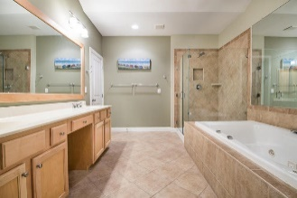
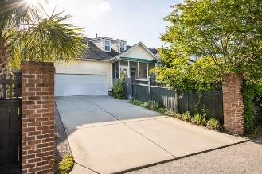


1104 Griswold Street Hamlin Plantation ~ Mount Pleasant ~ MLS# 18013236 ~ $499,000
Price Reduced
in the Old Village!
Now offered
For $499,000!
Townhome of exceptional quality, immaculate condition, master suite downstairs, located in a quiet neighborhood with lots of amenities, minutes from the beach and downtown Charleston, truly makes this a remarkable find!! Downstairs has a very large sized living and dining area with fireplace and adjoining kitchen with a family sized island and a generous breakfast area - all with hardwood floors! There is an open front porch for your rockers and a very nice screened porch (with a retractable awning) off the back which overlooks the garden and patio. Also downstairs, the master suite is roomy enough for your king bed and a sitting area! There are two walk in closets and the bath of your dreams. Upstairs has a large den, office area, 2 bedrooms with private baths, and huge walk-in storage.
Mac Jenkinson
M (843) 224-0210
mac@carolinaone.com
Beth Moore
M (843) 532-4892
bmoore@carolinaone.com
Jenkinson & Moore, LLC | Carolina One Real Estate | 1503 Palm Blvd | Isle of Palms, SC 29451-2280

