Slide 1

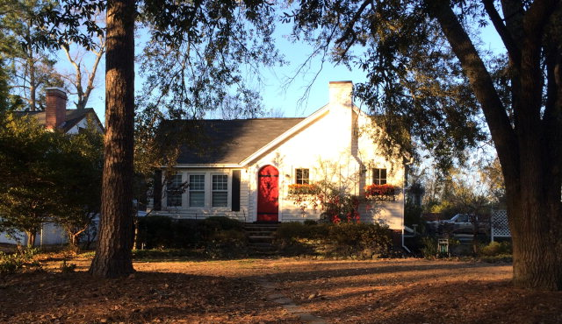

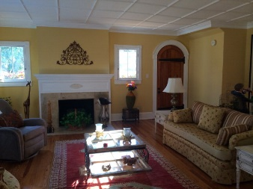
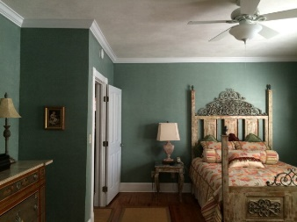
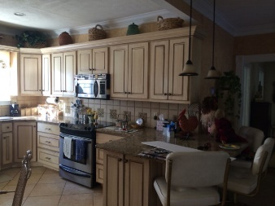
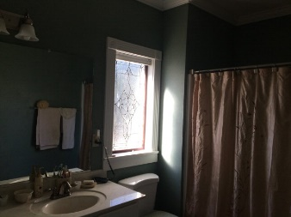
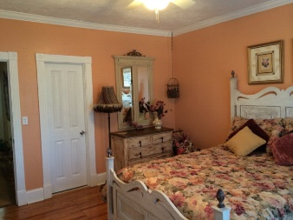
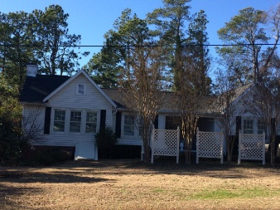


1104 Hayne Avenue
Aiken, SC 29801
MLS# 88970 / $232,000
Cottage Under the Oaks
Lovely renovated cottage close to all that Downtown Aiken has to offer. Three bedroom, two bath home with gleaming hardwood floors, beautiful kitchen, living room with fireplace adjoining formal dining room.
Charming home on corner lot, great downtown location.
Valli Catchpole
803.617.8540 / valli1@me.com
Property Consultants of the South, 1429 Lyon Dr SE, Aiken, SC 29801 / www.FineSouthernLiving.com

