Slide 1
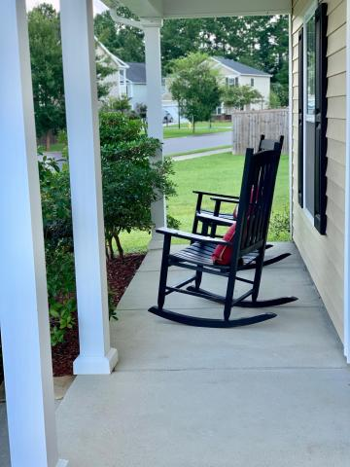
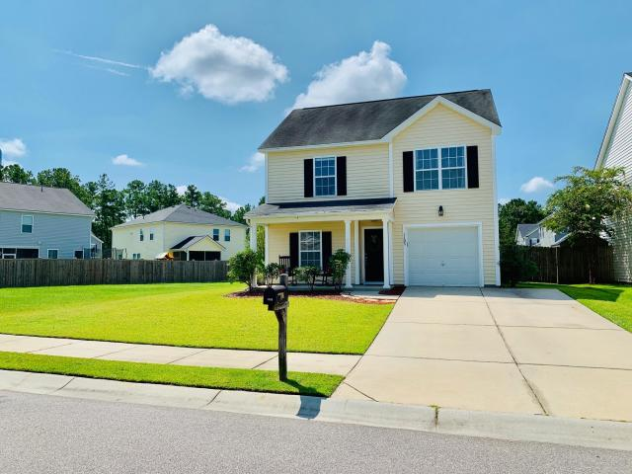
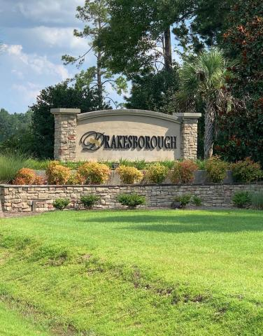
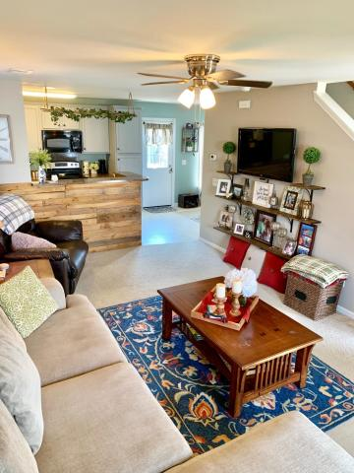
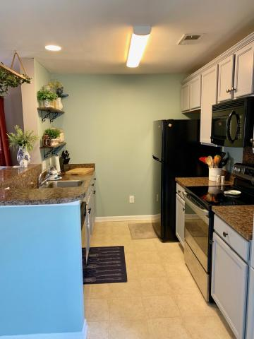
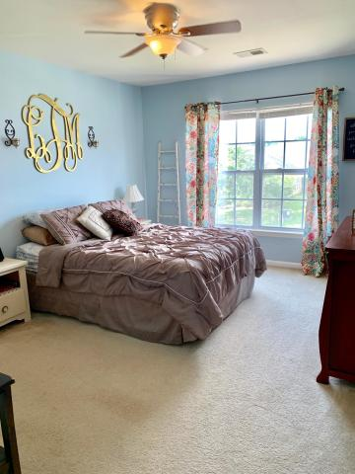
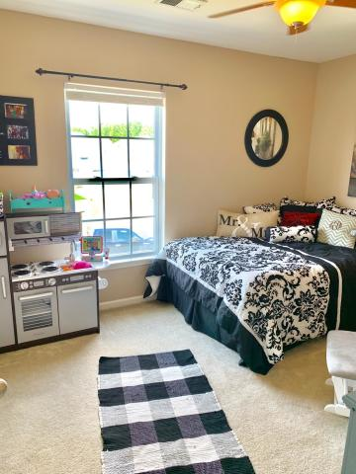
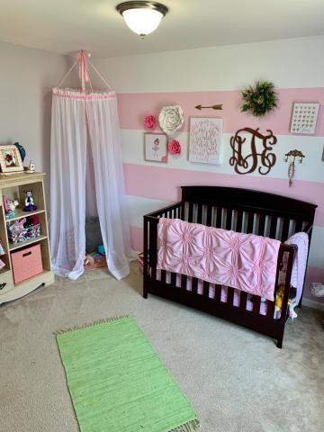
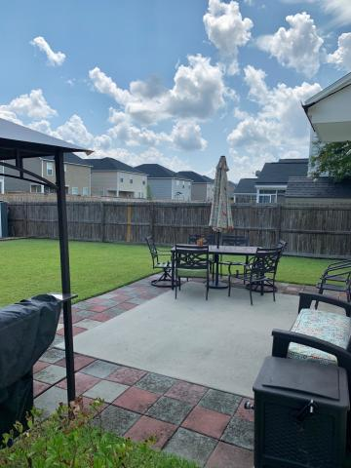
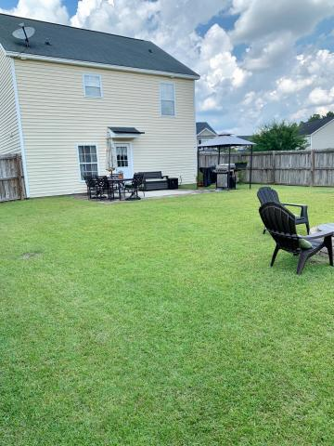
1105 Flyway Road
Drakesborough ~ Summerville, SC 29483 ~ MLS# 19023307 ~ $195,000
$2,000 Realtor Bonus!
Great Summerville Home Under $200k!
Great location close to downtown Summerville, the new Volvo plant, and DD2 schools. Open floor plan down stairs. From the kitchen you can get to your large fenced in backyard and patio with firepit. Upstairs you find a split floor plan with master bedroom on one side and two additional bedrooms on the other, plus full bathroom and also the laundry room is upstairs. All bedrooms have walk in closets. It is evident this home has been well maintained. This is a large lot with no home to the left!
Regina Cook
Mobile - (843) 224-2429
reginatherealtor@yahoo.com
Harbourtowne Real Estate | 672 Marina Drive, Ste 110 | Daniel Island, SC 29492

