Slide 1
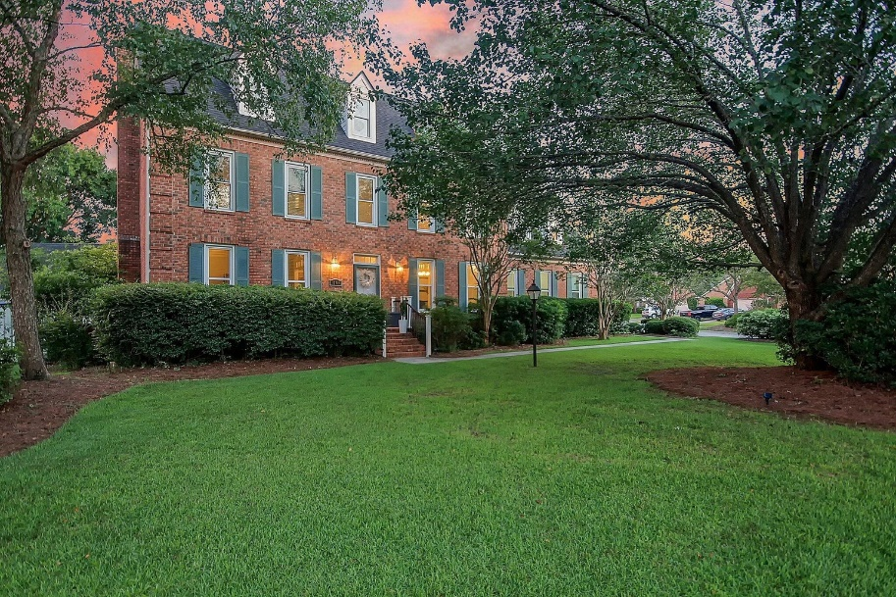
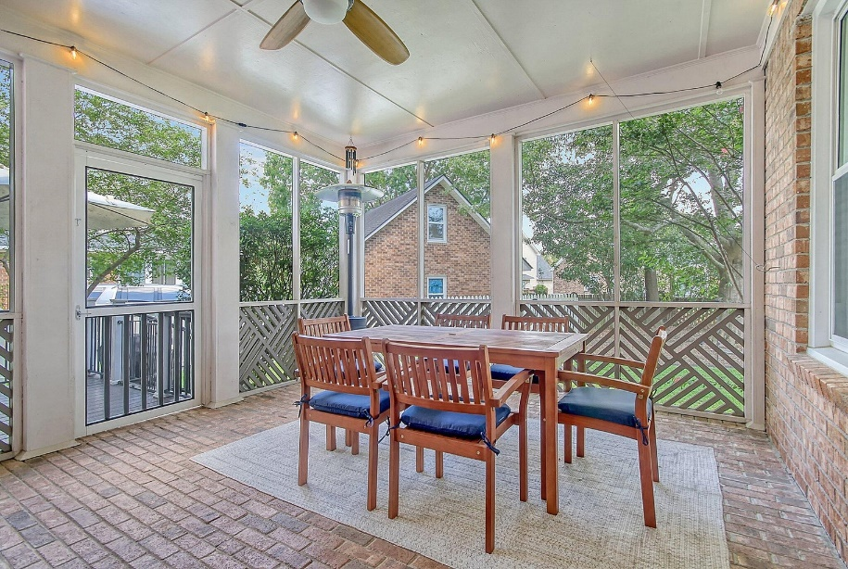
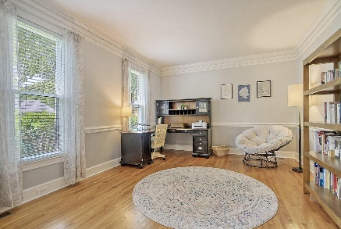
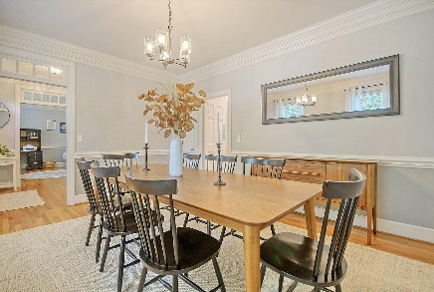
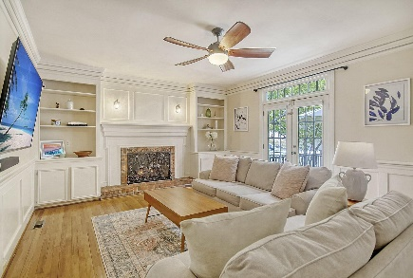
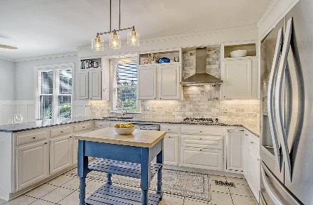
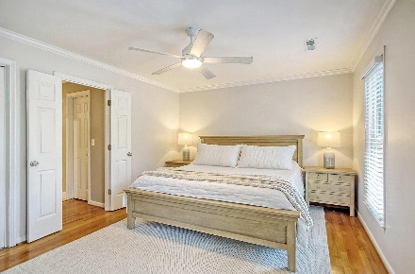
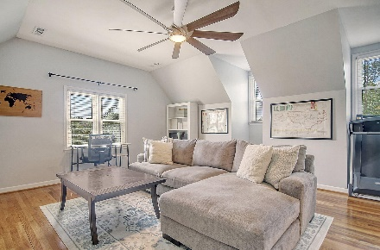
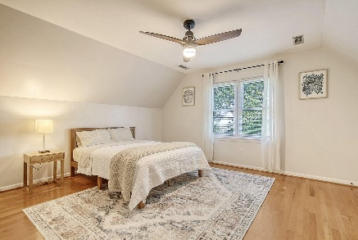
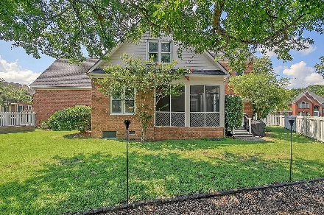



1105 Eagle Landing Boulevard Eagle Landing | Hanahan, SC 29410 MLS# 23017478 | REDUCED $719,000
Completely Renovated Brick Home
5 BEDS | 3.5 BATHS | 3,592 SQ FT
A quintessential colonial, brick home located in one of the most convenient, well-established and sought after neighborhoods, Eagle Landing, just down the street from the Goose Creek Reservoir. This home has been beautifully renovated and impeccably maintained. The main level boasts a stunning foyer with a beautiful wood staircase; a dining room big enough to host a crowd; a formal living room and/or office; a great room with gas fireplace surrounded by gorgeous custom wooden built-ins; a gourmet kitchen with breakfast nook, granite countertops, gas cooktop, double ovens, abundant solid wood cabinetry, custom tile backsplash, and high-end appliances. Just off the kitchen and great room, overlooking the backyard, is a screened porch with stunning brick flooring. The charm and character of the home continues throughout with its wood flooring and tile, triple crown molding, and high ceilings. The primary bedroom suite includes custom tile flooring, separate vanities, a large glass shower and jetted tub. The fifth bedroom with full bath over the garage feels like a private apartment making it the ideal flex space, guest suite, or office. Large back yard fully fenced with mature trees and low maintenance landscaping. Other notable features: Roof was replaced in 2018 and has a 30-year warranty. Rinnai tankless hot water heater, all 29 windows energy efficient (installed 2017), plumbing entirely replaced (2019), natural gas, freshly painted interior, high-end designer light fixtures. Centrally located to Charleston and just 20-30 minutes to most beaches and attractions! Minutes to the mall, amazing cuisine, shopping, and Bettis Boat Landing for the boaters! With five bedrooms and three and a half baths, this dream home is oozing with charm and curb appeal!
Click here for interactive floorplan and virtual tour
Katie Wishneff
843-870-8784
katie.richterco@gmail.com
Brand Name Real Estate
4 Carriage Lane Suite 106
Charleston, SC 29407

