Slide 1
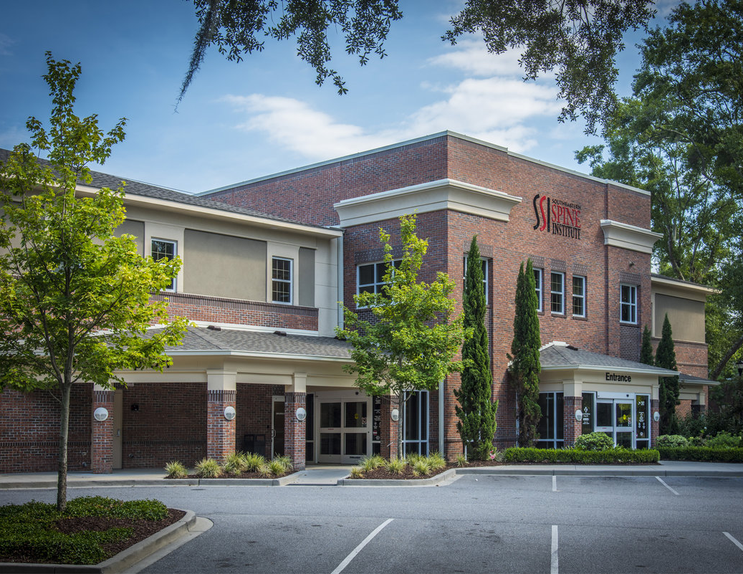
1106 Chuck Dawley Blvd, Bldg B
Mount Pleasant, SC 29464
CMLS# 30474907
Medical Office Building for Lease
Convenient to Boeing, Charleston International Airport, Tanger Outlet, & Hotels.
130 Acres of Vacant Land
Approximately 18,187 sqft with an elevator, MRI room, a physical therapy suite, private physician parking, 2 reception areas, & 2 waiting areas.
Charles Salmonsen
M (843) 224-0300 | O (843) 388-6613 | charles@salmonsen.com
Salmonsen Realty | 864 Lowcountry Blvd Ste B | Mt Pleasant, SC 29464

