Slide 1
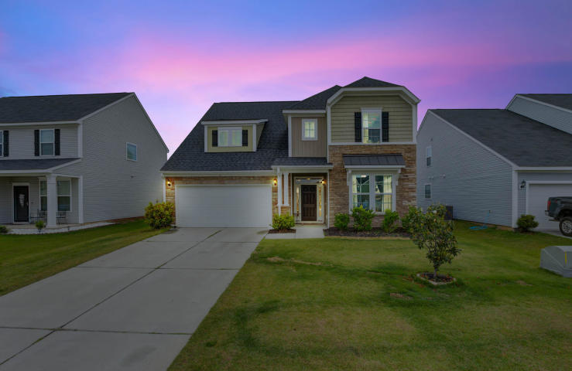
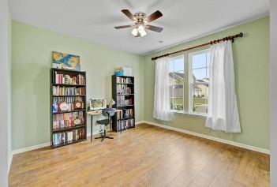
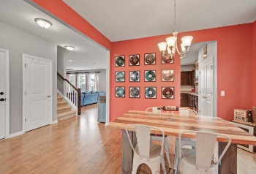
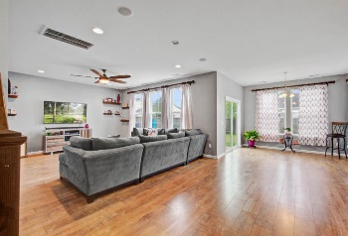
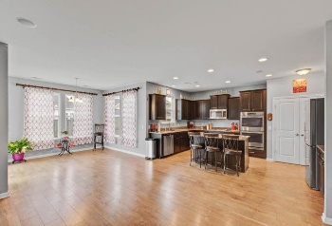
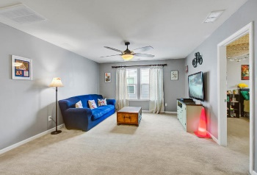
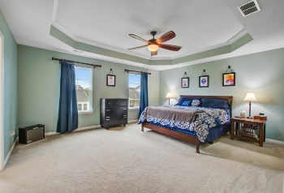
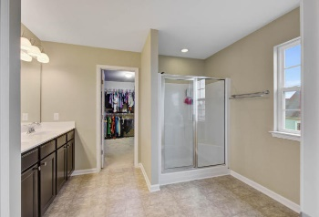
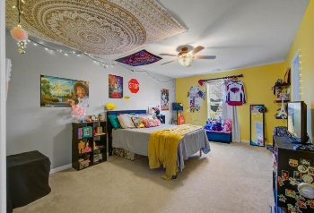
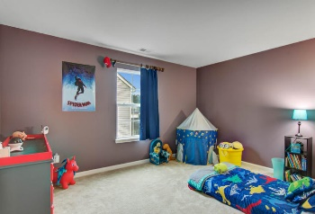
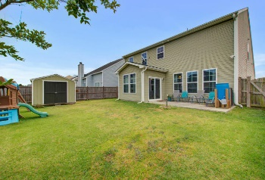



PRICE IMPROVEMENT!! GREAT PRICE!!
1106 Friartuck Trail
Hunters Bend
Ladson, SC 29456
MLS# 20014008
$294,500
3 Bedrooms | 2½ Baths | 2,878 sf
Home warranty being offered with satisfactory offer! This home has beautifully maintained and ready for you to move. Plenty of room for a crown for entertaining and holidays.
Large loft on the upper level is a great space for gaming, crafts or a playroom. Open concept living area is extremely spacious. Downstairs features roomy office area in the front of the home. Entire downstairs area has high ceiling adding to the openness.
Neighborhood has a gorgeous pool/amenity center.
Be sure to check out the virtual tour:
https://my.matterport.com/show/?m=5oCirYkpF8g
Sandy Pomeroy
Owner/CEO
843-637-7334
sandy@seaturtleproperties.com www.seaturtleproperties.com
Sea Turtle Properties
2007 2nd Ave Ste C | Summerville, SC 29486

