Slide 1
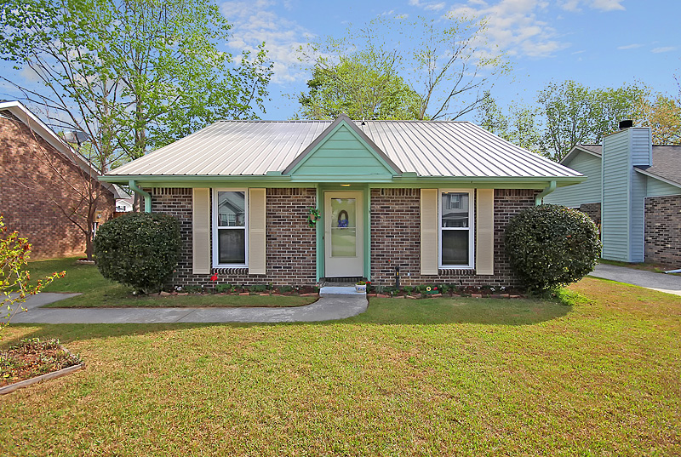
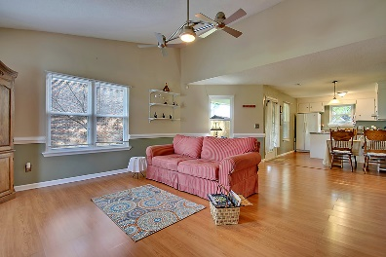
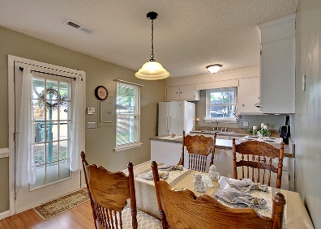
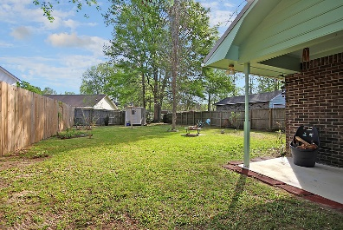
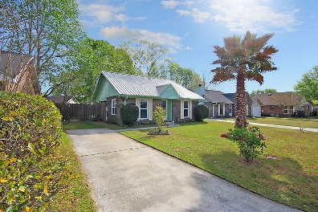


1106 T J Lane Summerville, SC 29486 | MLS# 17009585 | $125,000
Just Listed in Ashley Plantation
Stop by to see this charming home located between Goose Creek and downtown Summerville. This home has been well maintained and updated with a metal roof, new windows, and plumbing – all within the past 3 years. There is laminate flooring throughout which was also updated to include the kitchen and bathroom floors. All appliances covey, including the refrigerator, washer and dryer. The master bedroom has 2 closets, one for him and one for her. With the covered back patio, and the spacious backyard, this home is ready for 4th of July cookouts and quiet nights around the fire pit. In the Berkeley County school district, this home truly is a must see.
Sharon Sanders
O (843) 494-9284 | M (843) 817-2392
sbricesanders@gmail.com
www.homesolutionreservices.com
Home Solution Real Estate Services | 7679 Dorchester Road | North Charleston, SC 29418

