Slide 1
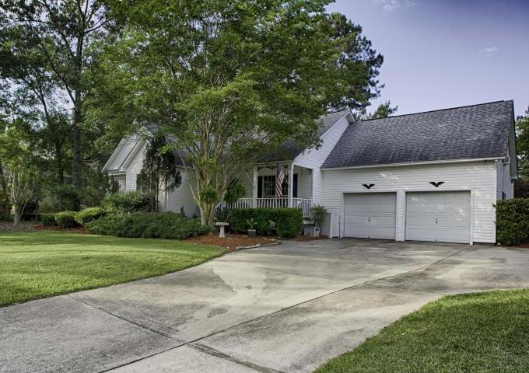
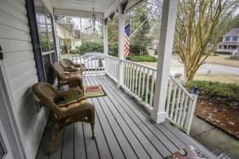
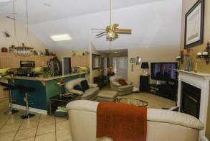
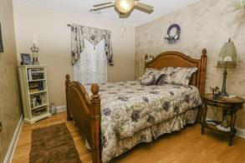
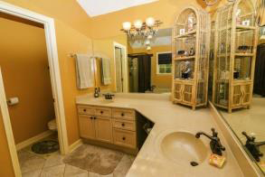
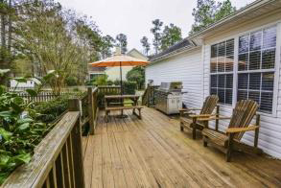
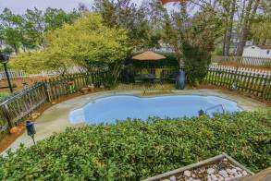
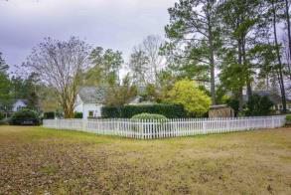
$6,000 Price Reduction!
1106 Trotters Boulevard
Trotters Ridge
Summerville, SC 29483
MLS# 15011387
$279,000
Spectacular 4 bed,3 bath home in quiet neighborhood that features hardwood floors. Large kitchen with island. Silestone counter-tops and lots of cabinet space. Large Stainless steel appliances including a Bosch quiet dishwasher. Vaulted ceilings. Master bath has upgraded faucets and lighting along with garden tub with jets. Sun Room set off the living area by French Doors. Upgraded blinds throughout. Oak stairs leads to FROG with walk-in closet and full bathroom. The Sun Room opens onto a 25 foot by 12 foot deck with 7' wide staircase down to the in-ground heated pool. The garage is now converted into an entertainment room and also has a workshop with workbench. Garage doors still function. New A/C system installed in March 2015. Plenty of storage for a boat/RV at rear of the property.
David Hickman | 843.505.0456 | davidisyouragent@gmail.com | www.omnicarolinarealestate.com
Omni Carolina Real Estate | 126 Eston Dr | Goose Creek, SC 29445

