Slide 1
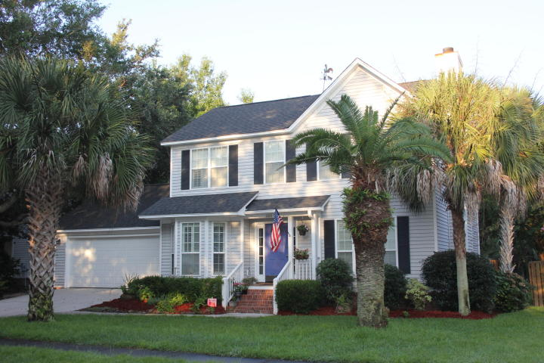
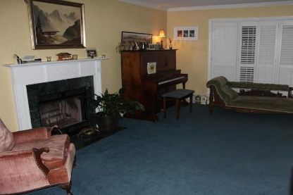
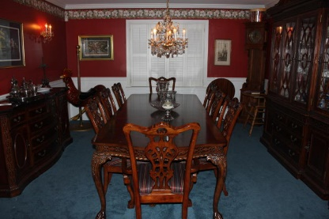
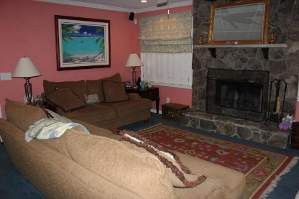
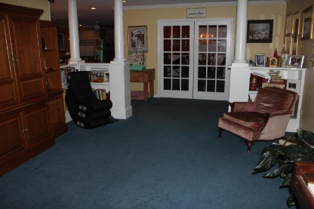
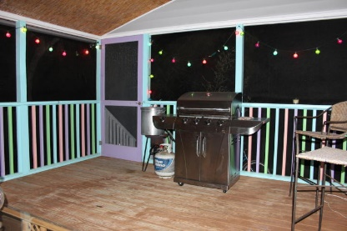
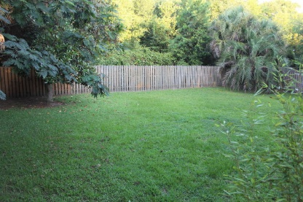
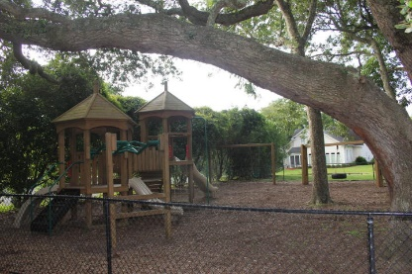
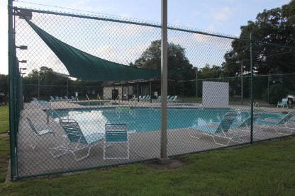
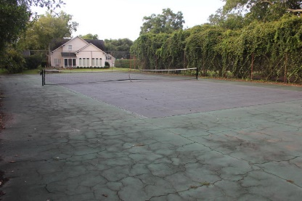


1106 Wayfarer Lane
Bayview Farms
Charleston, SC 29412
MLS# 15021379
$425,000
Large 5 bedroom, 2.5 bath in highly sought after Bayview Farm neighborhood on James Island. Large living room with fireplace & extra large dining room. Gourmet kitchen with heated tile floors, stainless steel appliances, GE Profile double ovens, microwave, Bosch dishwasher, Granite counter tops & Cherry custom cabinets. Kitchen open to the family room with fire place.
Smooth ceilings, crown molding & Plantation Shutters throughout. Upstairs has master bedroom with walk-in closet & private bath.3 larger bedrooms and one small bedroom can be use as office. Screen porch, large fenced back yard&2 car garage, irrigation system in front yard. New roof & HVAC system in 2013.
The neighborhood offers 5 stocked lakes, 2 swimming pools, Children's play park, clubhouse, tennis court, half-court basketball.
Cathy Rosenblum
843-817-7869
crosenblum@comcast.net

