Slide 1
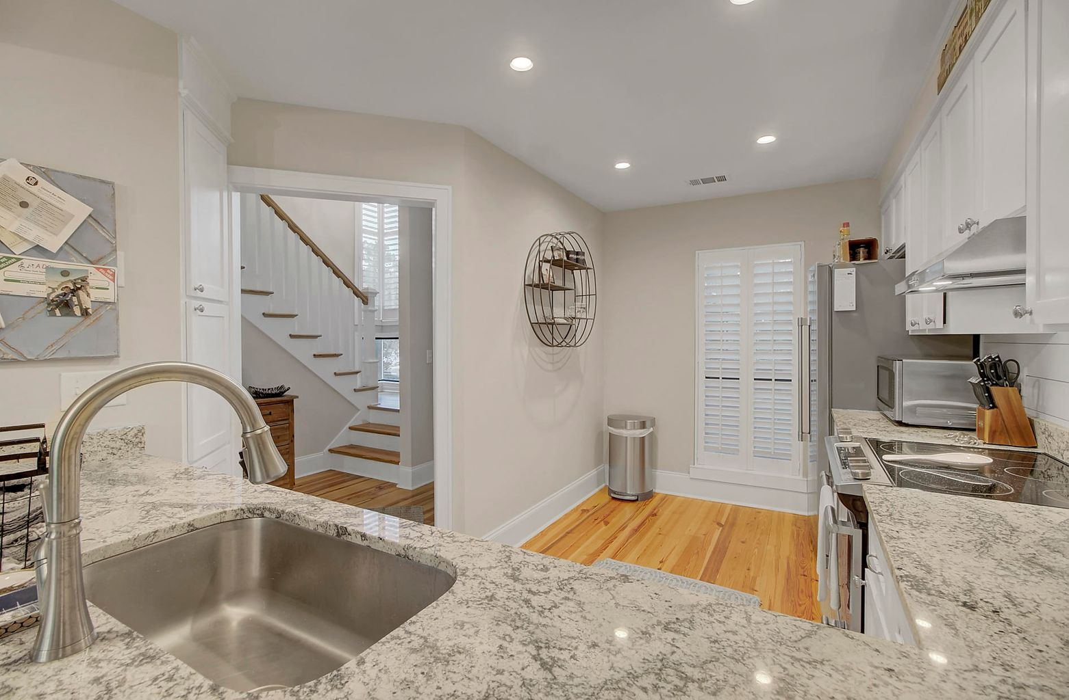
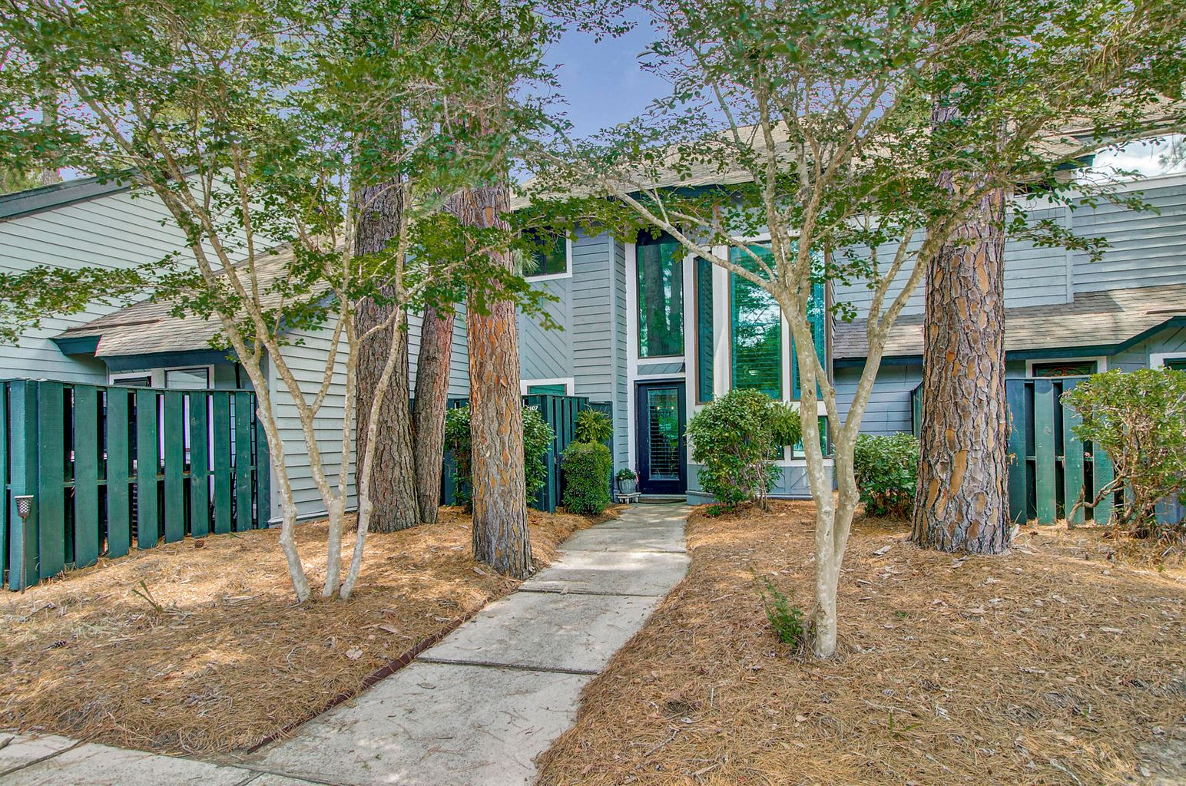
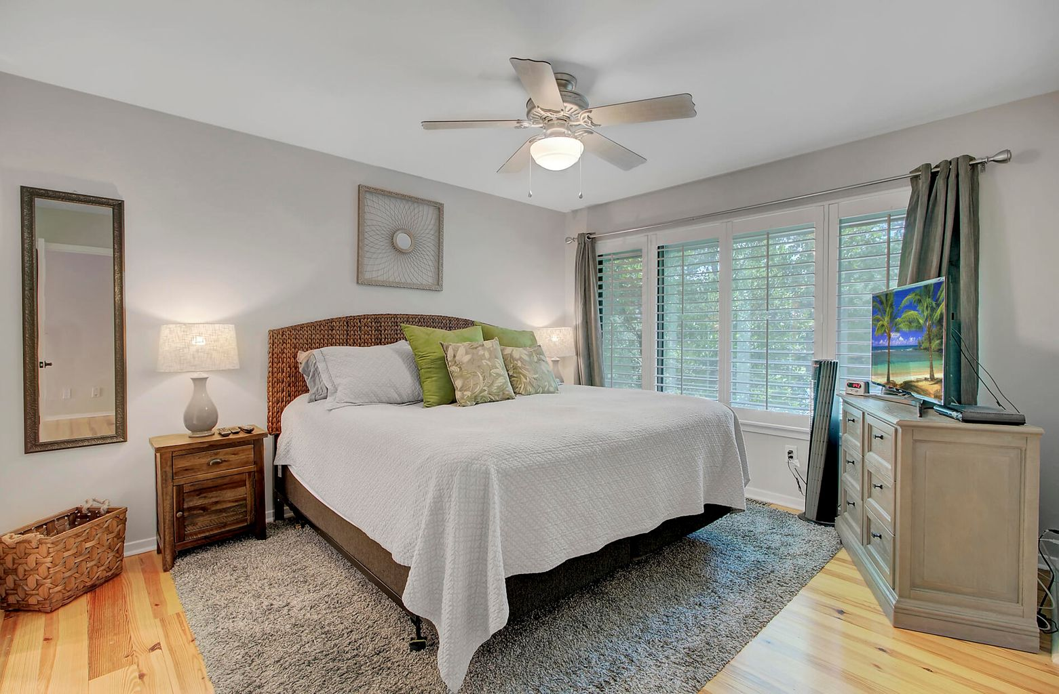
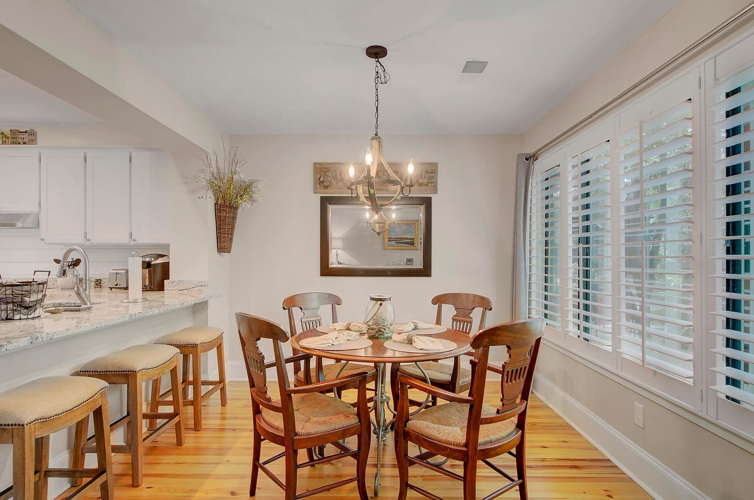
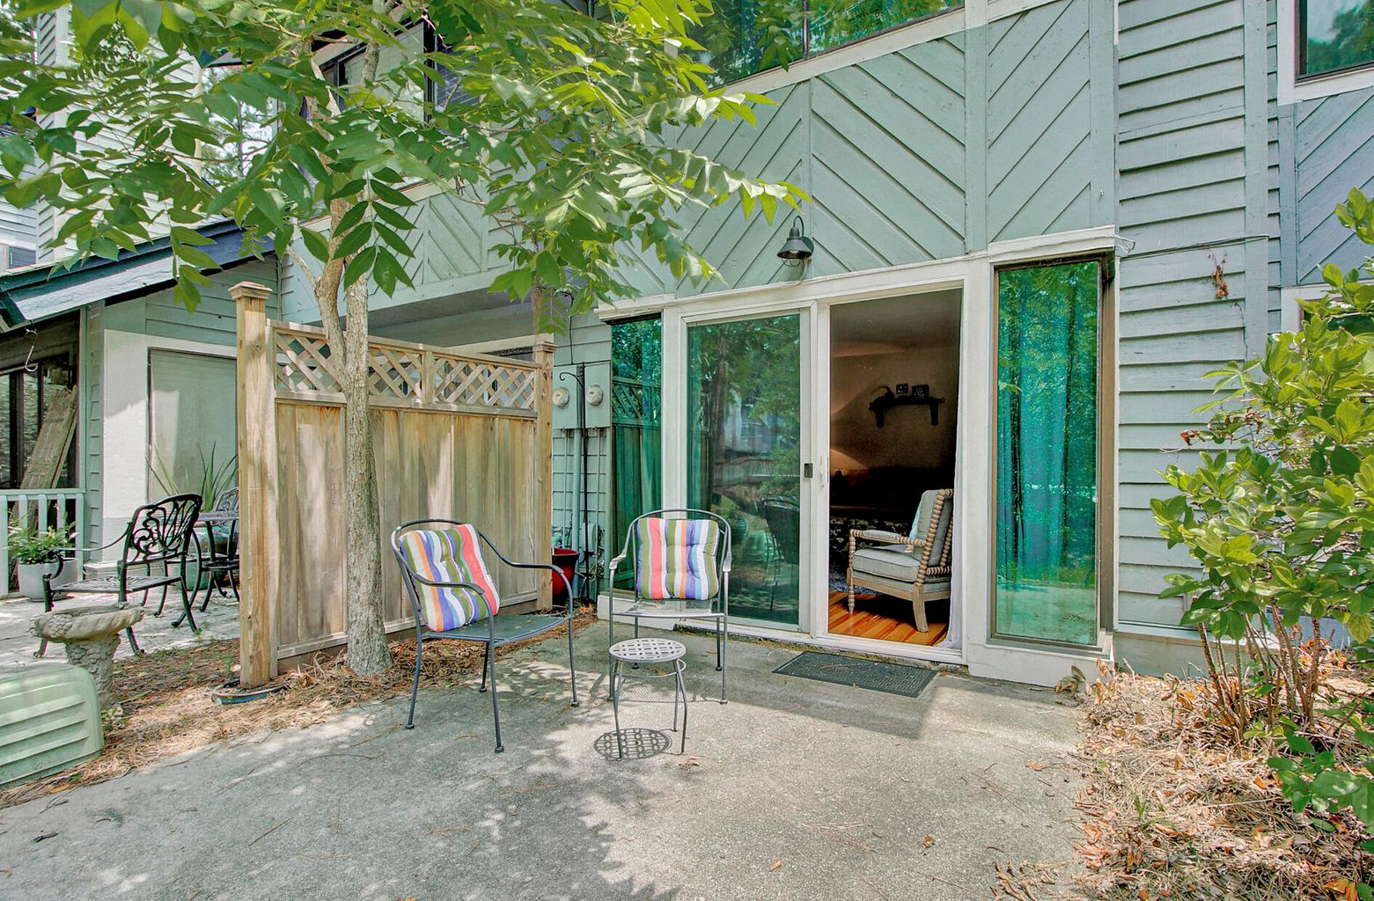
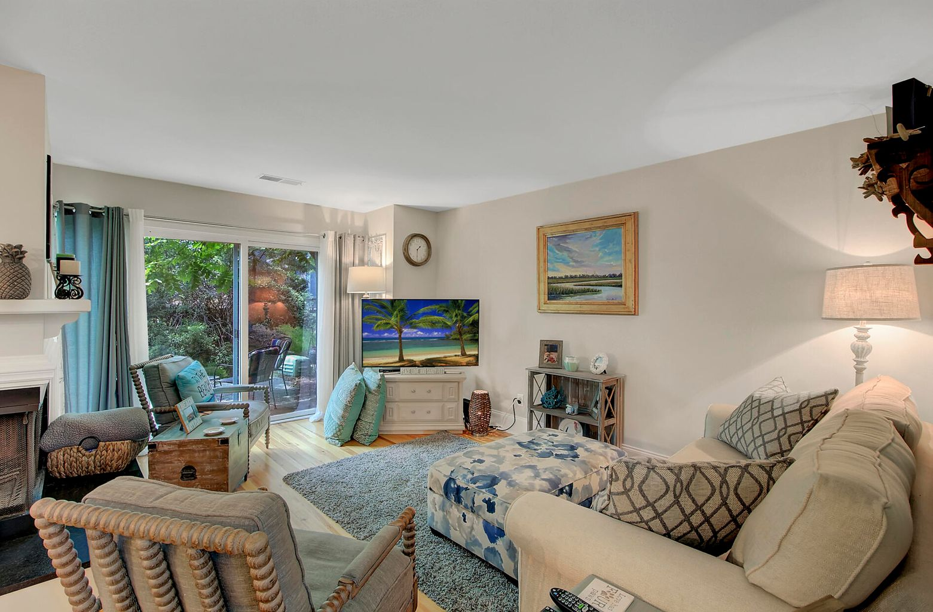
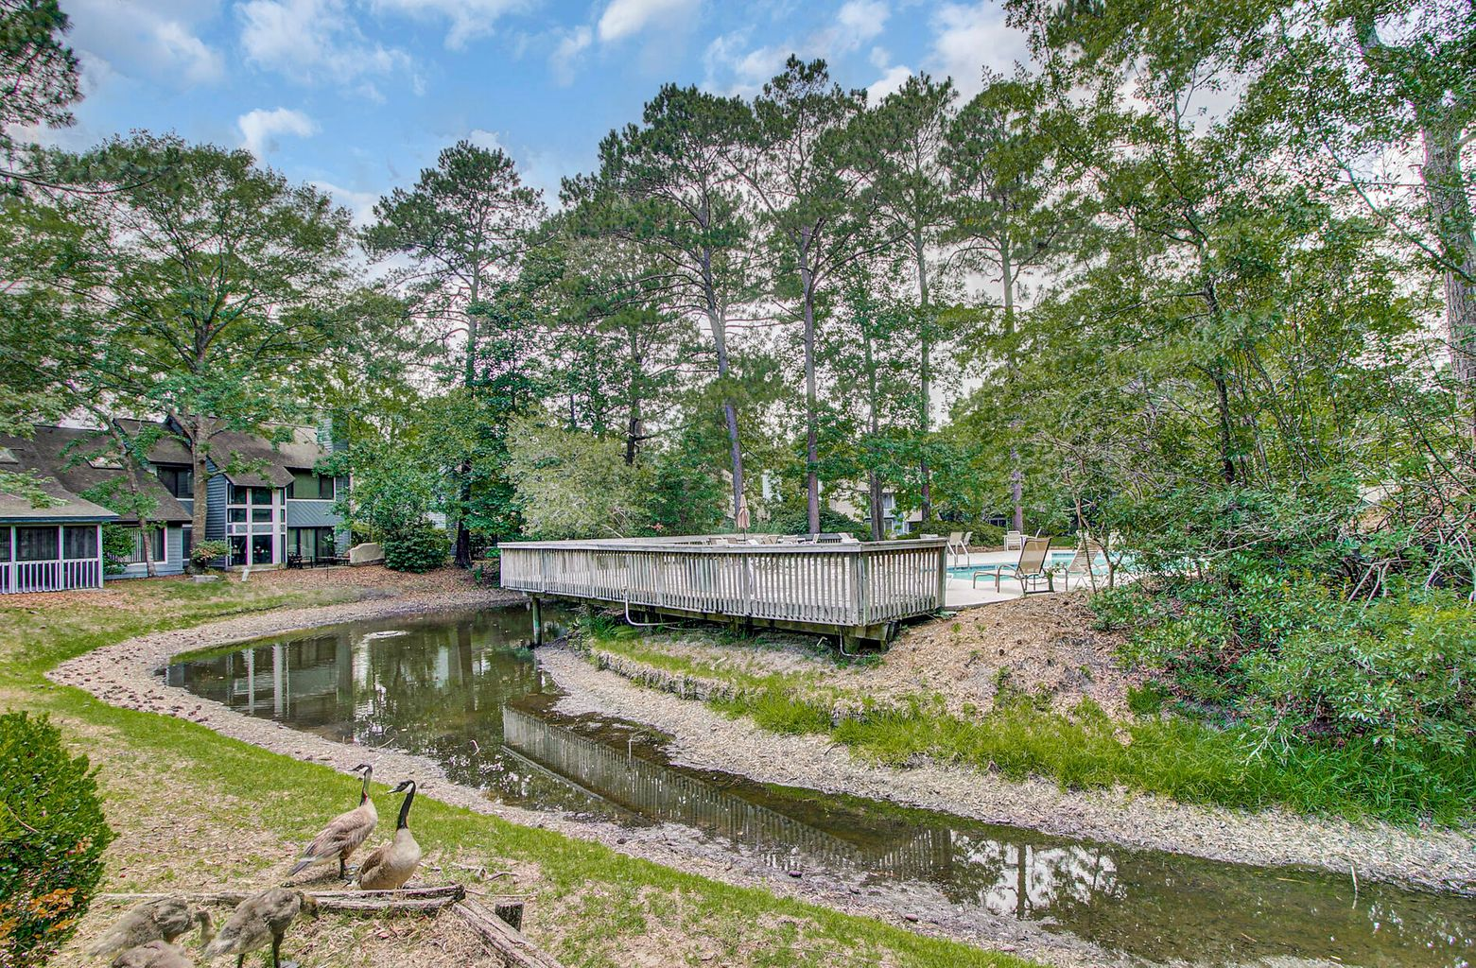


JUST LISTED
Fully Renovated Condo In Desirable Snee Farm
1107 Shadow Lake Circle 19
Snee Farm
Mount Pleasant, SC 29464
MLS# 21016241 | $345,000
Step inside this beautifully renovated condo and you just may think you are in a model home for new construction! A full renovation has been completed with decorator finishes. Additionally a new HVAC system was installed in 2017! Upon entry you are immediately impressed with the bright and airy feel of this stunning property. The heart pine flooring is breathtaking and the best news is... it's everywhere! No carpet in this residence. The kitchen has a fresh modern look with new cabinet doors and hardware, stunning granite counters, new stainless steel appliances, and shiplap backsplash. The modern coastal theme is carried throughout the home, reminding visitors that this would make a fantastic lock it and leave it vacation home by the beach or the perfect, turn key full time residence. The kitchen opens to a dining space and family room with fire place. Sliders open to the back patio overlooking a stream and a short walk to the pool. The lower level bathroom is a stunner with shiplap and designer wallpaper. This is where you will find the laundry rom and additional storage as well. Upstairs you will find two master bedroom suites. Each bedroom has its own private full bath with beautiful granite and tile floors. All bathrooms have new vanities, and be sure to notice the solid wood interior doors throughout the home. Custom lighting, plantation shutters, neutral paint colors, shiplap accents and tasteful finishes throughout - the attention to every detail will leave an impression! This is a home like no other. To increase energy efficiency a tint has been added to the exterior of the windows. This residence is in the heart of all that Mt. Pleasant has to offer. Located minutes from Towne Center Shopping, grocery stores, a movie theater and restaurants galore, you have all the conveniences you would want or need just outside your door. It is a short ten minute ride to the beautiful beaches at Isle of Palms or five more minutes to Sullivans Island if you prefer. Historic Downtown Charleston is a mere 15-20 minutes away! Commuters will appreciate easy access to Rt. 17 and Hwy 526. A gem like this is a rare find so do not delay in scheduling your tour while you still have an opportunity to make this YOUR special home.
Check out the video tour here: https://video214.com/play/Jx5hjseRZ5ckTCdRmcN91A/s/dark
Ellen O'Neil
Broker/Owner, ABR, e-PRO, CNE
Charleston Realtor of Distinction
(843) 300-8530
www.EllenONeilProperties.com

