Slide 1
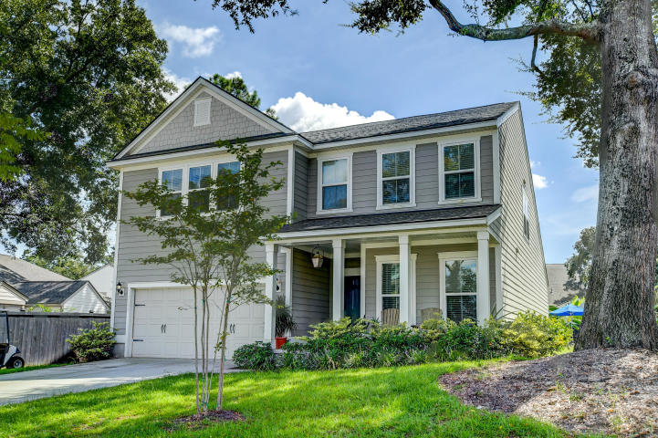

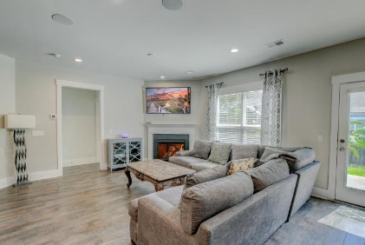
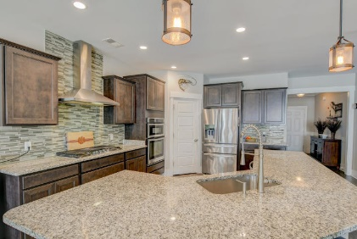
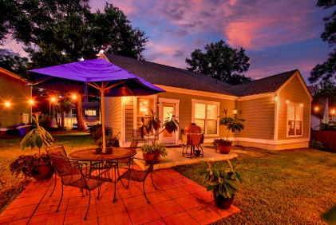
Spacious James Island Home
1109 Bright Court
The Preserve at Dills Bluff ~ Charleston, SC 29412 ~ MLS# 20025573 ~ $524,900
Welcome to beautiful James Island, and this spacious home in The Preserve at Dills Bluff. The foyer features crown molding and wainscoting. To the right of the foyer are glass-front French doors leading to an office/den area. An office nook with a built-in desk can be found just before the family room. The open and airy living and dining area. The family room has a lovely fireplace, and the dining area has a door leading to the patio and the fenced-in backyard. The gorgeous kitchen includes granite countertops, abundant cabinetry, a tile backsplash, stainless steel appliances including a gas cooktop and hood, a roomy panty, and breakfast bar seating. The main level owner's suite has a tray ceiling and overlooks the backyard. The owner's en-suite has a frameless step-in shower, dual vanity and a massive walk-in closet. The main level also has a drop-off area by the garage door and laundry room. Head upstairs to find a huge loft area, three spacious bedrooms, and two full bathrooms. The roomy backyard has a patio space...perfect for dining al fresco and enjoying the outdoors. This home is located close to shopping, dining, Folly Beach, and downtown Charleston.
There's a lot to love with this great property, so book your showing today!
Nate Gainey 843-513-2038
nate@mattoneillteam.com
Christopher Smith 843-267-0735
christopher@mattoneillteam.com

