Slide 1
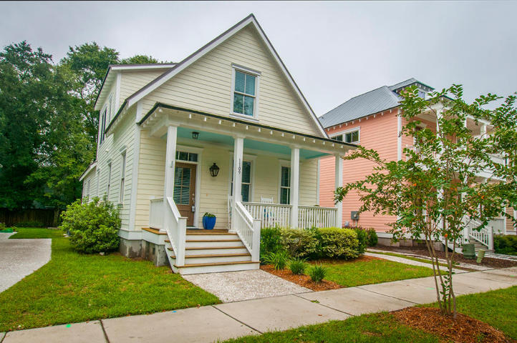
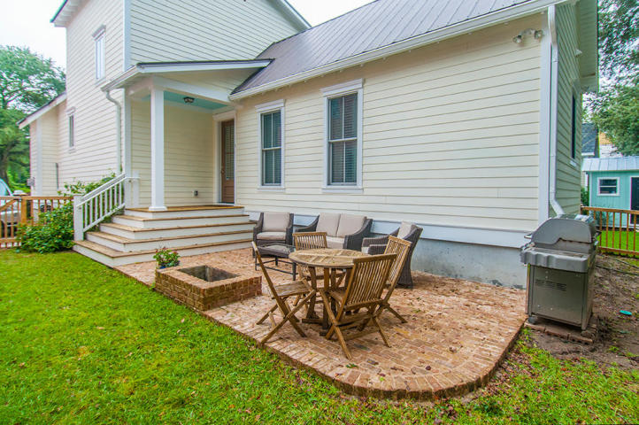
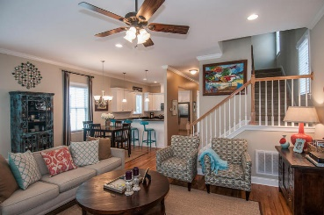
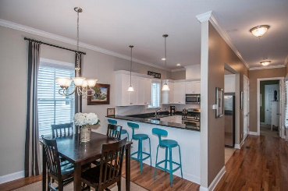
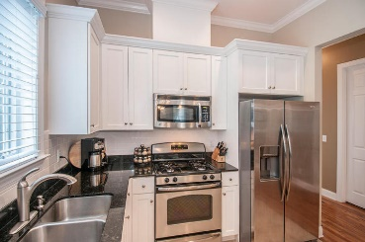
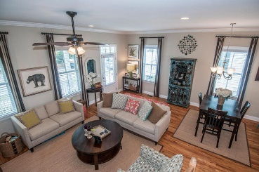
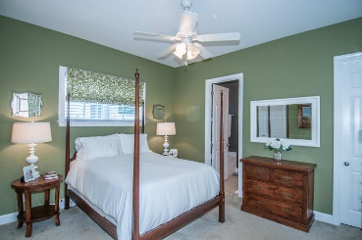
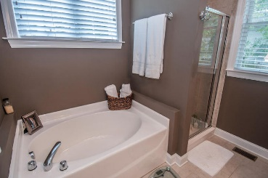
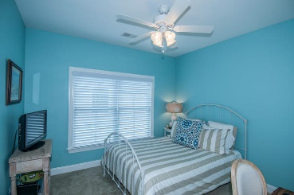
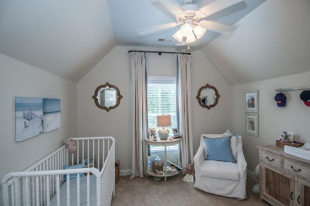

Open House - Sunday, October 11th, from 1-4
Refreshments will be provided!
1109 Phillips Park Drive
Phillips Park ~ Mount Pleasant, SC 29464 ~ MLS# 15025978 ~ $529,000
Come see one of the best kept secrets in Mt Pleasant. Phillips Park is a quaint and quiet neighborhood just off the corner of Rifle Range Rd and Coleman Blvd. You can be downtown or on the beach in just a few minutes. You can easily walk to over a dozen restaurants, shopping, grocery stores, and the farmer’s market. This 3Br/2.5Ba home was recently built in 2010 and has been cared for by its original owners since. Cement Plank siding, metal roof, brick patio with built in fire pit, and full front porch are just a few of the exterior features. Inside there are 10’ ceilings downstairs and 9’ upstairs, hardwood floors, recessed lighting, granite countertops, ceramic tile in the kitchen, a sit up kitchen bar, spacious downstairs master, and an open floorplan. Don't miss this one!
Will E Freeman
Office - (843) 971-1312
Mobile - (843) 270-5454
wfreeman@thebeachcompany.com
BH&G RE The Beach Company, 1973 Riviera Drive, Suite 7, Mt Pleasant, SC 29464

