Slide 1

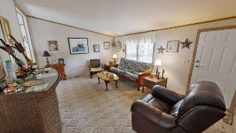
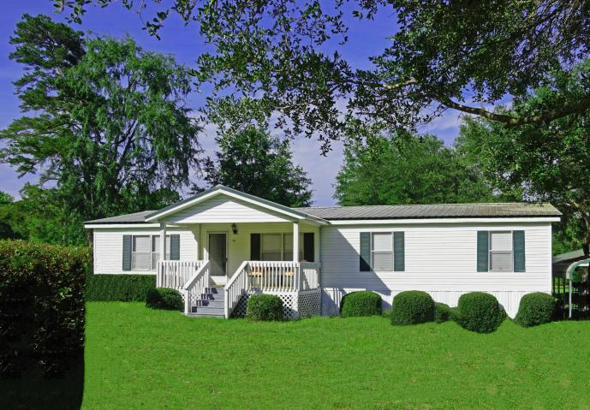
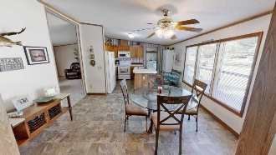
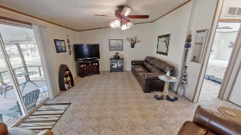
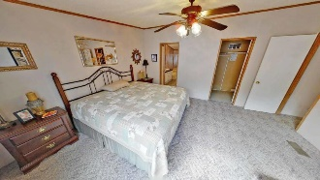
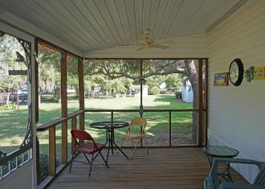
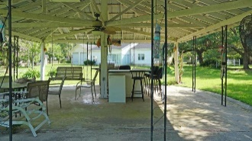
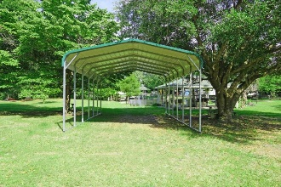
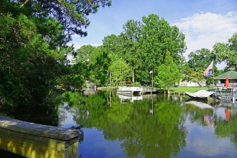

Welcome to the LAKE!!!
110 Abby Lane
Eutawville, SC 29048 | MLS# 20016076 | $284,900
3 Beds | 2 Baths | 1,561 Square Feet
Nothing could be finer than to be on waterfront Lake Marion with your own boat ramp and dock. This beautiful 3 bedroom and 2 bath home is on quiet canal and just minutes to big water. It is also off a cove when you have rough weather. Its literally less than a mile from a Public Lake access if needed. This home has a LARGE gazebo for outdoor entertaining as well as a front porch and a screened back porch. There are several storage building that could be used as a garage, workshop or just for storage.
This home is a MUST SEE!!! Make your appointment today!!!
Step in and take a virtual tour: https://my.matterport.com/show/?m=RxTwUyHErsk
Carla C Davis
Mobile - (843) 437-4873
gaweber@tds.net
AgentOwned Premiere Group
141 A N. Main Street
Summerville, SC 29483

