Slide 1
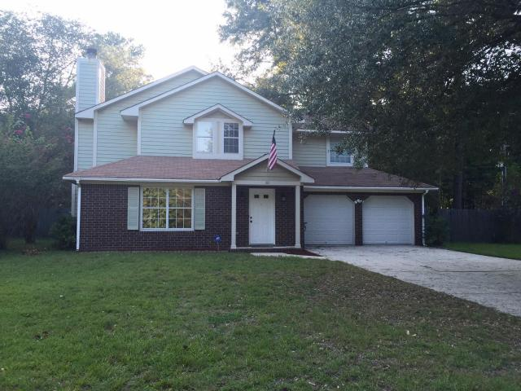
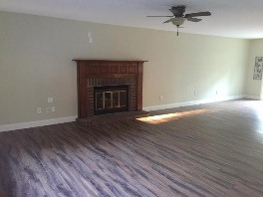
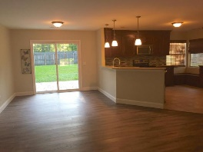
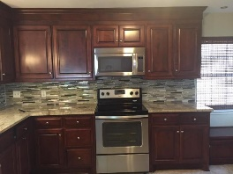
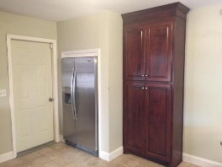
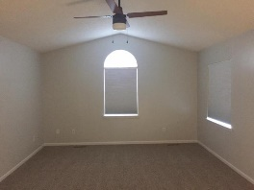
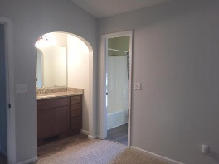
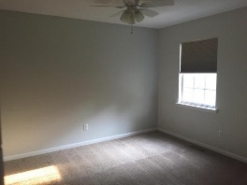
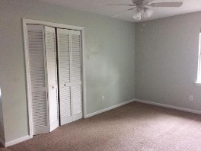
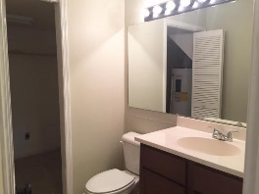
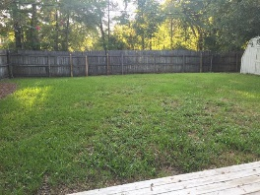
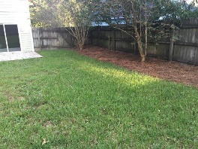
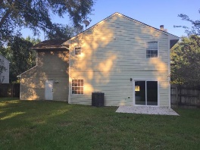


Summerville Under $200k!!!
110 Bayberry Run
Laurel Hill
Summerville, SC 29485
MLS# 16023974
$190,000
3 Bedrooms | 2½ Baths | 1,747 sf
Get ready to be wowed! Cul de sac home with large fenced in yard under $200k! This home is a must see! Completely upgraded kitchen with stainless steel appliances, granite and gorgeous backsplash! Kitchen also offers a large pantry and window seating. The kitchen overlooks the dining room/ living room combo which offers wood floors and a fireplace. Off the dining area are sliding doors to the HUGE backyard! Large storage shed and completely fenced in, this is a dream yard! You'll find a half bath as well as the laundry room on the first floorl. Upstairs, the master bedroom has a vaulted ceiling and plenty of closet space. Granite counter in master sink with separate space for shower and toilet. Two more good size bedrooms with a full bath as well upstairs. Plenty of parking space in the driveway as well as a two car garage. Enjoy the privacy of a cul de sac location! Just minutes from downtown Summerville, Gahagan park and shopping. This home is a must see and won't last! Move in ready!!!
Larry & Kathy Mazalatis
Larry Cell 843-693-0529
Kathy Cell 843-693-0159
Office 843-871-9133
AGENTOWNED PREMIERE GROUP | 1800 TROLLEY RD | SUMMERVILLE, SC 29485

