Slide 1
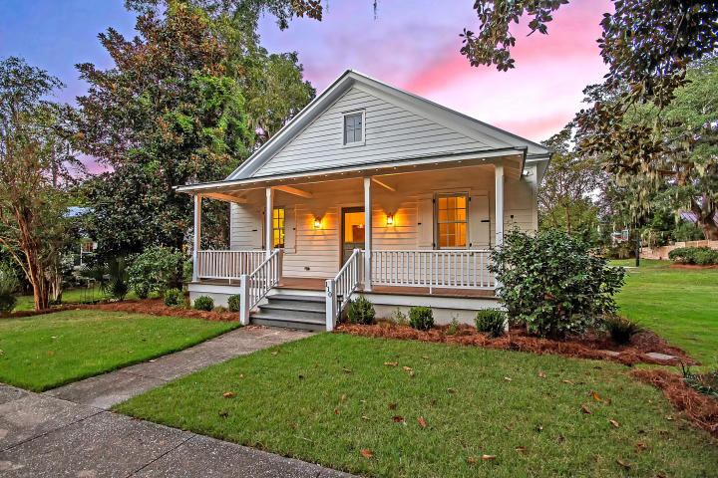
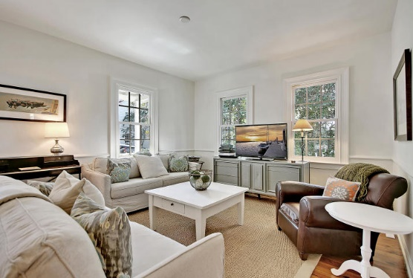
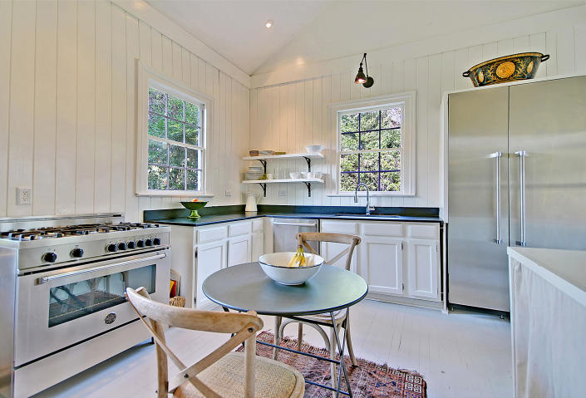
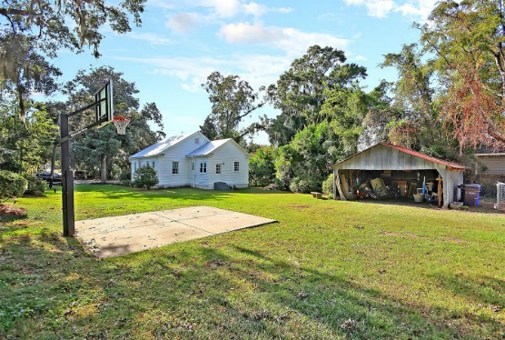
Price Reduced in Dunes West!
New A/C Units With Nest Controllers PLUS a 10 Year Warranty
Huge Buildable Lot!
110 Bennett Street
Old Village ~ Mount Pleasant, SC 29464 ~ MLS# 18027349 ~ $1,699,000
There is a large buildable footprint with an option to add on the existing home, or you can use the cottage as an additional home and build a larger home.
Nate Gainey nate@mattoneillteam.com 843-513-2038

