Slide 1
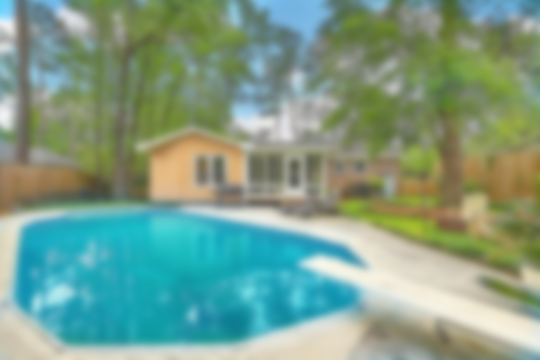
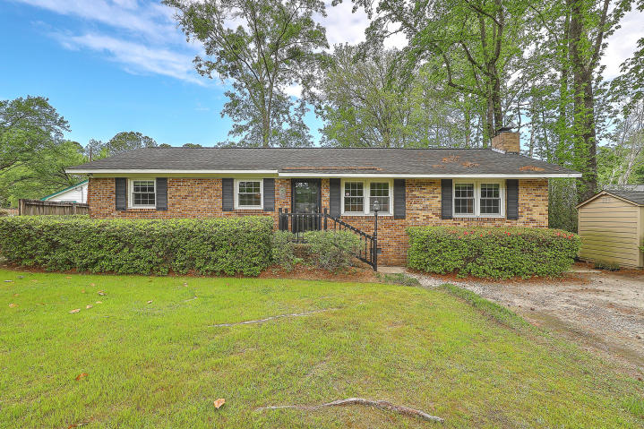
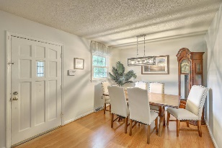
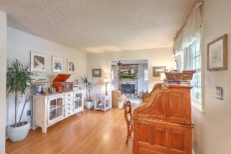
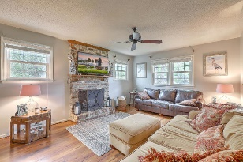
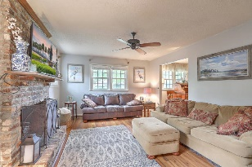
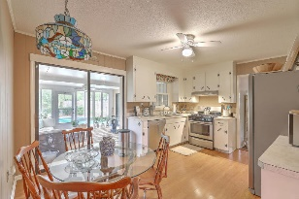
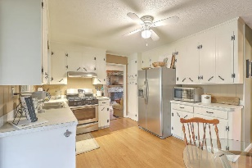
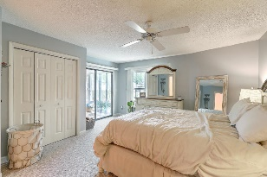
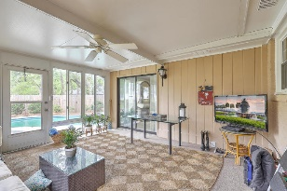
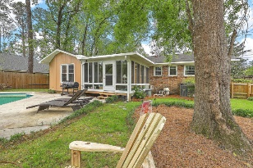
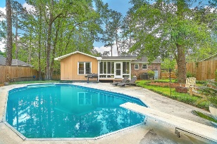


Open House Sunday June 28th 1-3pm
110 Boone Hill Parkway
Summerville Heights | Summerville, SC 29483 | MLS# 20009910 | $259,800
Separate sitting and dining areas flow into kitchen with wood cabinets, lots of storage and sunlight. Eat in area open to heated and cooled sunroom and pool. Master suite a true retreat area with access to sunroom and views of pool. Easy access to all areas of house. HVAC and appliances have been replaced. Great location in Dorchester Two schools and close to downtown Summerville and interstate.
For video go to https://youtu.be/DhVxYovvFqs
Jordy Tupper Office 843-576-2697
Mobile 843-209-0848
gtupper@gtupper3.com
www.gtupper3.com
RE/MAX Pro Realty
9209 University Blvd.
N Charleston, SC 29406

