Slide 1
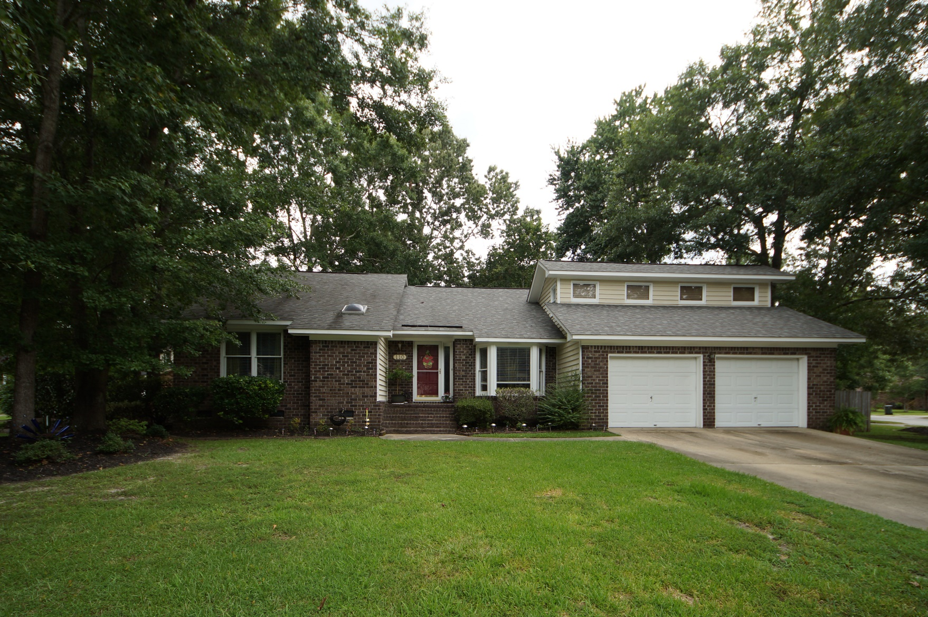
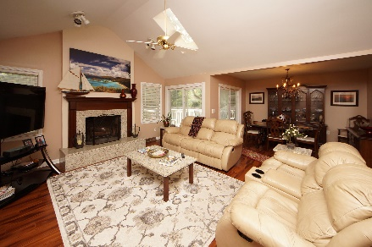
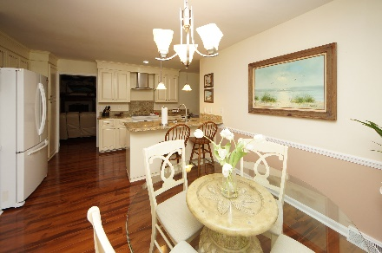
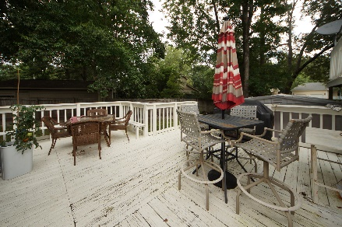


110 Bridlewood Place Goose Creek, SC 29445 MLS# 18020160 :: $269,000 4 Bed / 2½ Bath
Crowfield Plantation
Recently Remodeled
2.67 Acres!
Spectacular remodeled home in Crowfield Plantation!
Seller as installed custom kitchen cabinets, granite counter tops, laminate wood flooring, smoothed the ceilings and upgraded both bathrooms.
Bedroom/bonus room over the garage has a half bath and private deck that leads to the lower level deck.
This home is move in ready for a new owner!
Connie White, Broker
843-532-3356
conniesyouragent@gmail.com
Charleston Homes · 597 Old Mt. Holly Road · Suite 301 · Goose Creek, SC 29445

