Slide 1
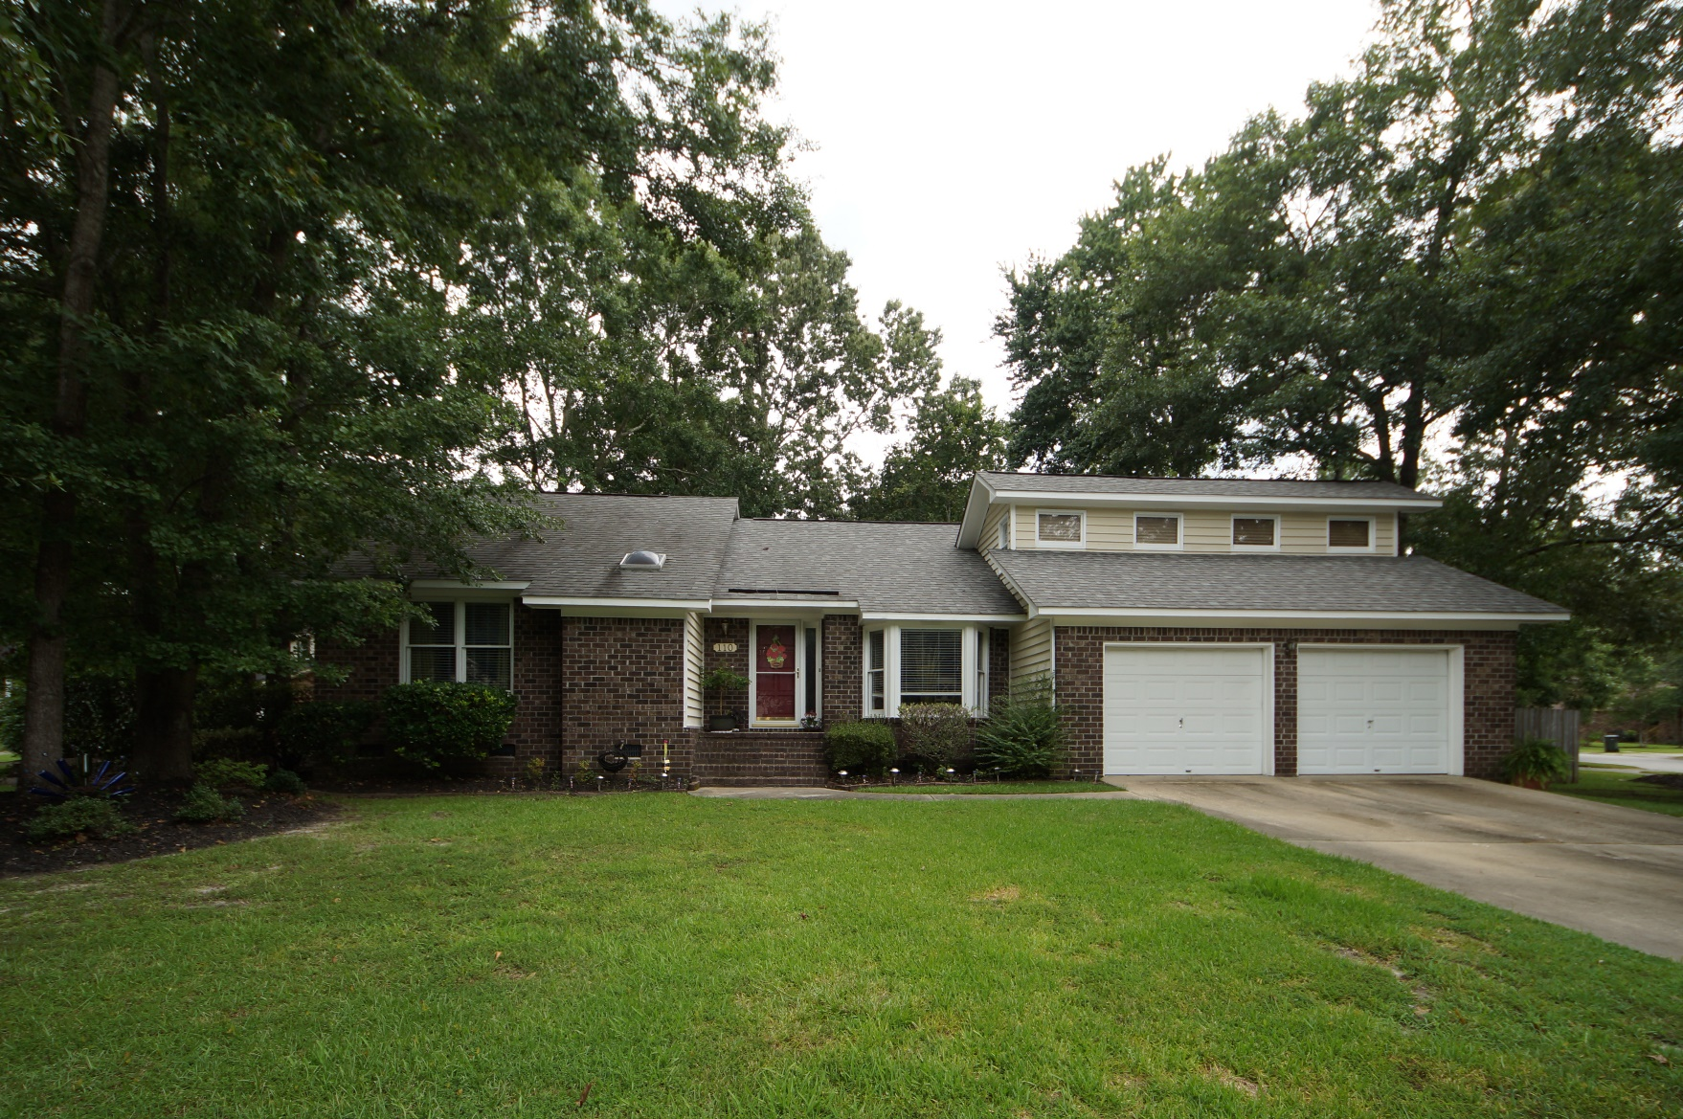
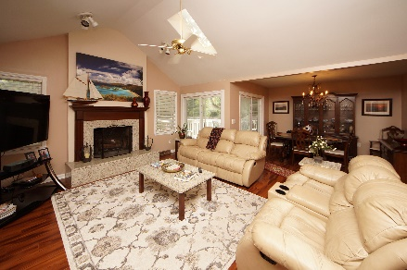
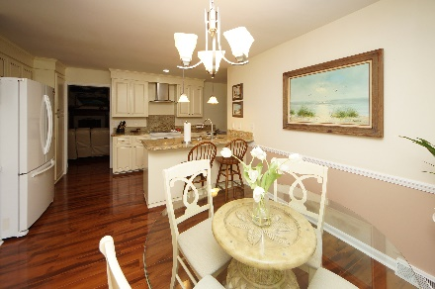
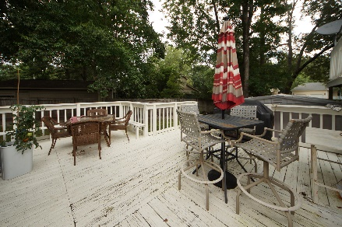


110 Bridlewood Place
Goose Creek, SC 29445
MLS# 18020160 :: $258,000
4 Bed / 2½ Bath
Hunters Woods
Crowfield Plantation
Upgraded Kitchen And More!
Reduced!
Spectacular remodeled home in Crowfield Plantation!
Seller as installed custom kitchen cabinets, granite counter tops, laminate wood flooring, smoothed the ceilings and upgraded both bathrooms.
Bedroom/bonus room over the garage has a half bath and private deck that leads to the lower level deck.
This home is move in ready for a new owner!
Connie White, Broker
843-532-3356
connie@chrepros.com · conniewhiterealestate.com
Charleston Homes · 597 Old Mt. Holly Road · Suite 301 · Goose Creek, SC 29445

