Slide 1
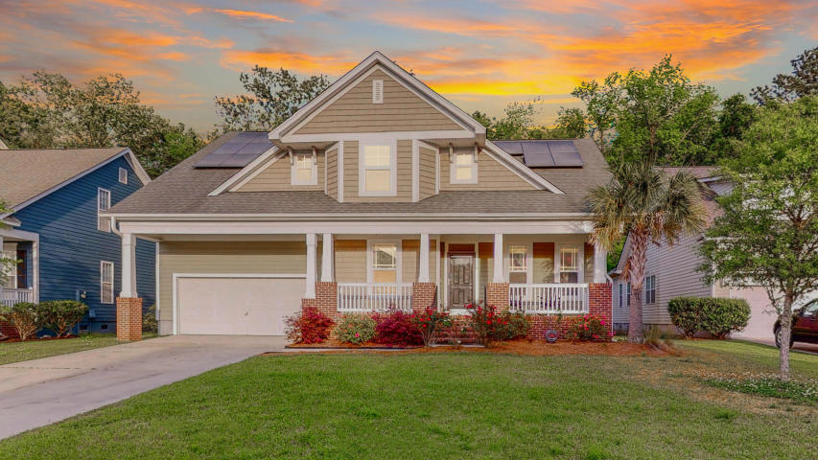
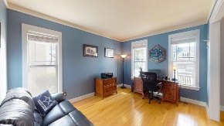
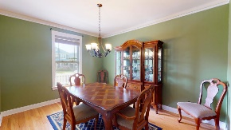
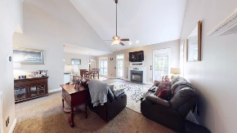
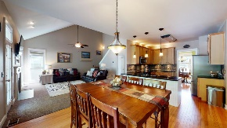
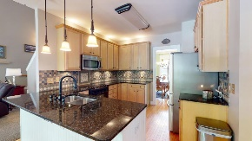
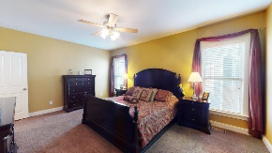
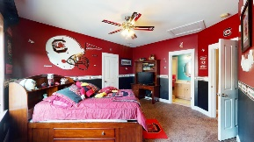
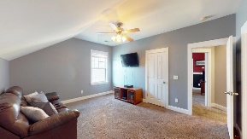
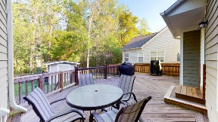
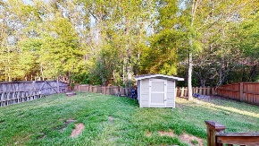


Motivated Sellers!! Gorgeous 5 Bedroom & 3.5 Bathroom Home in Legend Oaks!
110 Carriage Ride Lane Legend Oaks Plantation
Summerville, SC 29485
MLS# 20008912
$361,000
Now's your chance to own this gorgeous 5 bedroom & 3.5 bath home plus study in the renowned Legend Oaks Plantation! This entire house is meticulously cared for top to bottom! Upgrades include granite countertops and custom backsplash in the kitchen, newer carpets, custom built deck, new downstairs HVAC unit, new evaporator for upstairs HVAC unit, Cat 6 Cable throughout the entire house and so much more. Walking into living room of this home with enormous cathedral ceilings is truly enchanting. Enjoy your favorite movies and TV shows next to the gas burning fireplace overlooking the woods in the backyard. The impeccable kitchen with custom backsplash and granite countertops is awaiting its next chef. This kitchen boasts tons of cabinetry and countertop room, plus lighting both above and below the cabinets. Enjoy your fresh cooked meals in the formal dining room which is also a wonderful spot for holiday dinners. 110 Carriage Ride Lane has the desirable downstairs master bedroom with a walk-in closet and master en-suite. The bathroom has his and her vanities, a separate garden tub and separate stand-up shower. Upstairs has the additional large spare/guest bedrooms with Jack and Jill bathrooms. An additional room, currently used as storage, can easily be converted into an office or another study by finishing the room. Afraid you'll be giving up storage room? Don't worry because this home still has tons of storage room throughout the home, including inside the attic from one of the guest bedrooms and on the ceiling shelf inside the 2-car garage and much more. If you love enjoying family time outside and entertaining, you'll absolutely love the custom deck in the backyard with no neighbors behind you. The back is already fenced in so you can let Spot roam free without worry! Legend Oaks community includes a club membership and a golf club membership, which allow access to the pools and golf courses. The award winning Dorchester District 2 Schools are conveniently located just minutes away! So what are you waiting for? Schedule your showing today.
Virtual Tour: https://my.matterport.com/show/?m=QUo5y8gaSJn
Nick Mazzilli (843) 640-5575
nick@nickmcharleston.com www.nickmcharleston.com
Reside Real Estate LLC
155 Wingo Way Unit 421 Mt. Pleasant, SC 29464

