Slide 1
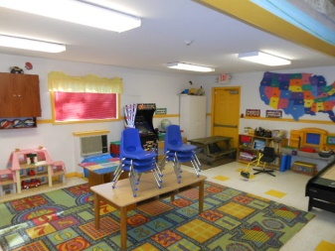
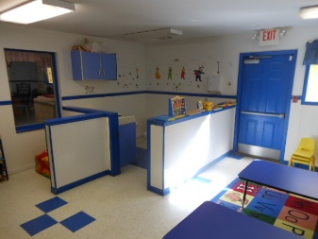
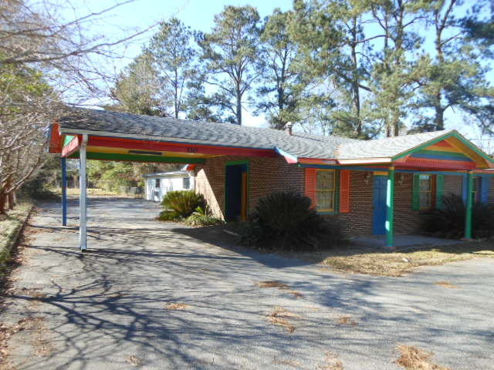
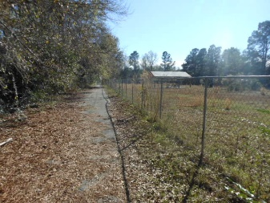
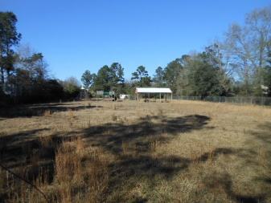
Former Day Care Facility
5,000 sq ft · $375,000
$40,000
Price Reduction!
First class all the way!!!
Truly a 10 on a 10 point scale
110 Cone Lane
Summerville, SC 29483
The property had been used as a Daycare facility for 20 years. Its in superior condition and could be used as a Church, Daycare, or many other uses. The 5,000 sq.ft. building has 8-10 separate areas with a Lobby/Reception area and 2 Adult bathrooms and 6 small toilets for children. All equipment can be purchased separately if Purchaser/User desires to keep its use as a Daycare facility. The property consists of 2 separate TMS #'s 135-16-00-025 and 135-16-00-066. The Parcel with Building is Approximately .8 Acres, an additional 1.5 Acres is available for purchase. The property is just .25 miles from the Orangeburg Rd. and Central intersection and 3 blocks from the Knightsville Elementary School.
You better hurry…this home may very well have multiple offers
the first weekend it's offered for sale.
Rick Willis
843-327-3017 · Rick@RickWillis.com · The Group, LLC

