Slide 1
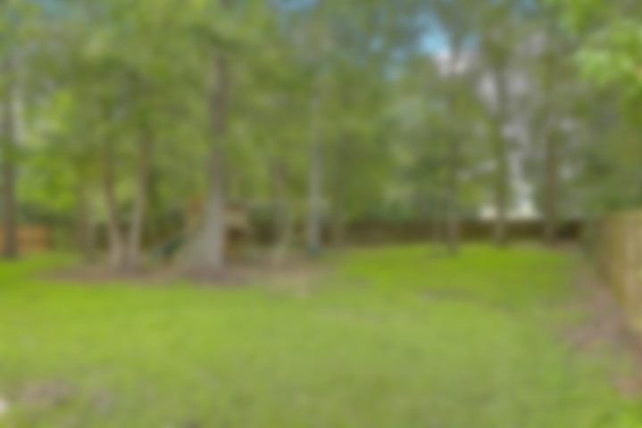
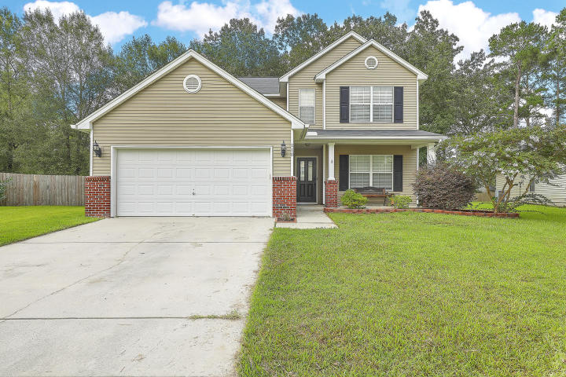
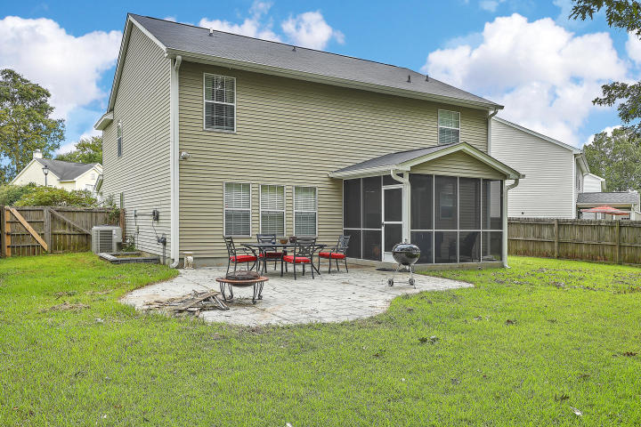
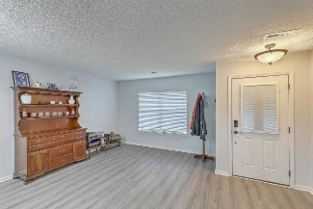
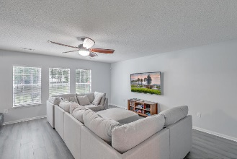
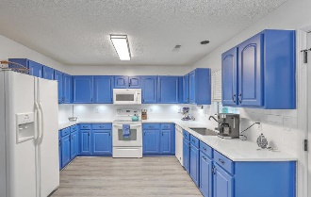
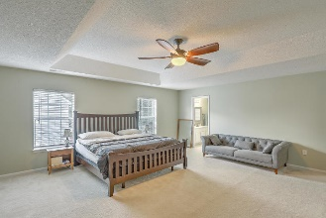
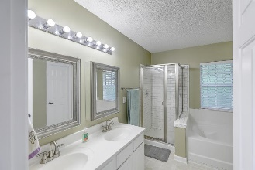
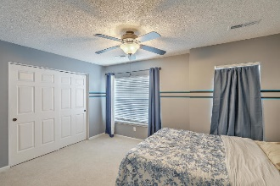
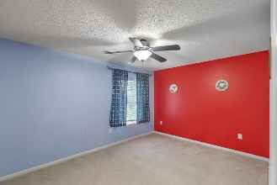
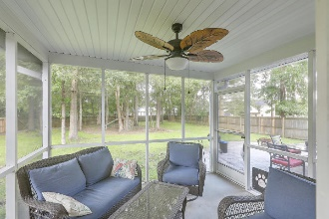
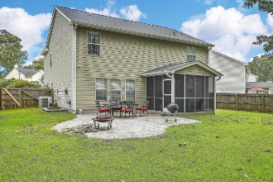
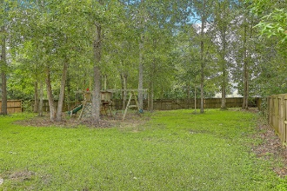

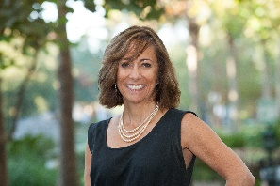
JUST LISTED!
Liberty Hall, Goose Creek | Wonderful 5BR Home
110 Elbow Circle
Liberty Hall Plantation | Goose Creek, SC 29445 | MLS# 20021773 | $272,000
This beautiful, well kept home has plenty of space for all of your needs and just freshly painted and brand new flooring installed, along with 1-yr old roof, it is ready for you to move in! This fully functional floorplan includes a Living Room/Dining Room, Great Room, 1st floor bedroom, which is great for guests and has a full bath adjacent to the bedroom. The updated, open kitchen with large pantry, has plenty of storage and prep space for meals and sleek, hard marble counters, complete with 25 year stain protection, and classic subway tile backsplash. Finishing off the 1st floor is the laundry room which leads out to the garage. Upstairs you will find 4 more bedrooms, including a huge 20x20 Owners Suite with separate tiled shower, garden tub, dual vanities and large walk-in closet. A large hall bath finishes off upstairs. Outside, you have plenty of room outside to entertain with a screened porch, large grilling patio, huge fenced yard, complete with playscape. Liberty Hall Plantation has a wonderful pool and outdoor area for you to enjoy, with lots of sidewalks for you to walk the neighborhood. And, enjoy easy access to Boeing, Volvo, Naval Weapons Station, as well as the downtown shopping.
Virtual Tour: http://vimeo.com/445324766
Desiree Maurer
Office - (843) 416-2000
Mobile - (843) 327-9010
desiree.maurer1@gmail.com
www.yourcharlestonhousesearch.com
Keller Williams Realty
496 Bramson Ct Ste 200
Mt. Pleasant, SC 29464

