Slide 1

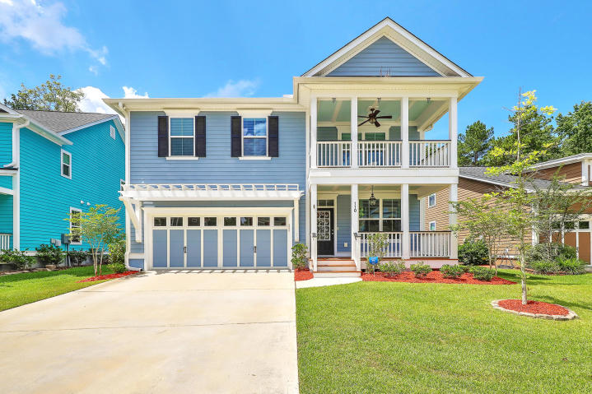
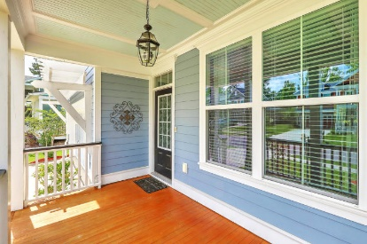
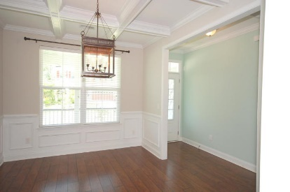
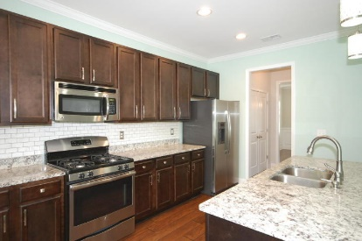
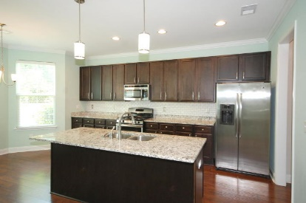
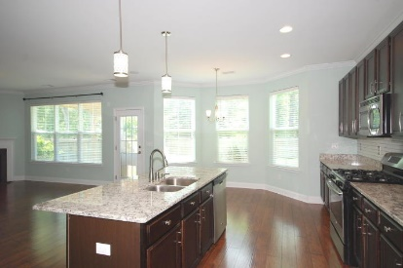
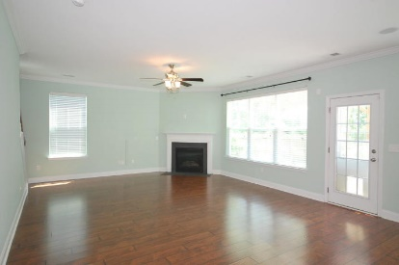
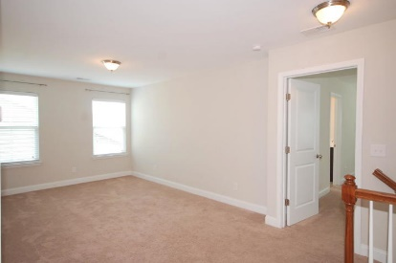
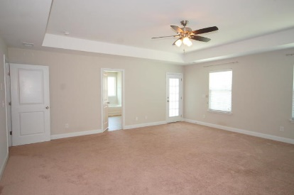
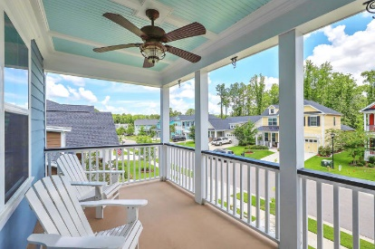
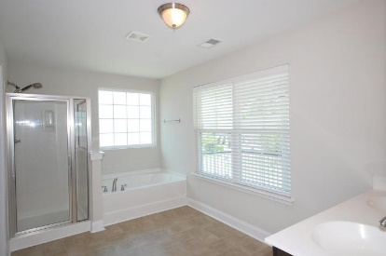
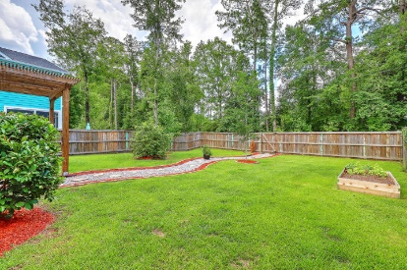
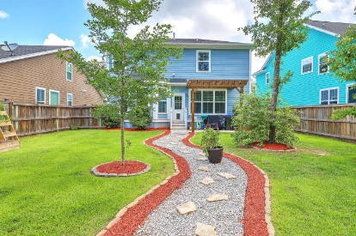
Debbie Cromer
ABR, RSPS, REALTOR, CRS
(843) 437-6342
debbie@debbiecromer.com
www.mylowcountryhomes.com
Offering 3.5%
Commission
110 Evelyn Joy Drive
Branch Creek | Summerville, SC 29483 | MLS# 19018126 | $314,900
Beautifully upgraded 3 bedroom/ 2.5 bath with large loft. From the double front porches to the light filled open floor plan, you notice the thoughtful details. The formal dining room features a coffered ceiling, beautiful wood work and a custom light fixture. In the cook's kitchen, you find ample cabinets, granite countertops, double sink in a large island, stainless steel appliances and a bright sunny eat in area. The living room with gas fireplace has views of the beautifully manicured and privacy fenced backyard. Upstairs you find the loft as well as a huge master bedroom with a large master bath with separate tub and shower as well as two walk-in closets. Two additional bedrooms and a full bath finish out the second floor. All that is missing is you!
Century 21 Properties Plus | 1090 Park West Blvd; Ste 3 | Mount Pleasant, SC 29466

