Slide 1
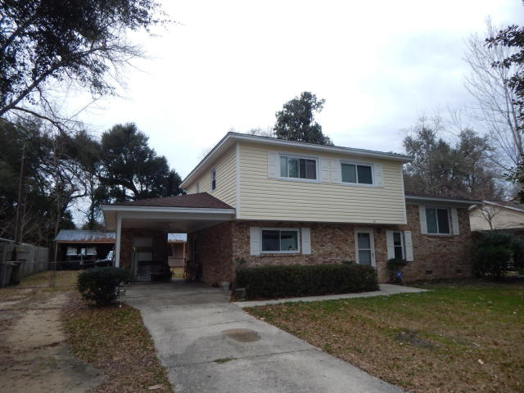
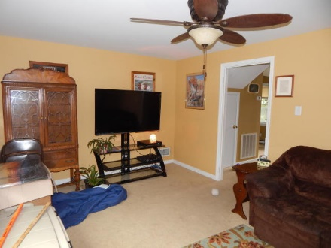
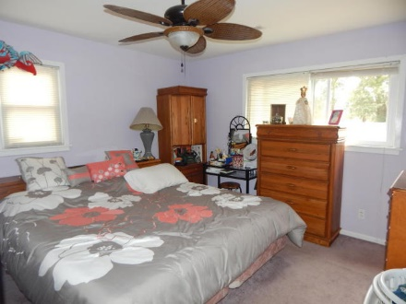
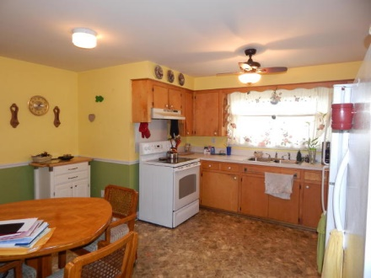
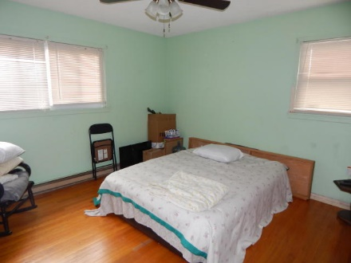
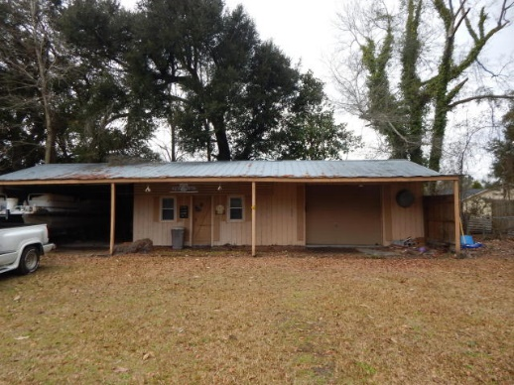
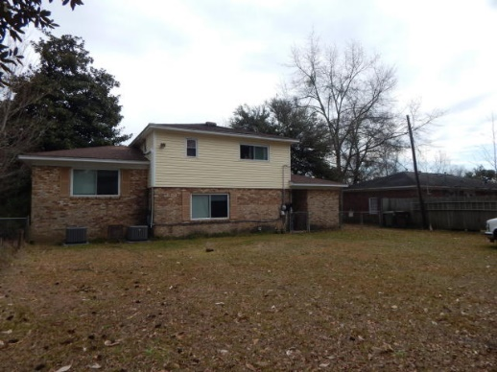
Convenient Location ~ Lots of Room
110 Gibson St
Whitesville
Moncks Corner
MLS# 16004386
$149,000
Wonderful opportunity to own a 3 bedroom home with a large bonus room under $150,000.
Large open kitchen offers lots of cabinets space and plenty of natural light. HUGE bonus room with hardwood floors. Bedrooms 2 and 3 also have hardwood floors.
Enjoy the large fenced in backyard with an awesome garage, storage room and carport. Perfect for a woodworkers workshop or just to tinker around.
This home is conveniently located near the crossroads of 17A and E Main in the heart of Moncks Corner.
Jennifer Laffey-Foster, MRP
Real Estate Agent
Miler Properties
Office: 843-821-1111
Cell: 843-708-1582
jlfoster86@gmail.com
www.milerproperties.com

