Slide 1
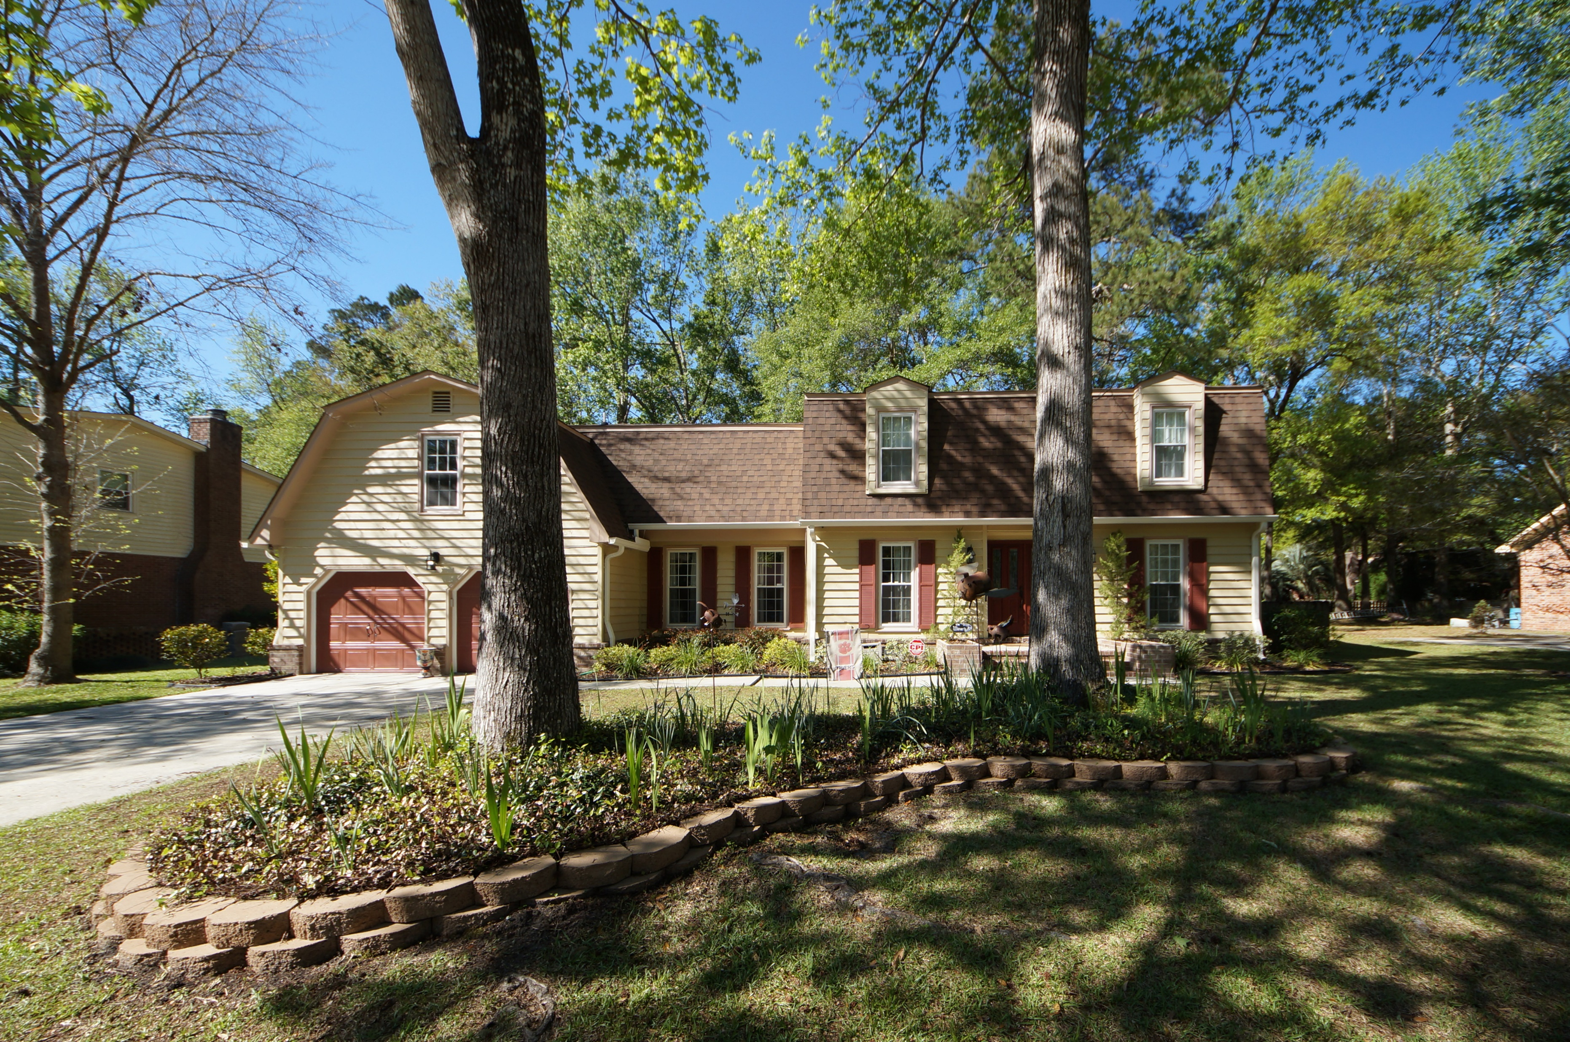
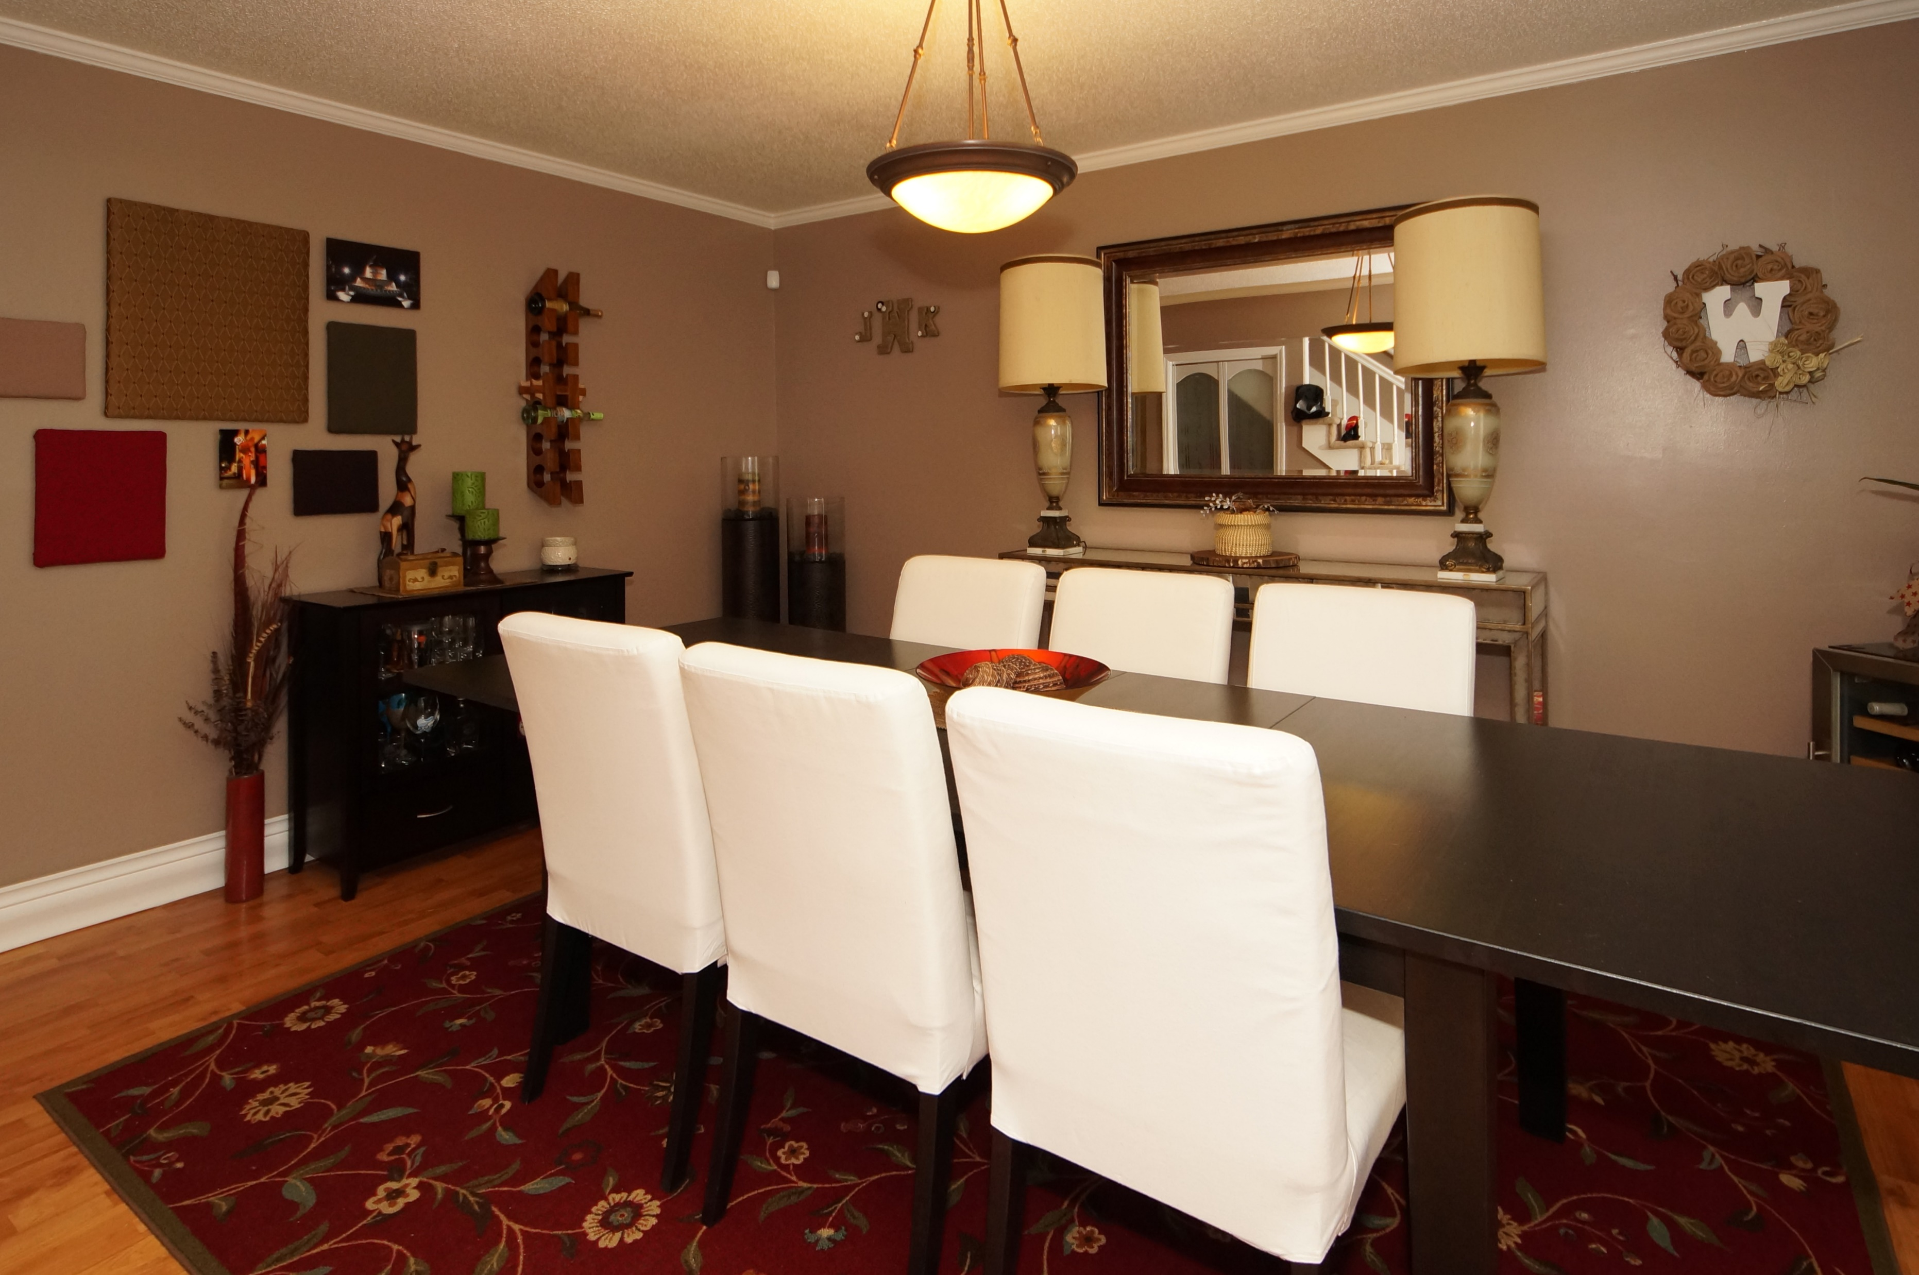
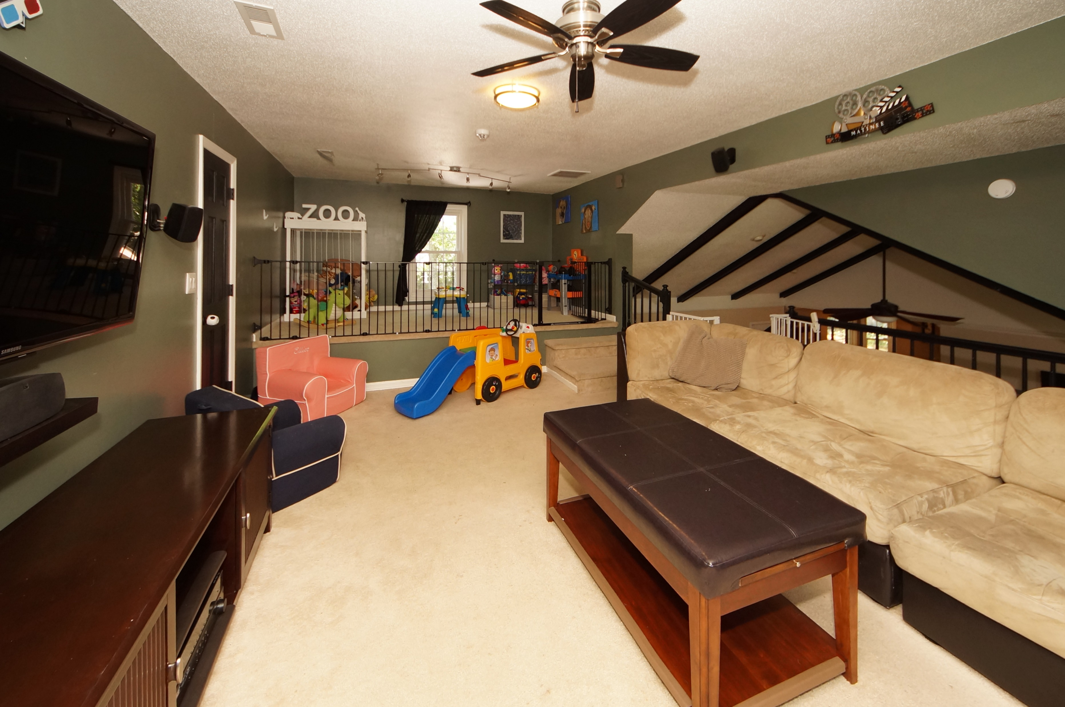
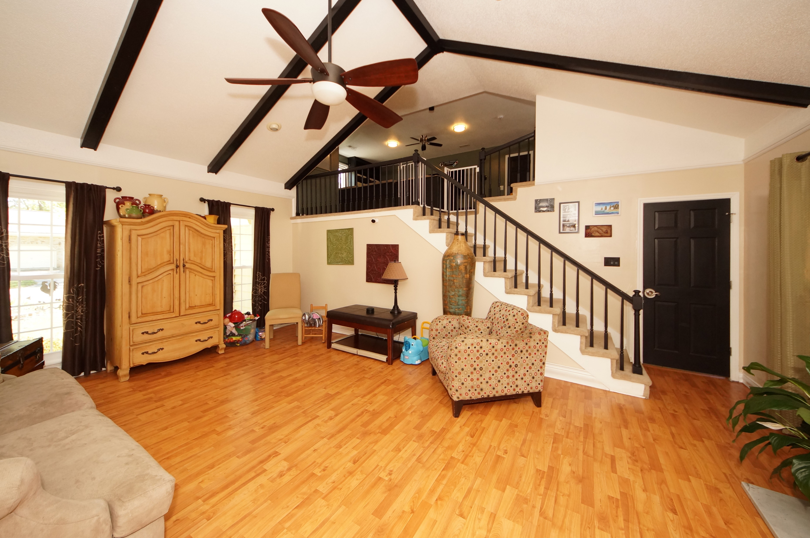
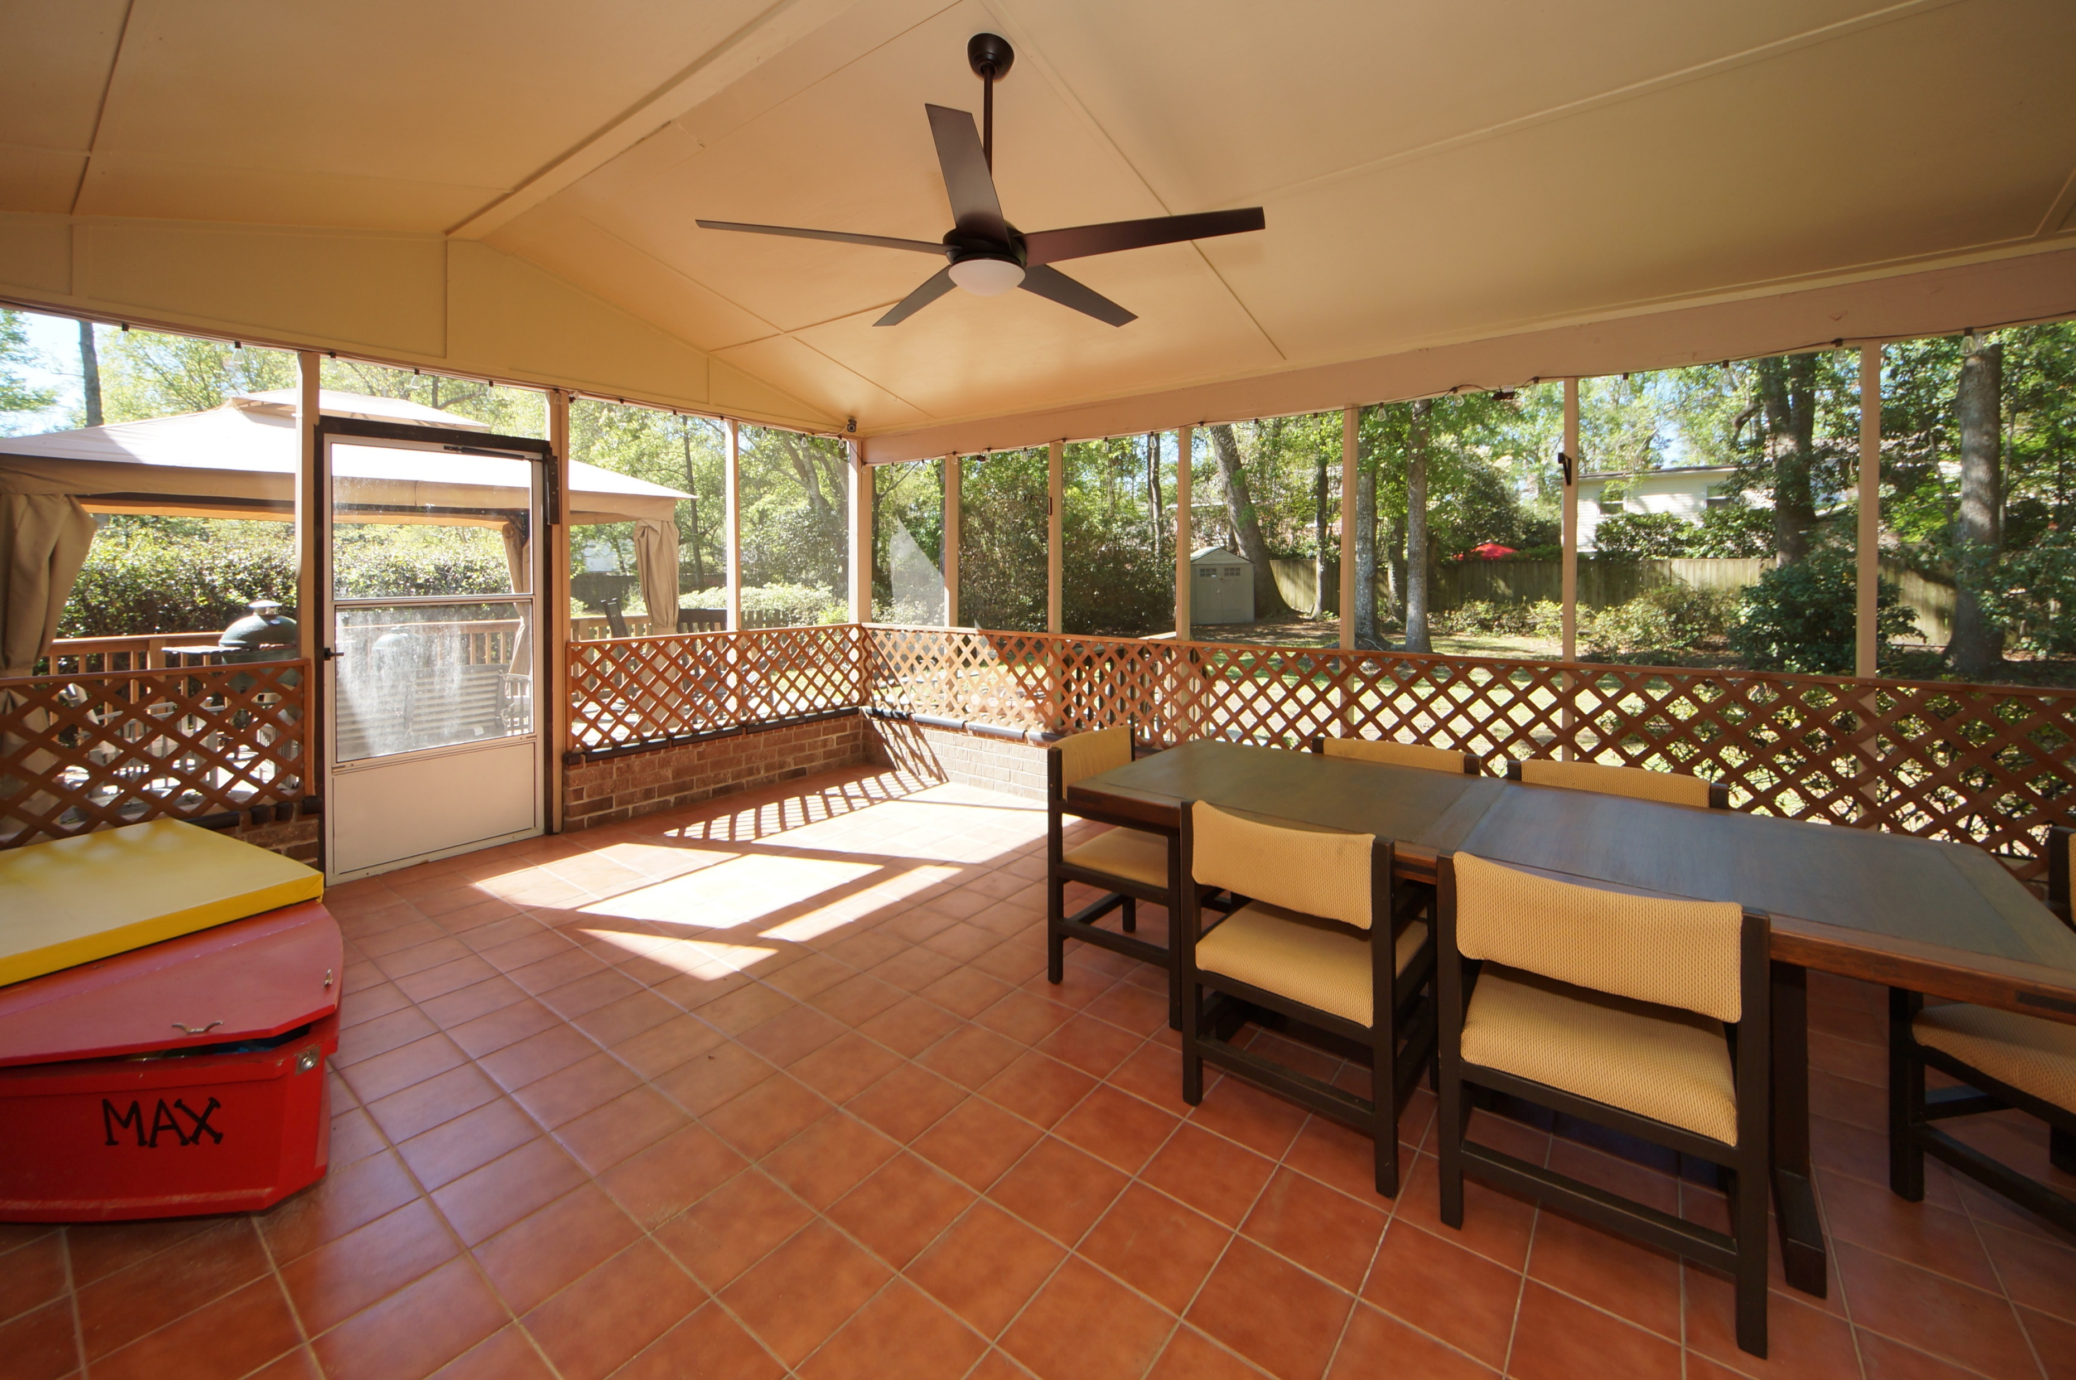
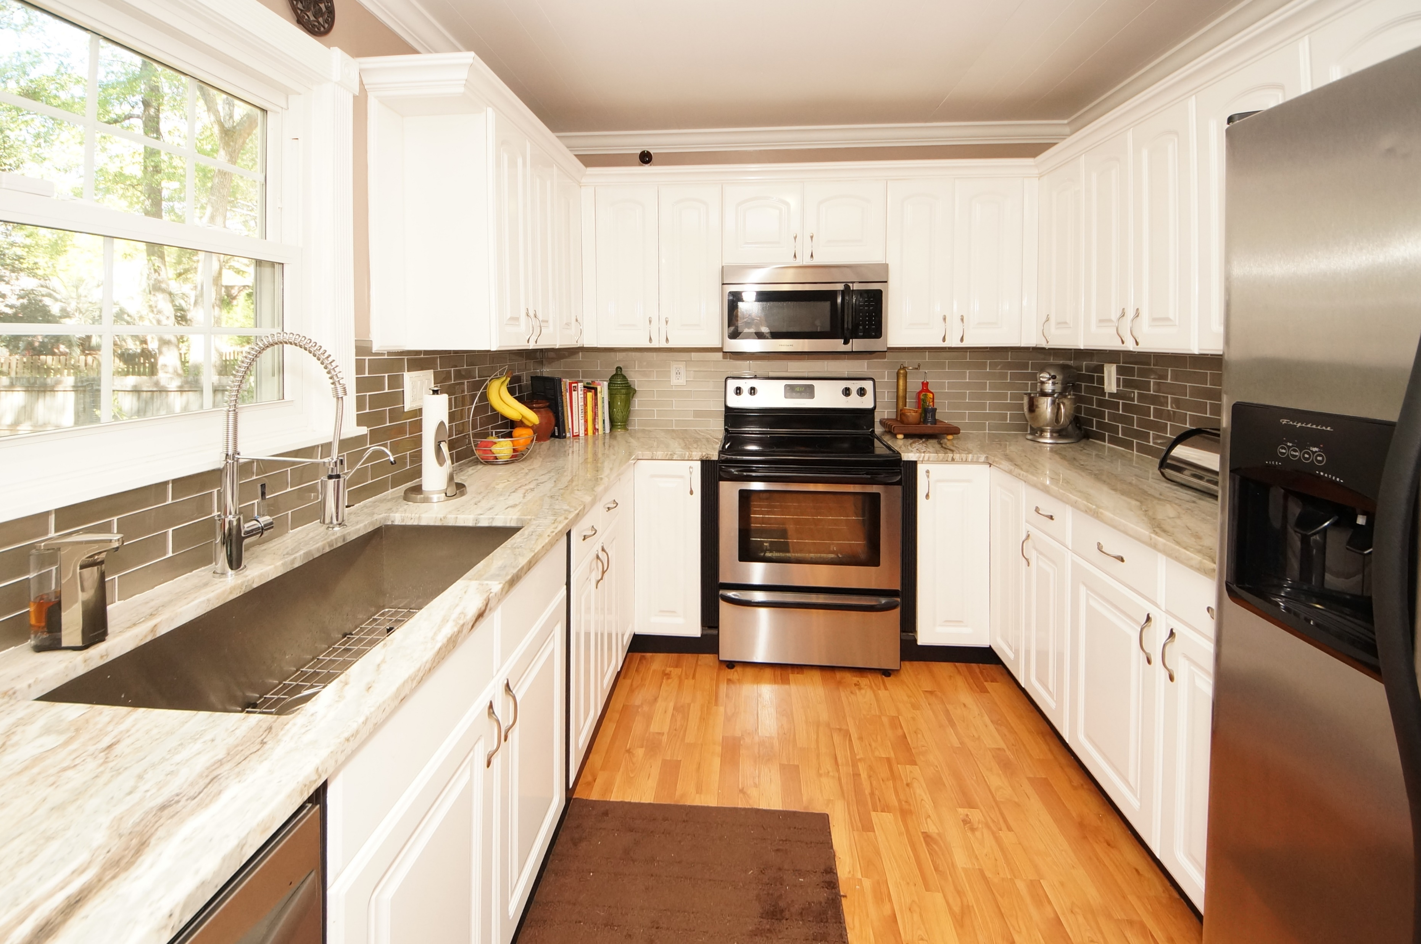
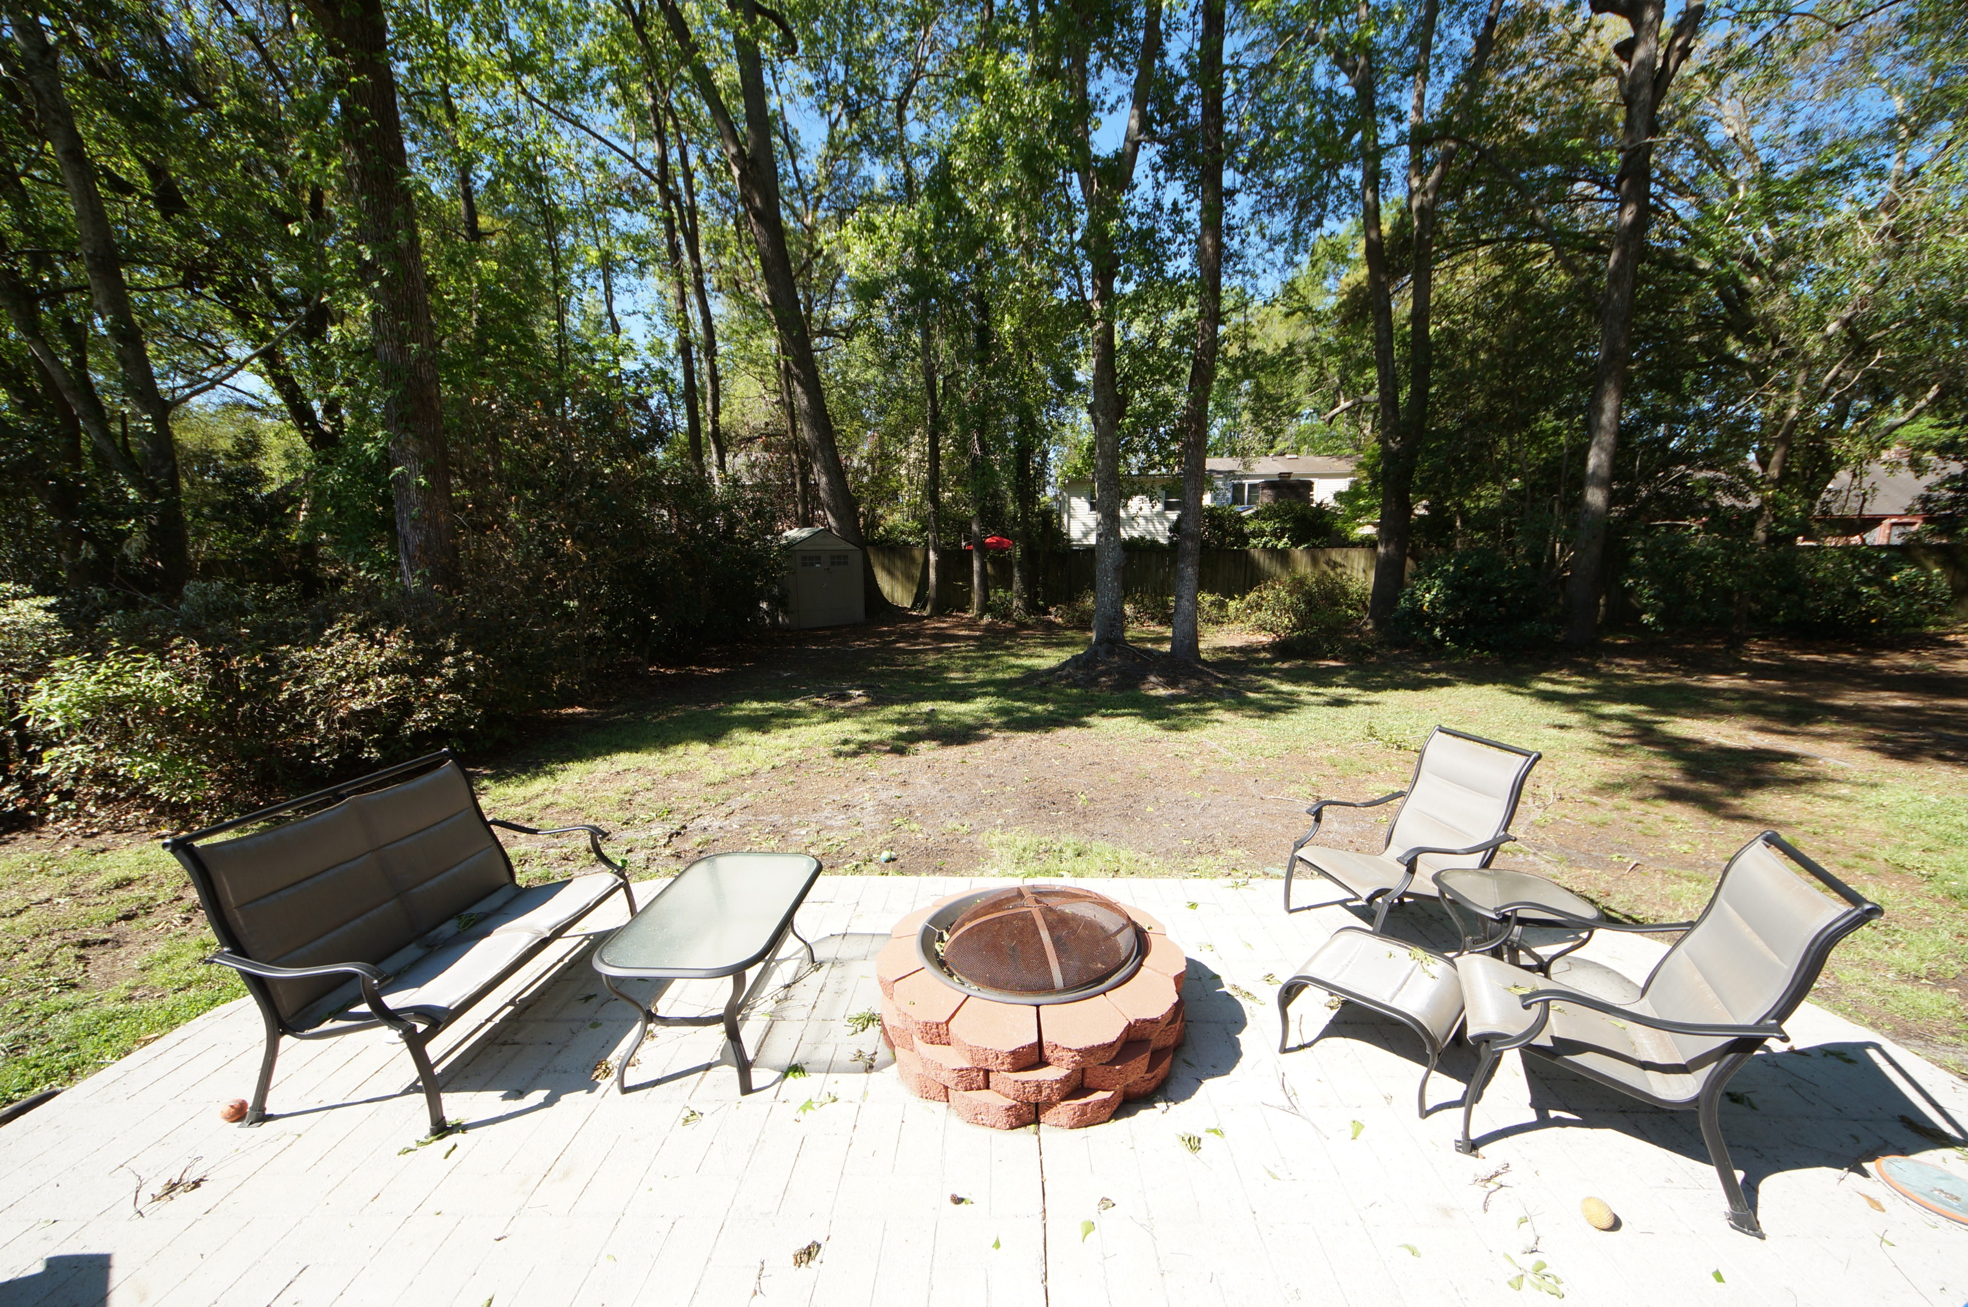


Ashborough Gem Just Listed
110 Heritage Street ~ Summerville ~ MLS# 17010186 ~ $284,900
~Just Listed~ A gem of a home right in the middle of the highly desired neighborhood of Ashborough!!
Do NOT miss this opportunity to buy a move-in ready, updated 4BR, 3BA house with plenty of space to live, grow, and entertain. This home has been well-maintained and has so many upgraded features, they're almost too numerous to list. A brand new double entry front door welcomes you home.
Recent updates, upgrades include a brand new dishwasher (Feb), 8 exterior security video cameras installed (Jan), all smoke detectors replaced (Feb). The two updated bathrooms were gutted to the studs and include new wiring, new plumbing, new drywall, and new fixtures, floors, and tile. The home's plumbing has been updated to PEX (from copper), with the exception of wet bar and master bath.
And that’s just the start…there are too many upgrade and features to mention here. Be sure to read all the details on the MLS!
Tammy Thompson
843-412-1856 tammylthompson@live.com
Keller Williams Realty
496 Bramson Ct Ste 200
Mt. Pleasant, SC 29464

