Slide 1
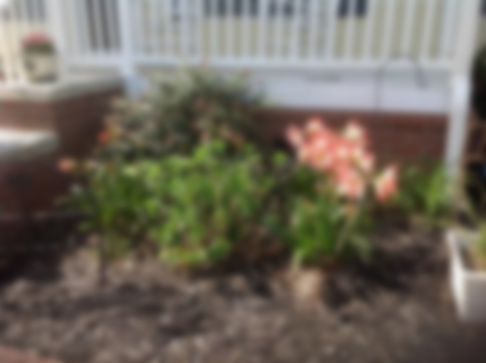
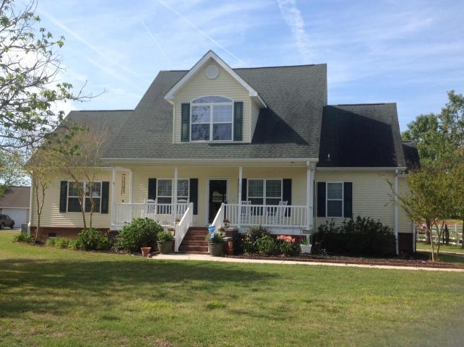
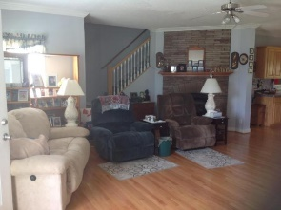
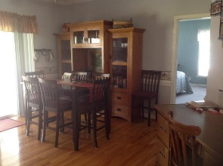
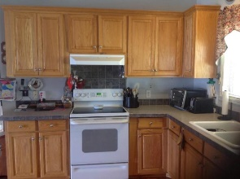
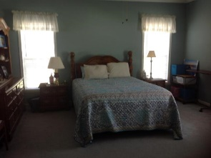
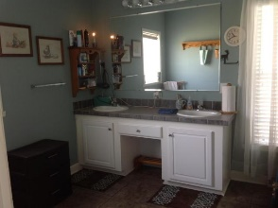
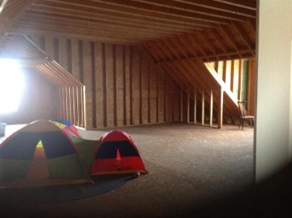
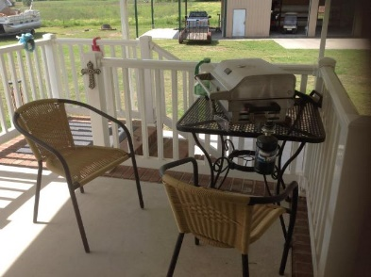
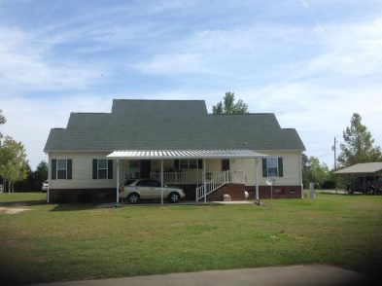
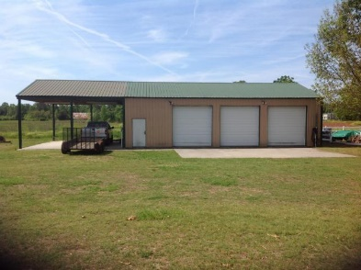

Looking For A House At The Lake With A Huge Workshop?
110 Meredith Drive
Plantation II | Eutawville, SC 29048 | MLS# 17010409 | $235,500
3 Beds | 2½ Baths | 1,953 Square Feet
This immaculate home is less than 5 minutes from Rocks Pond. Bonus space upstairs for more bedrooms, recreation room or whatever you need. The garage/workshop is approximately 1500 sq feet. Three garage doors with openers. Room for storage and workspace.
Carla C Davis
Mobile - (843) 437-4873
gaweber@tds.net
AgentOwned Premiere Group
141 A N. Main Street
Summerville, SC 29483

