Slide 1
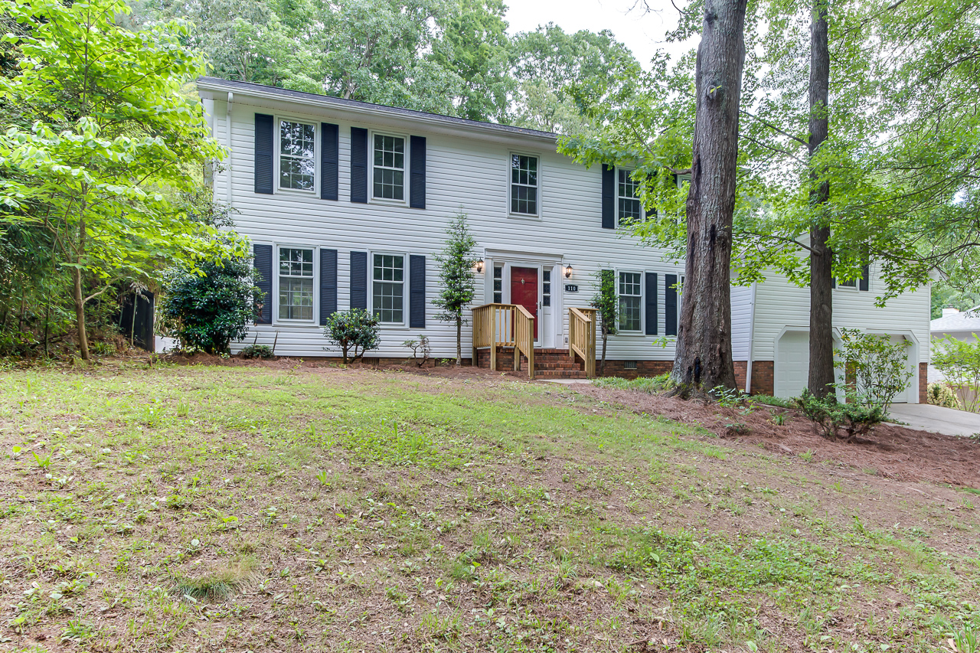
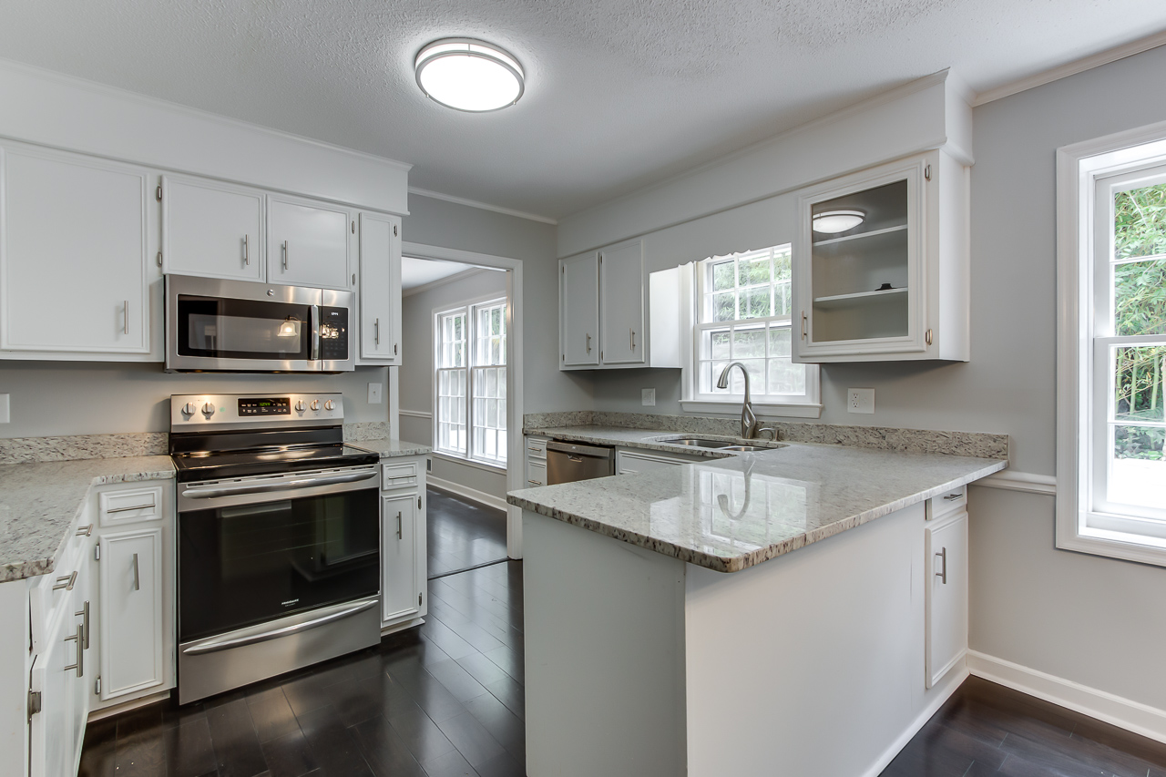
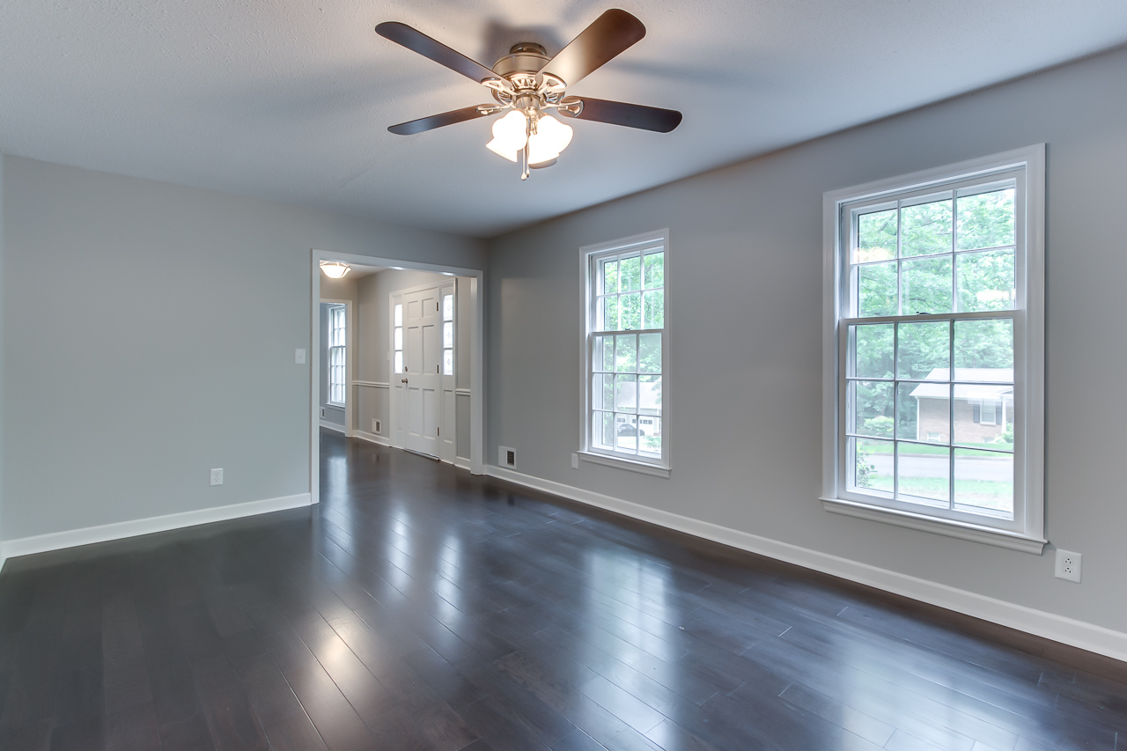
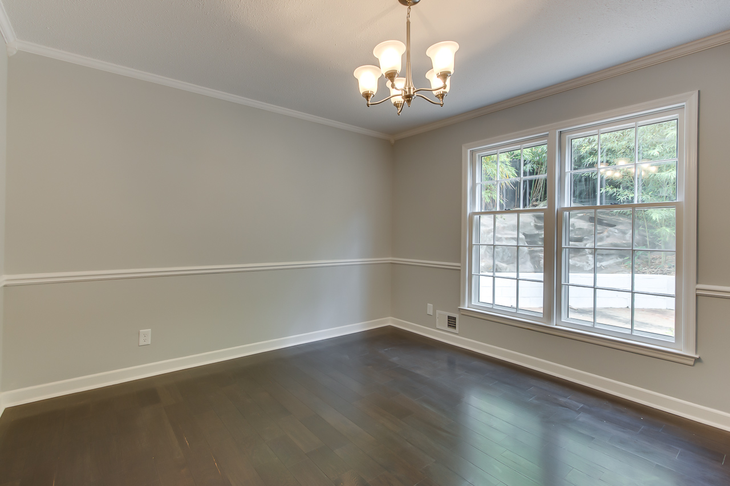
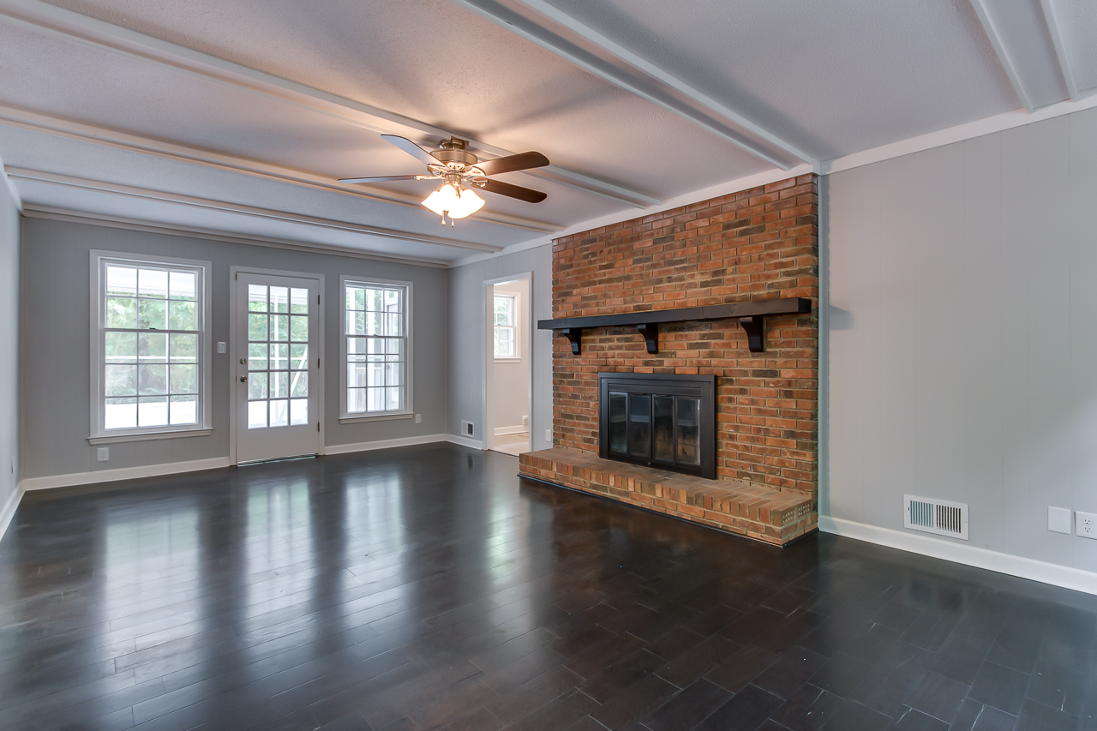
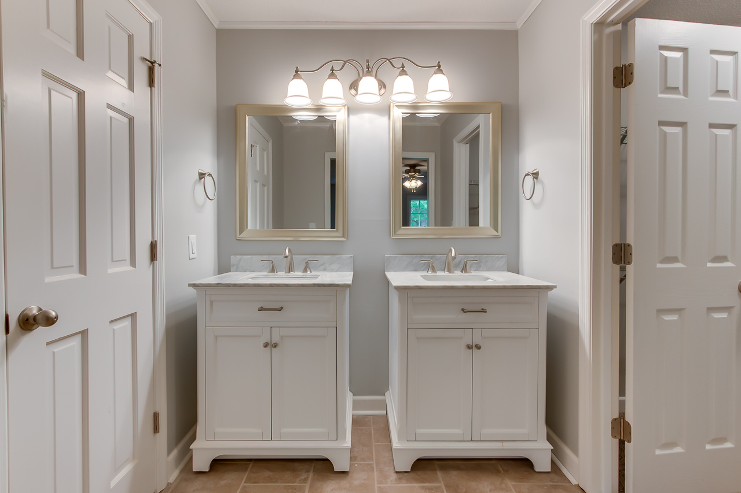
110 Roswell Terrace~ Spartanburg
$200,000
WOW! Just Renovated 4 Bedroom/ 2.5 Bath /2 Car Garage Home on cul-de-sac with large fully privacy fenced yard in Heathwood! New Architectural Roof! New Vinyl Siding & Metal Fascia/Soffit! 2 New HVAC systems! Just Painted! New Premium Lam. Wood Flooring in Living, Dining, Den & Kitchen! New frieze carpet/pad in bedrooms! New Tile in Bathrooms! New Brushed Nickle Ceiling Fans/Lights! Great floor plan with a large living room that connects to Dining Rm and Kitchen/Breakfast area! The Kitchen has ample white cabinets, New Granite countertops, New sink/faucet & New premium Stainless Steel appliances (range/oven, microwave, & dishwasher)! Both the master full bath & hall full bath have New premium vanities/ tops, & Tile showers/tubs. All 4 spacious bedrooms have large closets. A separate indoor laundry room makes for easy convenient laundry days! Large 2 Car garage has extra storage area and freshly painted epoxy floor! Fully privacy fenced yard with mature trees/vegetation and storage shed!
Bedrooms:
Bathrooms:
Sq Ft:
Fence:
Lot Size:
4
2.5
2484
YES
0.37 Acres
Year Built:
New Roof:
New Central Air:
New Heat:
Type of Floors:
1977
2018
2018
2018
Wood, Ceramic Tile, Carpet
Greg Cook
Anchor One Realty, LLC
843-343-3030
gcook@AnchorPropertiesofSC.com

