Slide 1
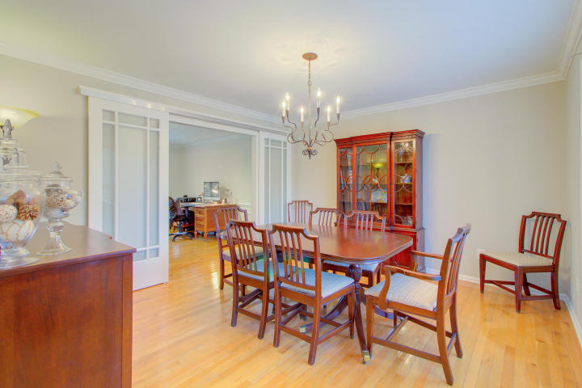
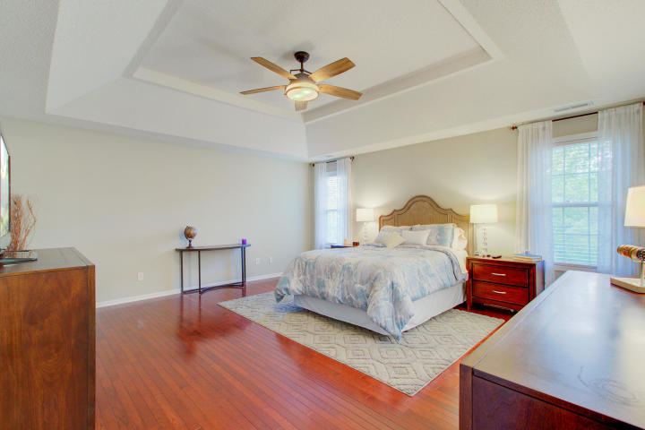
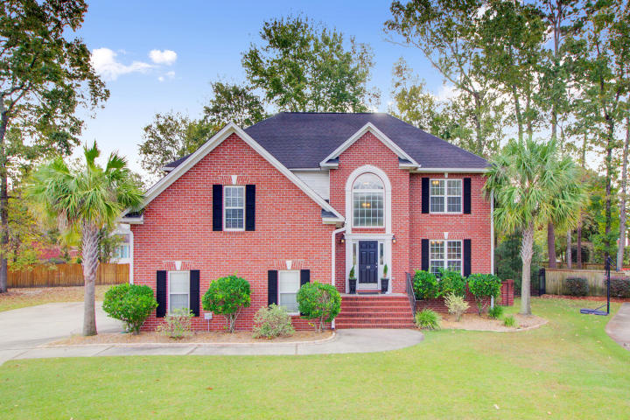
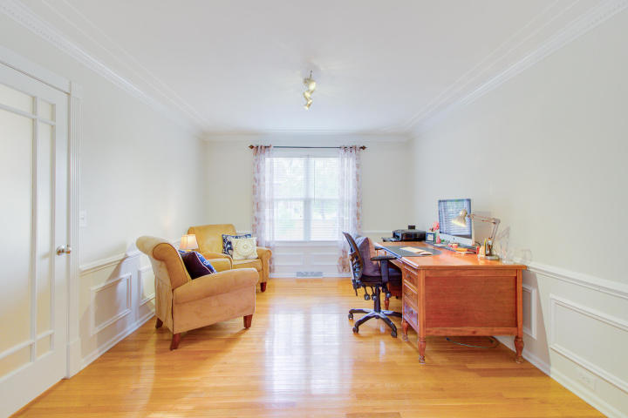
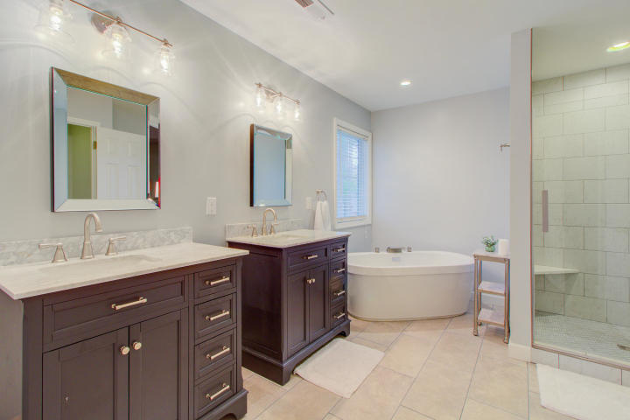
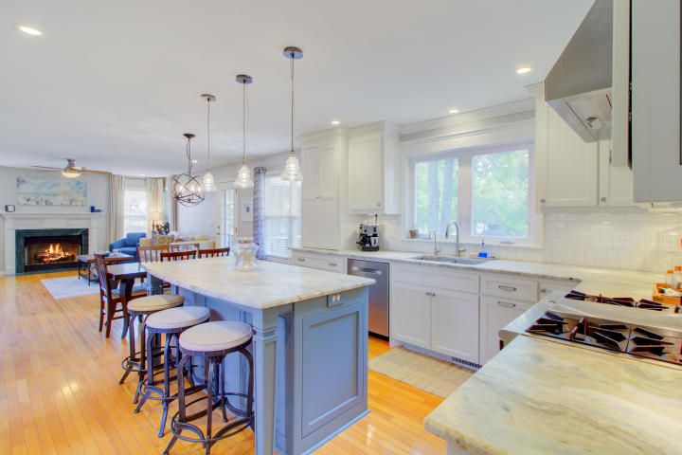
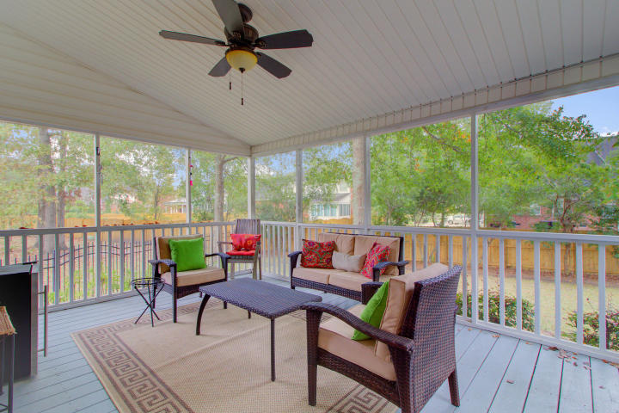
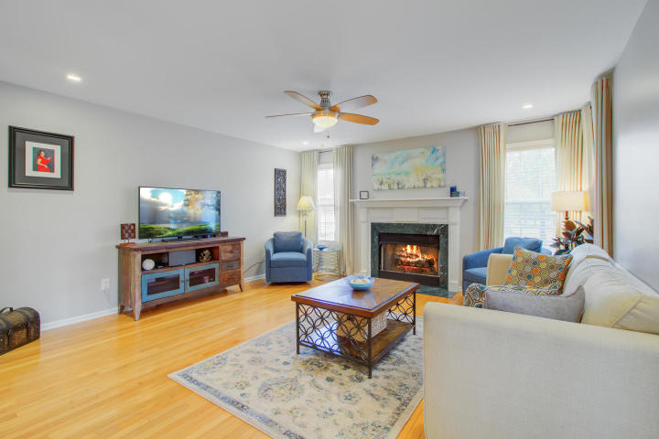
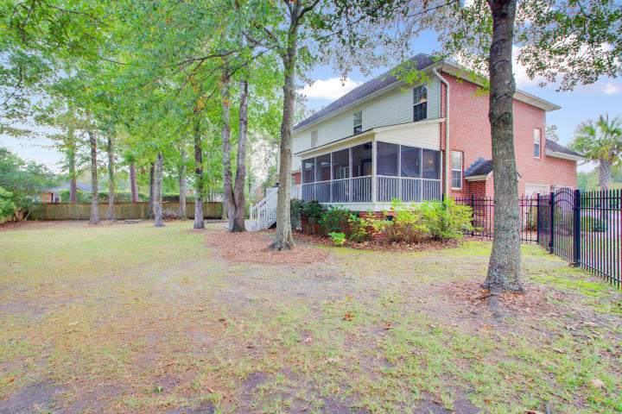


JUST LISTED!! Renovated Four Bedroom Beauty In Desirable Golf Community
110 Sandlings Court
Crowfield Plantation
Goose Creek, SC 29445
MLS# 18030824 ~ $379,000
This is the home you have been waiting for! Located in the Hamlets, the sought after golf community in desirable Crowfield Plantation, you will love this RENOVATED four bedroom beauty! This home is truly move in ready as you can see in the 3D Virtual Tour. The kitchen was recently fully renovated and is absolutely stunning! Bright white custom cabinets and gorgeous quartzite counters are two standout features. The large kitchen island is a beautiful contrast to the bright white cabinets keeping with today's style. It is all about the details in this dream kitchen, with under cabinet lighting, hidden / under cabinet electrical outlets, and soft close cabinet doors and drawers. Stainless steel appliances, including a gas range with hood, refrigerator, wine refrigerator, and dishwasher. The owners spared no expense with the installation of the high end Liebherr Refrigerator Freezer with Biofresh advanced technology. It provides optimal food storage preserving freshness and taste longer. DuoCooling Technology creates ideal conditions in the refrigerator and freezer compartments. The chef in the house will simply love cooking on the high end gas stove with griddle! The eat in kitchen overlooks the family room with gas fireplace providing the open concept living that is appreciated by families and is perfect for entertaining. There is a formal dining room as well as a home office or den also on the main level. The home office can be closed off from the dining room and kitchen with rolling doors and a conventional door, each with glass allowing light to flow into the office while providing privacy at the same time. As you walk through the home you cannot help but appreciate the fine details including gleaming hardwood floors, crown molding, wall panels in the office and upgraded light fixtures all bringing this home up to modern style while maintaining elegance in this traditional two story brick home. Traveling upstairs, you will quickly notice that there are hardwood floors throughout all bedrooms and that the FROG (also serving as a 4th bedroom) is the only carpeted room in the home. The master bedroom is the ideal owner's retreat boasting a tray ceiling and his and her closets. Step inside the master bath and appreciate the spa like setting. This recent renovation was completed with a vision of luxury and relaxation in mind. Dual vanities, beautiful tile flooring, a luxurious tile shower with a free standing tub comprise this thoughtfully planned and executed upgraded bath. The second and third guest bedrooms are generously sized and share a bath in the hall. The large FROG is the 4th bedroom. The only carpeted room in the house, this space has abundant storage and if not needed as a bedroom, would make a fantastic bonus room, play room, hobby room or anything else your creative mind can think of. This versatile floor plan is ideal. Please note, there are two new AC units (Downstairs replaced mid year 2017 and upstairs in August 2018) and three NEST thermostats which can be controlled via the internet. The FROG has its own thermostat in addition to the upstairs and downstairs zones. 110 Sandlings Ct. is a four sided brick home situated at the end of a cul de sac. It has a side loading garage and very large back yard as a result of being on the cul de sac. The yard has several mature trees that not only add to its beauty, but provide much desired shade that makes your time outdoors and on the porch most enjoyable. A large screened porch offers an additional living space overlooking the private back yard. There is also a beautiful deck and large concrete patio, each perfect for grilling and additional outdoor seating. The back yard is completely enclosed with fencing yet views of the golf course are still available from the screened porch and back yard. This beautifully renovated home with tasteful colors and decor throughout is ready for its new owners. Nothing needs to be done here! Take advantage of this rare opportunity and schedule your appointment to see this stunning home that is a true stand out in this premier location!
3D Walk thru tour: https://my.matterport.com/show/?m=xrASG1bDNmn
Ellen O'Neil
Broker/Owner, ABR, e-PRO, CNE
Charleston Realtor of Distinction
(843) 300-8530
www.EllenONeilProperties.com

