Slide 1
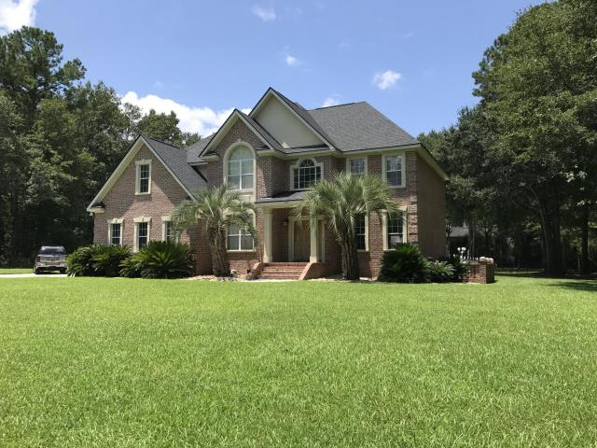
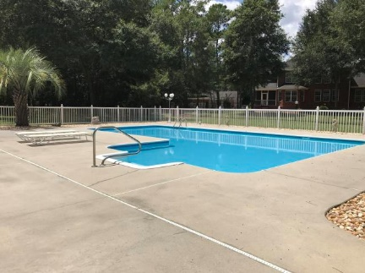
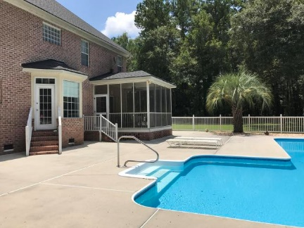
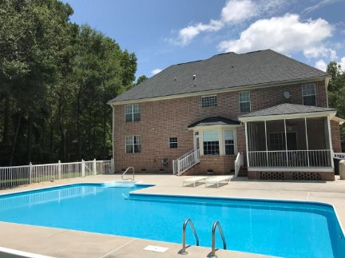
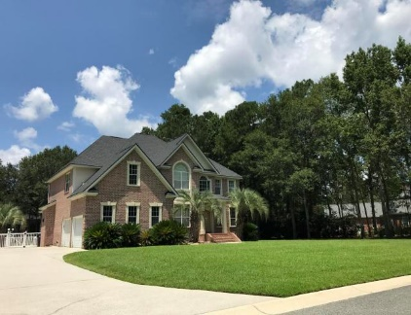


In-ground Pool! Low HOA fees in Summerville!
110 Springbrook Court
Walnut Farms
Summerville, SC 29485
MLS# 17026035
$425,000
5 Bedrooms | 4 Baths | 3,184 sf
Curb appeal galore and an in ground pool in the gorgeous, sought after neighborhood of Walnut Farms! This well built custom home is on almost an acre of land, located on a cul-de-sac street and offers tons of privacy. The first floor has a guest bedroom with a full bathroom in the hall. The formal living can be used as an office and even has a door for added privacy. The dining room is a great size and is located directly off the kitchen. The kitchen has tons of cabinet space, double ovens, island with gas cooktop, desk area, eat in kitchen area all overlooking the family room. The family room has a gas fireplace and access to the large screened in porch. Upstairs, you'll find a large master. The master bath has new flooring, dual vanities, walk in closet, separate tub and shower.
Down the hall from the master is three large bedrooms. One bedroom has its own full bath! The other two bedrooms, both with tons of closet space, share a hall bath. Back in the hall, you'll find the laundry room with a utility sink. Then, the huge bonus room which has so many possibilities...game room, work out room, media room, the choice is yours! The backyard is an oasis with a gorgeous in ground swimming pool. Large patio, outdoor shower and gas hookup for a grill make this backyard ideal for outdoor living! Walnut Farms is a great neighborhood with very low HOA fees! All homes are on large lots offering tons of privacy. The neighborhood is just a short drive to the AFB, Boeing, Palmetto Commerce area, Bosch - and there is tons of shopping nearby. This home is just waiting for the perfect buyer to make it their own!
Larry & Kathy Mazalatis
Larry Cell 843-693-0529
Kathy Cell 843-693-0159
Office 843-871-9133
AGENTOWNED PREMIERE GROUP | 1800 TROLLEY RD | SUMMERVILLE, SC 29485

