Slide 1
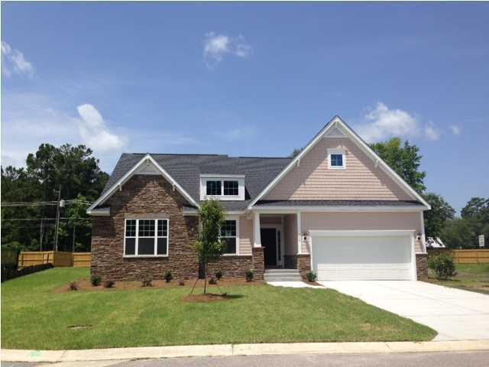
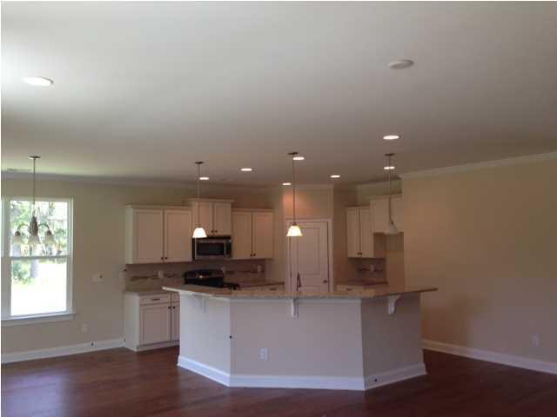
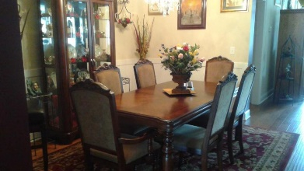
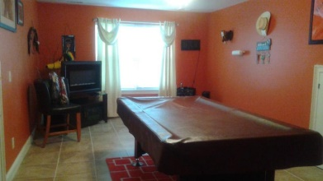
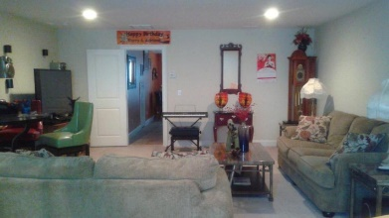
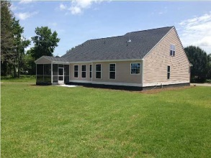

110 Wachovia Court Summerville MLS# 16025454 $355,000
Two-year old Ranch in Ashley Forest
Fantastic Woodlief single-story with loft available now. This two-year-old house has an open floor plan with lots of privacy. With a split floor plan, the separate master bedroom has a quaint bath with soaker tub and shower plus there is a huge walk-in closet for one or couple to easily share. Two secondary bedrooms share a Jack & Jill bathroom with double sinks.
The kitchen is convenient with pantry and stainless steel appliances, including a gas range. Family room has great space for entertaining. Also on the main level is a study for a home office or small gym. A huge loft upstairs provides additional entertainment space with a separate room ideal for a man cave or create a 4th bedroom. Nice two-year-old storage shed stays. Privacy fence installed and extended drive added by owner.
Linda Brown
BIC, REALTOR, GRI
Mobile - (843) 343-9147
linda@trinitypropertiesone.com
Trinity Properties of Charleston
846-D Dupont Road
Charleston, SC 29407
www.trinitypropertiesone.com

