Slide 1
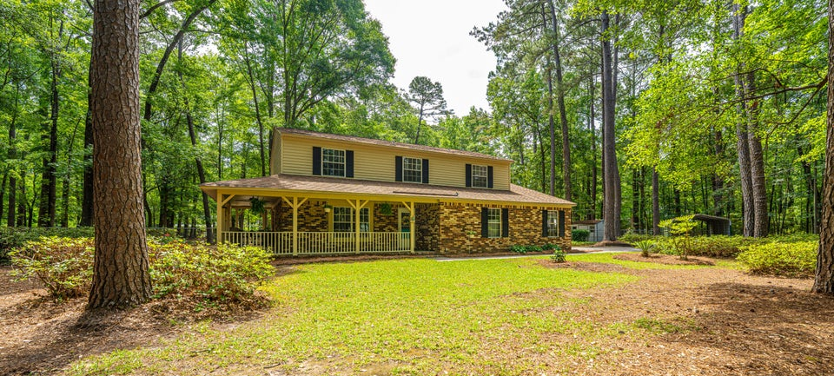
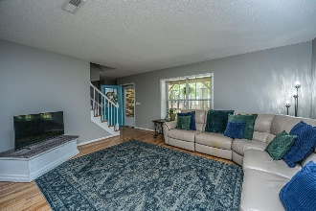
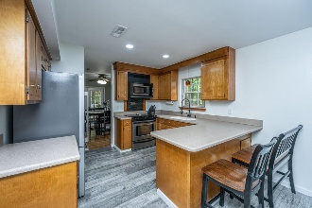
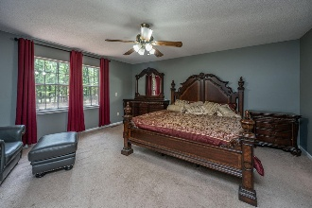
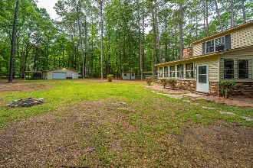
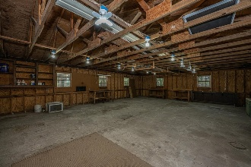

110 Cantering Hills Lane Cantering Hills · Summerville, SC 29483 · MLS# 25027313 · $625,000
Open House Fri Jan 2nd 12pm to 2pm
3.02 Acres, NO HOA and Not in City Limits, New roof, 2 car garage and 4 car garage, 3 miles from Hutchinson Square
NO HOA, 3.02 Acres, New Roof and NOT in the City Limits of the Town of Summerville. Really? What are you waiting for? 110 Cantering Hills Lane, situated on an expansive 3.02 acres that boasts a plethora of trees for privacy, conveniently located just three miles from Hutchinson Square in Downtown Summerville. It is also within minutes of grocery stores, restaurants, shopping centers, and numerous other amenities. Upon entering the residence, you will be greeted by a wraparound full front porch featuring two entrances. The ground floor comprises a separate living room, dining room, and an open family room which leads to an enclosed sunroom (this room is not included in the overall square footage as it is not climate-controlled).
The kitchen is conveniently positioned between the dining room and the family room, making it ideal for entertainment. The upper level houses a generously sized primary bedroom with a built-in desk area, a walk-in closet, and an en-suite bathroom equipped with a garden soaking tub, a walk-in shower, and dual sink vanity. Additionally, there are two more bedrooms, a full bathroom, and a laundry room completing the second floor. Outside, you will find a detached garage/workshop (28'3"W x 36'4"L) with its own electric meter providing 220 electric service and a dedicated water line. The Garage can hold upto 4 cars. In addition, there are two carports and a shed. The backyard is fully fenced, estimated to encompass over one acre. Do not miss the opportunity to explore this exceptional property; you will not be disappointed.
Nickole Samios
(843) 330-4136
nickole@carolinaone.com
Carolina One Real Estate
900 N Main St
Summerville, SC 29483
www.summervillesouthcarolinahomes.com

