Slide 1
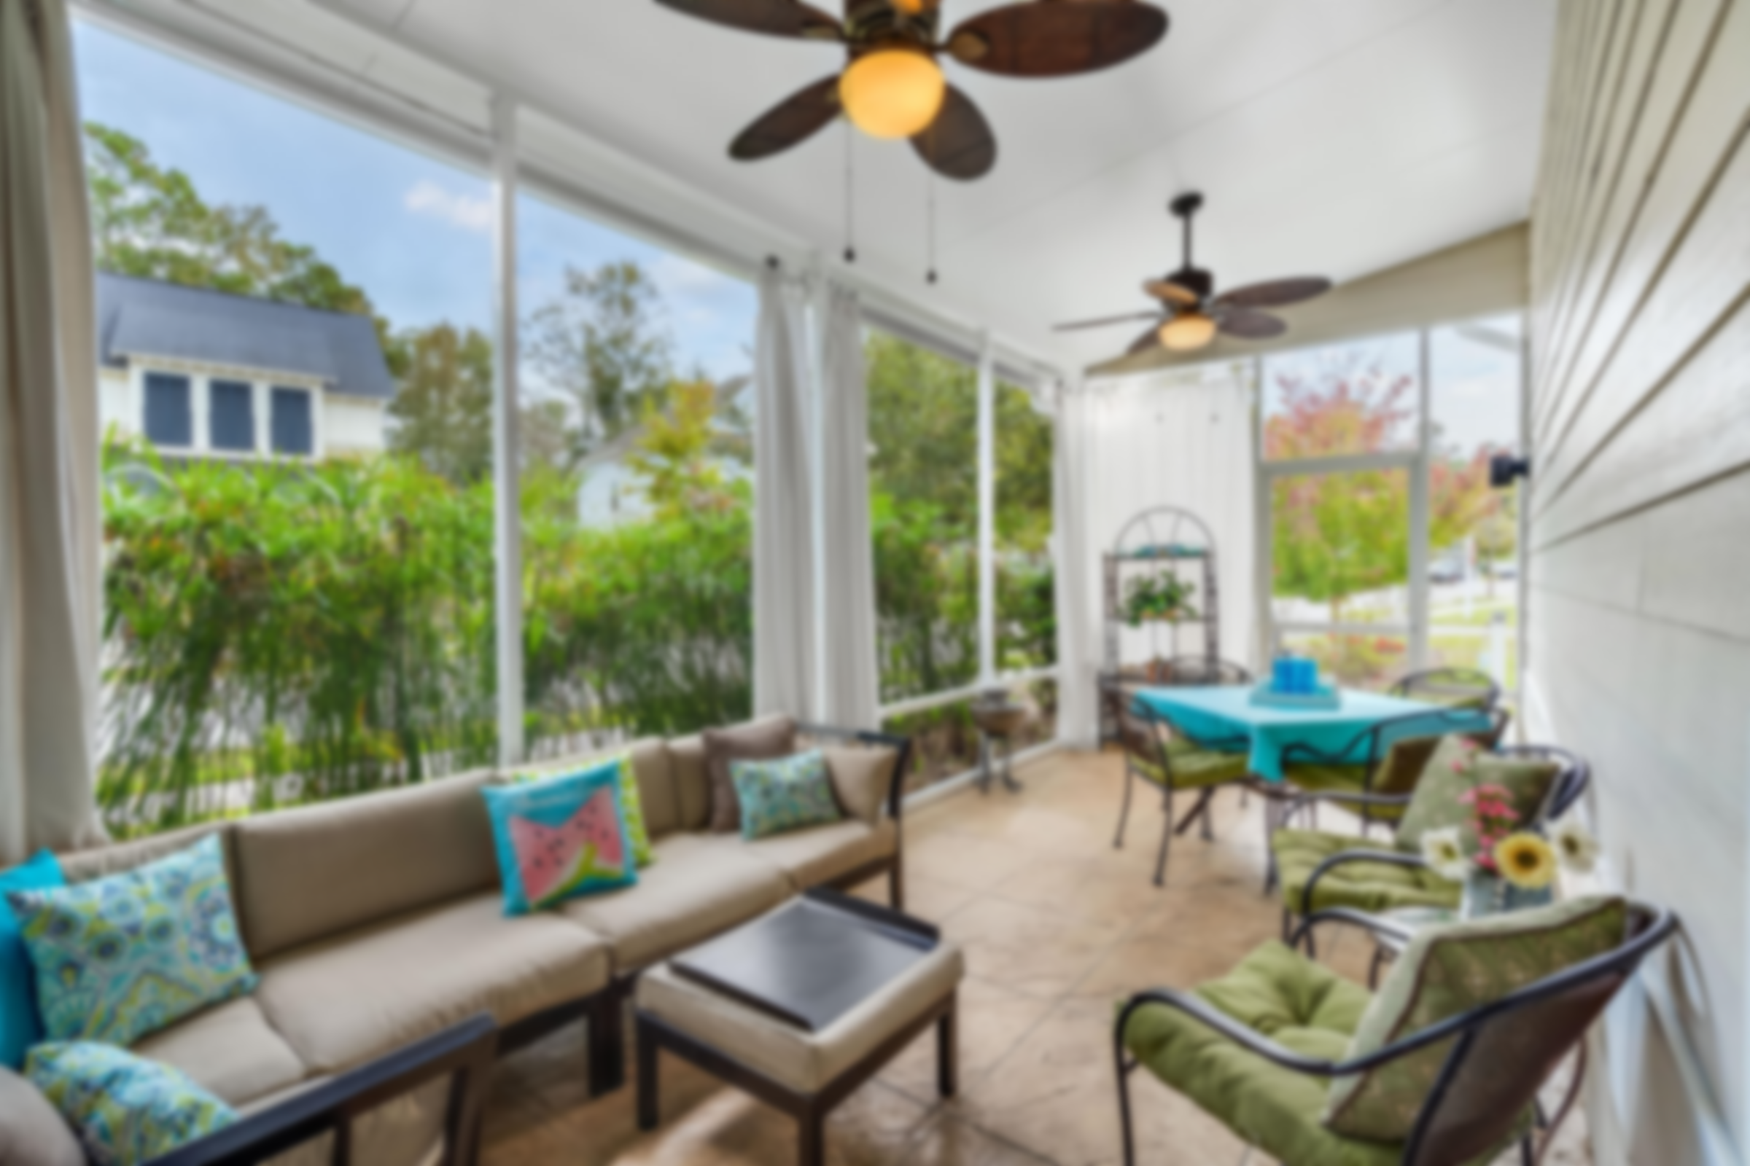
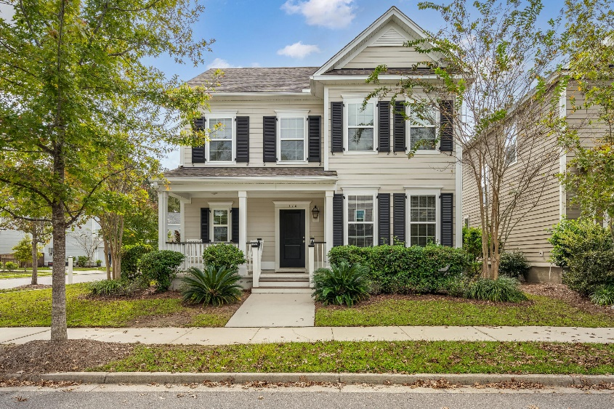
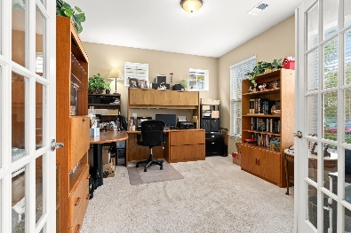
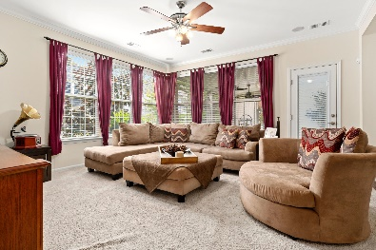
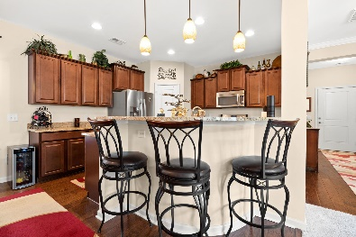
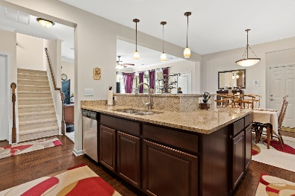
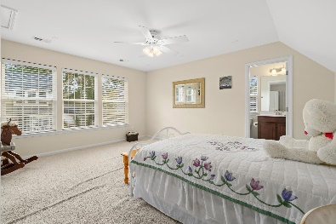
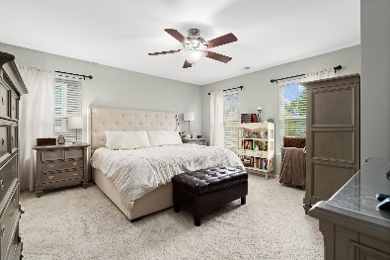

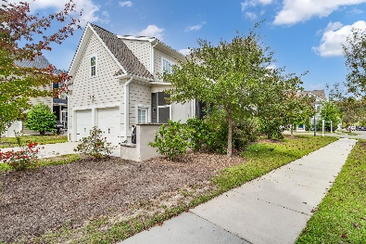

Open House Thursday 11a-2p
Check Out This Beautiful New Home
And Enjoy A Light Lunch
110 Green Grass Road
The Ponds
Summerville, SC 29483
MLS# 20030166
$369,900
A Must See!!
2 story Gorgeous corner lot home In the coveted subdivision of The Ponds. Dorchester 2 School District. This Beautiful 4 bed 3.5 bath boasts of a Gas lantern at entry, granite counters, Upgraded Range with convection option, tankless water heater, smooth ceilings, gutters for proper drainage, New Walk-in master shower, Frog w full Bath, office, as well a gorgeous stamped concrete sun room, tucked inside beautiful landscaping.
Also, offering a possible $2000.00 Carpet allowance. Schedule your appointment today.
Video tour:
https://vimeo.com/471845170
Susie Hummer
843-737-2132
susiehummerrealtor@gmail.com
The Boulevard Company, LLC
806 Johnnie Dodds Blvd Ste 100
Mt Pleasant, SC 29464
www. susiesellssummerville.com

