Slide 1
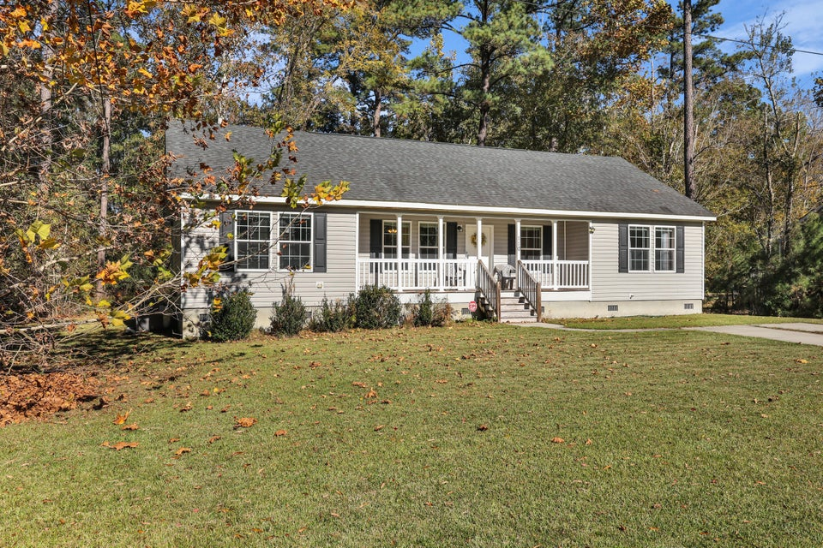
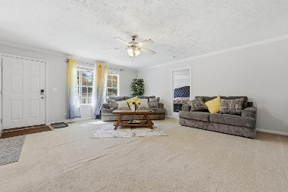
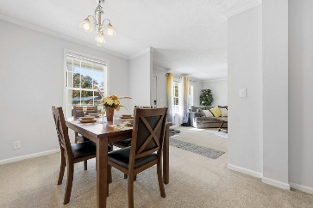
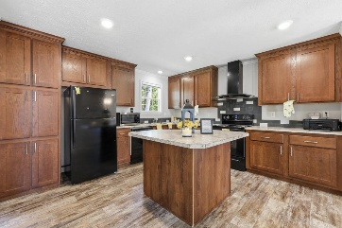
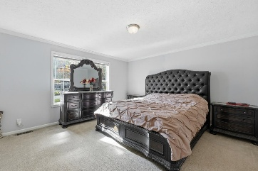
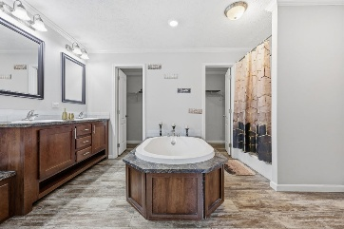
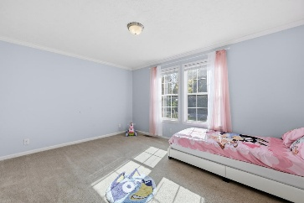
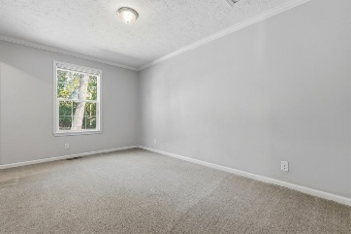
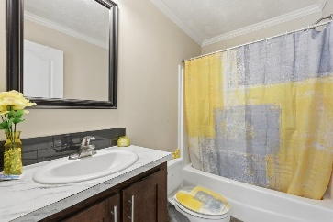
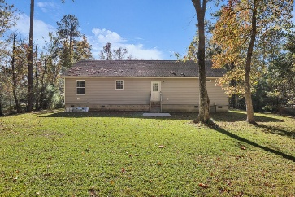
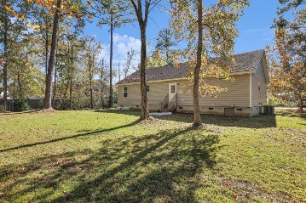

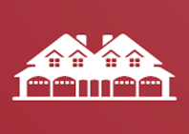

2016 Home in Heart of Ridgeville
110 Kay Street
Ridgeville, SC 29472
MLS# 25030162
$305,000
3 Beds | 2 Baths | 1,588 SF
Welcome to 110 Kay Street, a 3-bed, 2-bath 2016 modular home offering modern comfort and small-town charm. Sitting on nearly half an acre, this property features a welcoming front porch perfect for relaxing and enjoying quiet Lowcountry evenings. Inside, you'll find a spacious open layout, a large primary suite with dual vanities, separate tub and shower, and two oversized guest bedrooms — each with its own walk-in closet. The home also includes a seperate laundry area and plenty of storage throughout. Enjoy easy access to nearby conveniences including the Walmart Neighborhood Market, local schools, Carter's Truck Stop, and downtown Ridgeville. Makes a great primary residence or investment property! Come take a look today. Washer, dryer and microwave do not convey.
Nick Mazzilli 843-640-5575
nick@themazzilliteam.com
sellmyhousecharlestonsc.com
The Mazzilli Team
3427 W Montague Ave
Suite 6
North Charleston, SC 29418

