Slide 1
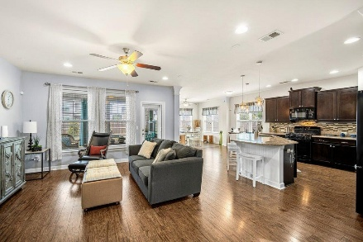
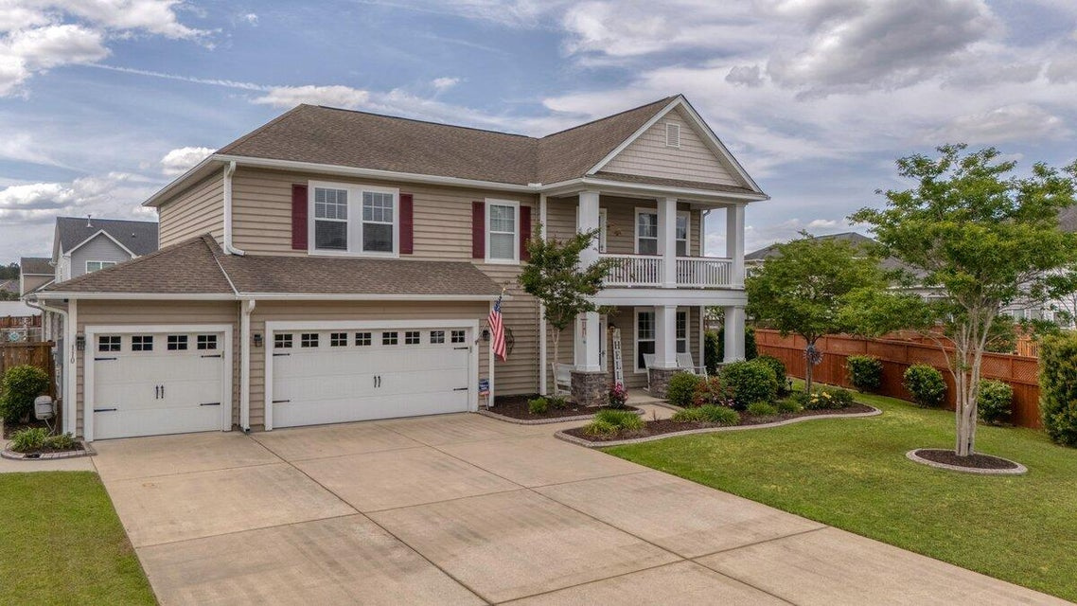
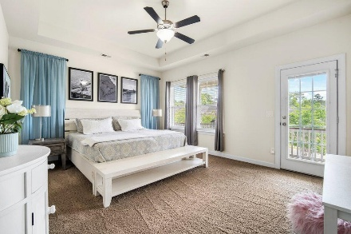
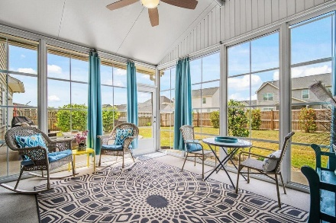

110 Ricewood Lane Foxbank Plantation | Moncks Corner, SC 29461 | MLS# 25011362 | $469,000
Darrell Creek Elevated Home With Elevator & Salt Pool
Add this Foxbank Plantation Home to your Buyer's Weekend Tour
4-Bedroom. 4-Car Garage, $469,000, 4 Your Client!!!
Co-hosting with Lisa Wood from Crown Home Mortgage
Offering $2500
Lender Credit
Welcome to 110 Ricewood Ln-A Stunning Home in the Sought-After Lakeside Community of Foxbank Plantation. Crafted by renowned builder David Weekley Homes, this beautifully designed 4-bedroom, 3-bathroom, and rare 4-car garage residence offers a blend of luxury, craftsmanship, and functionality. Nestled on an oversized .27-acre double lot, this home boasts charming double front porches, perfect for morning coffee or winding down with a cool evening breeze. As you step through the front door, you're greeted by 9-foot ceilings, gleaming luxury vinyl plank flooring, and an immediate sense of quality and sophistication. To the right, the formal dining room awaits, which is also ideal for a home office, or cozy den. The open-concept living area flows effortlessly into the heart of the home- the spacious living room and chef's dream kitchen featuring a large island, granite countertops, custom tile backsplash, gas range, and abundant cabinetry and pantry space. Whether you're prepping meals or entertaining guests, this kitchen is sure to impress. Adjacent to the kitchen is a light-filled sunroom, perfect as a breakfast nook or a vibrant gathering space. From here, step out to the expansive screened-in porch with vinyl windows, where you can dine under the breeze of the ceiling fan, or head out to the adjoining patio to grill and enjoy a meal al fresco! This outdoor setup is ideal for year-round entertaining. The fully fenced backyard offers ample space for pets, play, or gardening, making it perfect for the entire family! Also on the main level is a spacious guest suite with its own private full bath, offering comfort and privacy for visitors or multi-generational living. A stairlift is thoughtfully installed and will convey at no additional cost if desired.
Upstairs, a generous loft offers the flexibility of a second living room, media space, or play area. Two additional bedrooms share another full bathroom. The highlight of the upper level is the luxurious primary suite. Complete with tray ceilings, a ceiling fan, room for a full king-sized bedroom set and sitting area, and access to a private full-size balcony, this retreat is nothing short of serene. The spa-like primary bathroom is a dream come true, featuring dual vanities, a super shower with rainfall showerhead, and a massive walk-in closet that will truly impress. With enough space for a full wardrobe, it's large enough to share...and still have room to spare! Convenience continues with a walk-in laundry room, complete with built-in shelving and a stacked LG ThinQ washer and dryer that convey with the home. And let's not forget-this home features a rare and massive 4-car garage, perfect for housing vehicles, golf carts, boats, or converting into the ultimate workshop or hobby haven! The garage has a split unit to heat and cool the entire garage. The home is also equipped with a portable generator ready connection and transfer switch.
Located in the heart of Moncks Corner, Foxbank Plantation is the area's largest and most vibrant master-planned community, spanning over 800 acres with 141 acres of protected wetlands. It's the only neighborhood in town with direct access to a 67-acre lake, complete with a boat launch and dock, where residents can kayak, canoe, or fish right from their neighborhood. The community features over 20 ponds, countless parks, and lush green spaces, along with an open-air lakeside pavilion, two sparkling swimming pools, and a fun-filled playground- perfect for outdoor gatherings and family fun. There's even a spacious dog park for your four-legged family members and a state-of-the-art fitness center to keep up with your health goals. You'll also find a vibrant local scene right inside the community, with restaurants, coffee shops, retail stores, and your very own Publix grocery store for maximum convenience.
Education is top-notch with Foxbank Elementary School and Foundations Early Learning Center located within the community. Plus, you're only 10 miles from Summerville and 25 miles from Historic Downtown Charleston.
Come experience the perfect mix of lakeside living, community, space, and style at 110 Ricewood Lane. This home is truly a rare find-schedule your showing today!
House Tour | Amenities Tour
Elissa Campbell
843-853-1433 | elissa.campbell@agentownedrealty.com
AgentOwned Realty Preferred Group | 824 Johnnie Dodds Blvd | Mt Pleasant, SC 29464

