Slide 1
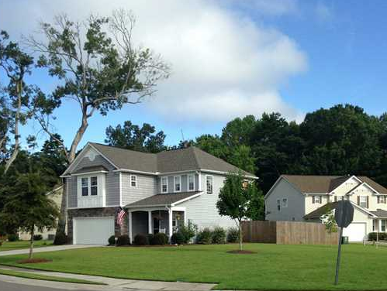
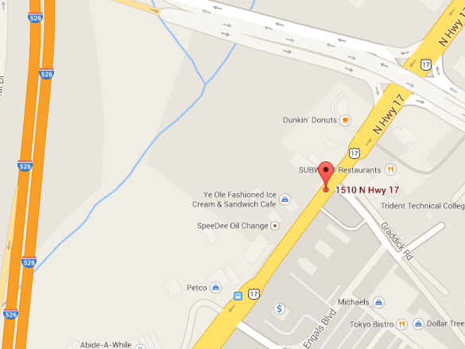
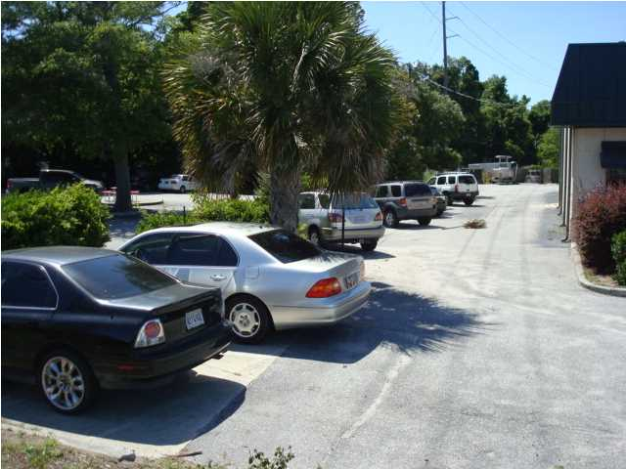
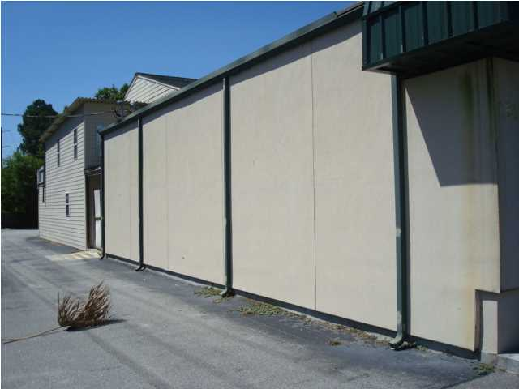
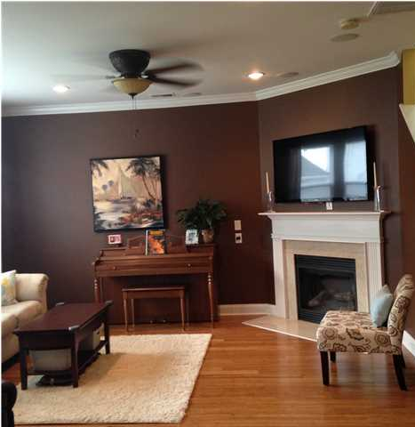
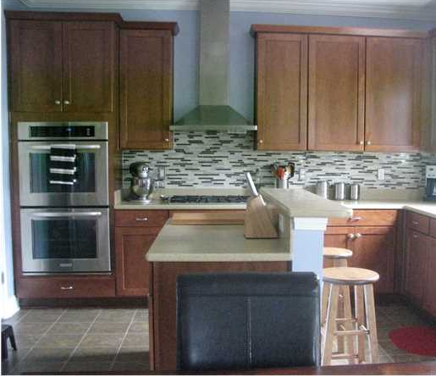
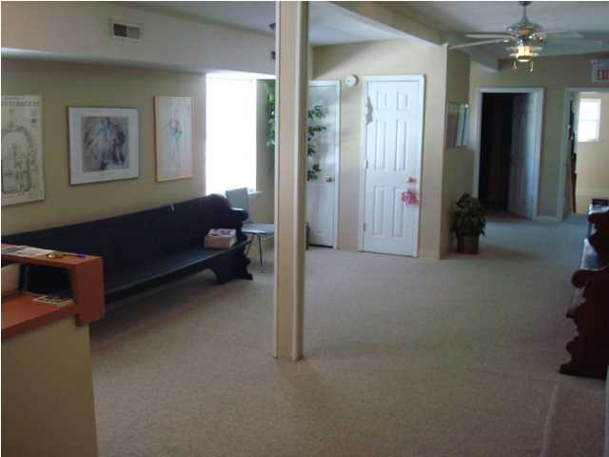
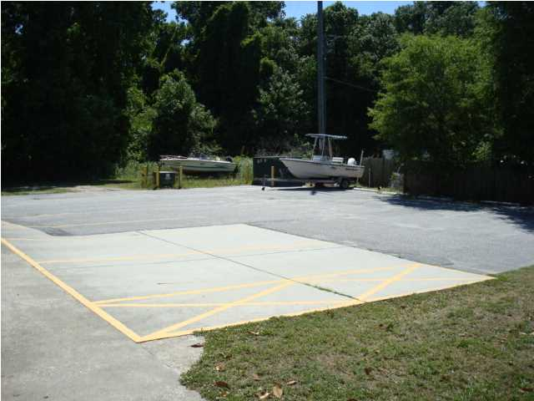
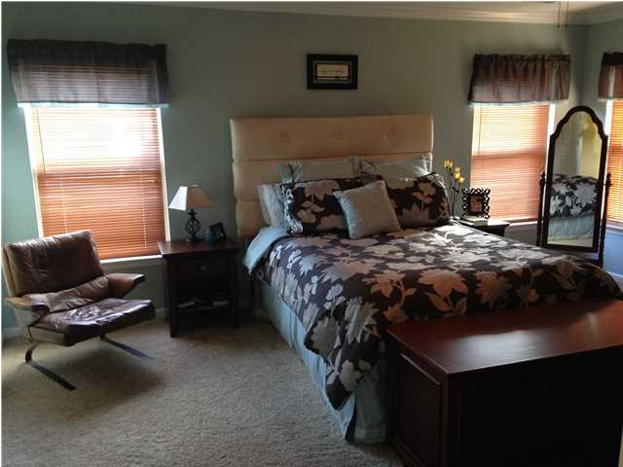
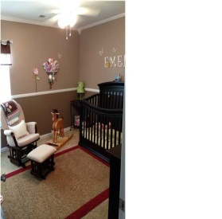
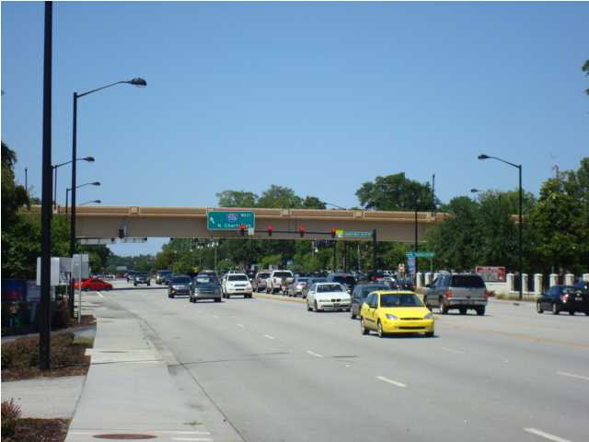
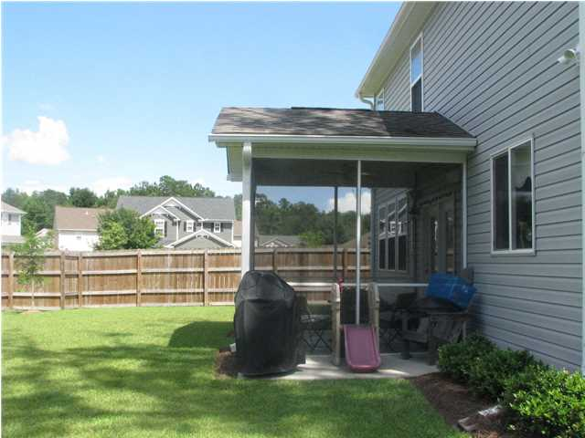
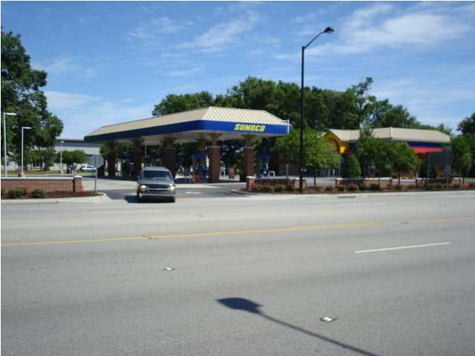
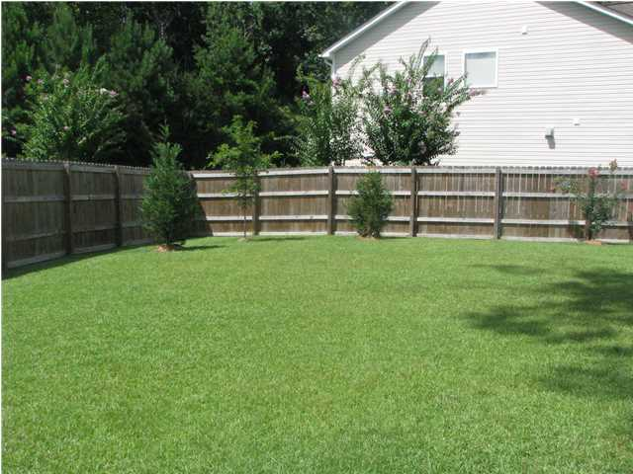
1110 Homework Ave
Eagle Run
Ladson
MLS# 1421094
$202,500
Open House This Saturday 11a-1p
Immaculate move in ready home in desirable Dorchester II school district located on a large corner lot between two cul-de-sacs. Pride of ownership shows throughout this well maintained and tastefully decorated home. Family Room is open to the Dining Area and Kitchen, great for entertaining. Family Room has bamboo wood floors, Gas Fireplace with Electric Blower and Surround Sound with Flush Mount Ceiling Speakers. Kitchen is a dream with Solid Surface Counters, glass tile back splash, 42" Maple Cabinets, Center Work Island and Upgraded Stainless Kitchen Aid Double Ovens, Dishwasher, Professional Canopy Exhaust Hood over 4 Burner Gas Cook Top and Refrigerator with French Doors and Freezer on the Bottom. The matching Kitchen Aid Microwave is installed in the Pantry to free up counter space. King Sized Master Suite features Flush Mount Ceiling Speakers connected to the sound system, crown molding, Dual vanity sinks, Extra Wide Walk-In Shower with Upgraded Surround, 2 Bench Seats and Glass Enclosure, Linen Closet and Large Walk-In Closet complete with Closet Organizer System including 2 Cabinets with Shelving Above. Bedrooms #2 & #3 have wide closets with Double Racks and Bedroom #2 has charming Window Seat and wired into surround sound with flush mount speakers. Hall Bath has extensive counter space over a large vanity. Laundry Room with Wall Mounted Cabinets is located on the 2nd floor for convenience. Front and back yard have been nicely landscaped. Front porch has room for rockers and the Rear Screened Porch & Patio is the perfect place to relax or enjoy weekend barbecues in the fully fenced backyard. Porch speakers are tied into surround sound system. Garage has automatic door opener, side service door, utility sink and epoxy coated floor. Other upgrades include Crown Molding on first floor, Recessed Can Lights in Family Room & Kitchen, Brushed Nickel Lighting throughout, Choice Surround Sound with Premier Multi-Room Distributed Audio wired to 4 zones with a total of 10 speakers scattered throughout, Select Home Network Package, Security System, Flat Panel TV Pre-wire over Fireplace, Exterior #220V 50 Amp Outlet on the exterior (if you want to add a hot tub!), Fully Insulated Garage Walls. This house is a must see. Transferable termite bond in place please check with Clark's Pest Control for accurate transfer fee costs and procedure.
Michelle Riser & Bob Glover
843-860-1229 (Michelle) | 843-693-1837 (Bob)
mriser@ccim.net | bobglover08@gmail.com
Matthew Ryan Company, 104 Berkeley Square, PMB 59, Goose Creek, 29445

